Slide 1

Environmental Justice Neighborhoods
A Green Vision For Cities

Slide 2

OUTLINE
Urban Greening
Local Food
Residential Building Efficiency
Healthy Homes
Green Infrastructure
Public Transit
Clean Energy
Green Jobs
Monitoring
Civic Engagement

Slide 3
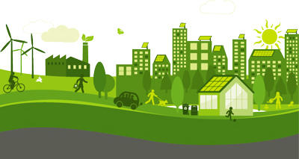
Our purpose
Some believe green lifestyles are for the wealthy; we believe all people have the right and ability to live in an environmentally-conscious neighborhoods. Our research shows there are many ways to transform impacted neighborhoods into greener communities.

Slide 4
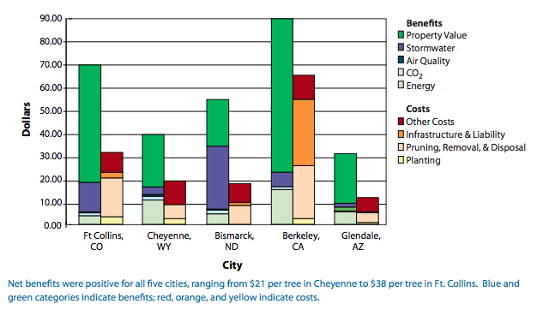
Urban Greening
Urban greening is the process to
improve the urban environment
and quality of life by making cities
greener, cleaner, and more efficient
Ex. parks, green spaces, street trees,
urban gardens, etc.
Benefits:
  Human health: space for exercise, contact with nature, child development, mental health, aesthetic/beautification
  Economy: Increase property value, energy savings
  Environment: mitigate urban heat island effect, carbon sink, stormwater runoff, habitat for wildlife,
Notes:
Julia Nassar
Figure: y-axis = $/tree
Energy savings: (shade & cooling reduce demand for AC)
Urban greenery reduces flooding. A mature tree can store up to 100 gallons of water and a green roof prevents rainwater runoff during a heavy downpour.

Slide 5
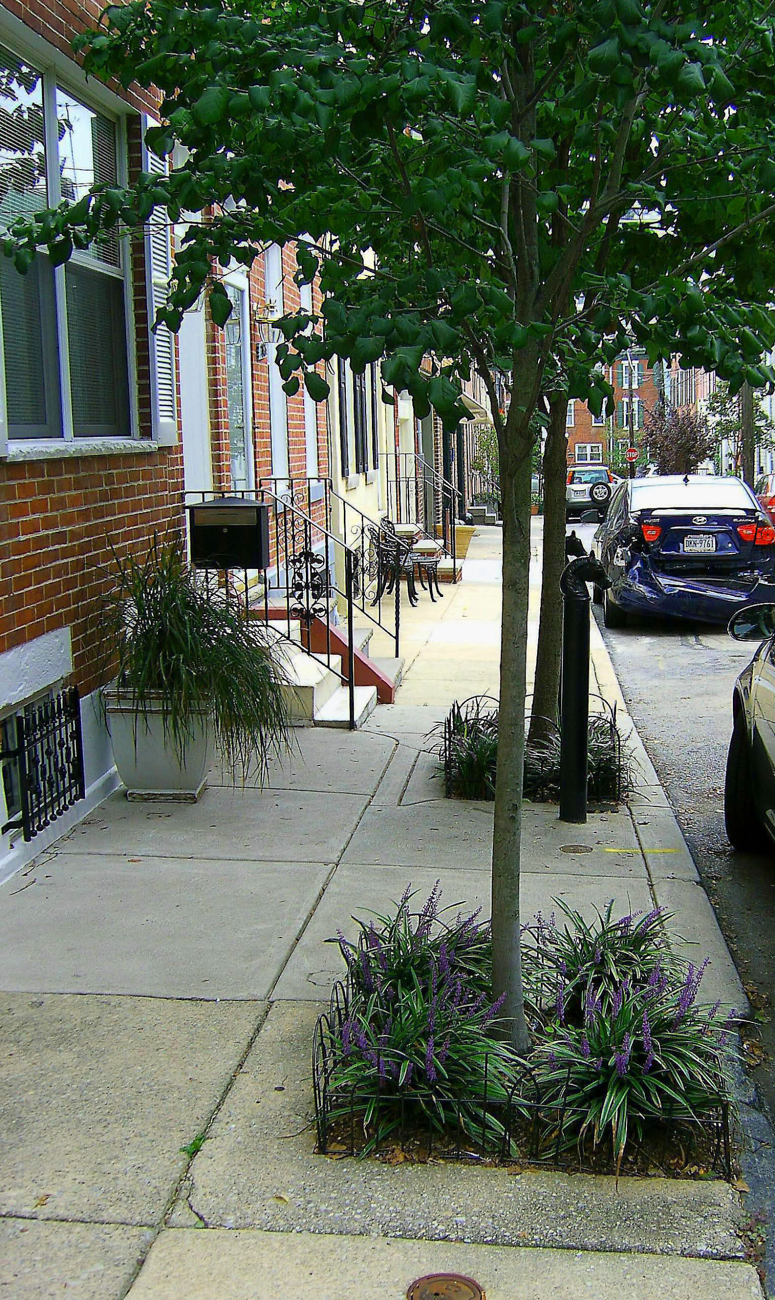

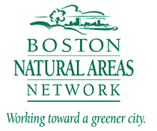

Urban Greening
Street trees
Benefits of trees dependent on proximity
  Equitable distribution of street trees to spatially expand benefits to all communities
Tree Maintenance: prevent high tree mortality
  Sufficient planning prior to planting (e.g. NYC million tree)
  Multiple tree wardens
  Community partnerships (ex. Speak for the Trees, Boston Natural Areas Network)
  Adopt-a-Tree Program
  Certification initiative for arbor technicians (TCIA)
  Improve city tree ordinances
    SftT Sample Proposals
Notes:
Julia Nassar
Improve city tree ordinances
SftT: analyzes/maps amount/quality of tree canopy cover, share up to date info on trees, collecting inventory of Boston city trees
Ask community what kind of trees they want to see: plant a ___ tree.

Slide 6
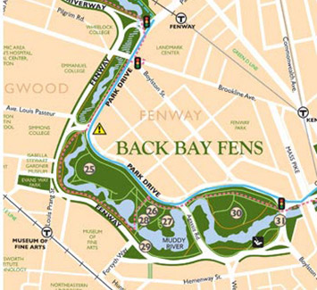
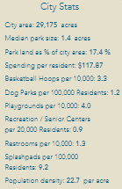
Urban Greening
Urban parks
Create new/improve existing green spaces
  Ex. turning deserted lots into parks
Improve groundskeeping of existing parks
  Street lights, infrastructure for greater access (e.g. sidewalks), urban gardening
  Source of jobs- local youth
Community engagement
  Community engagement- safety, naming
  Adding benches (naming program),
  Facilities and amenities,
  Park programs (sports, cultural, educational)
Focus on equitable distribution in space and of amenities
Notes:
Julia Nassar
***if time, also information on parks in a degraded state; stress the source of jobs - there should be community engagement on where parks need improvement, greater public safety (where people are afraid to go to parks

Slide 7
Urban Greening
Tree retention
Tree retention delivers numerous benefits including reduced energy consumption, watershed management, and aesthetic advantages. These factors can increase the value of the surrounding real estate, ergo, raising property taxes
  Ex: Homes adjacent to naturalistic parks and open spaces are valued at 8-20% higher than comparable properties (​Wolf, 2010​).
Low-income neighborhoods are not receiving the same benefits from replanting and retention policies, often due to a lack of representation within community governing bodies or lack of financing
City municipalities should work closely with CSOs to meet replanting and retention goals
  Ex: The Boston Tree Party campaign incorporated urban agriculture projects and nutrition education in Northeastern EJ neighborhoods with the support of local municipalities.
Notes:
Sam Morton
Sources
Wolf, K.L. 2010. Community Economics - A Literature Review. In: Green Cities: Good Health (www.greenhealth.washington.edu). College of the Environment, University of Washington.
http://www.bostontreeparty.org/about/party/

Slide 8

Urban Greening
Tree retention
The Greening of the Gateway Cities program is a Boston city initiative to increase tree canopy in targeted EJ neighborhoods
  Aims to help Boston meet its commitment to reducing its CO2 emission levels by 80 percent by 2050
  Has planted over 11,000 trees in 12 Massachusetts gateway cities
Policy implementation recommendations:
  Define requirements for minimizing forest cover removed in connection with development
  Require submission of a forest delineation plan with the submission of any land development plan
  Ensure low-income families are protected from gentrification (price ceilings and affordable housing options)
Notes:
Sam Morton
Sources
https://www.mass.gov/service-details/greening-the-gateway-cities-program

Slide 9
Eco-Gentrification
Prevention
Eco-gentrification: improvements in green infrastructure and desire to live near green belt inflates property value
  Ex. Greenpoint, NY
Environmental progress can be paired with socially sustainable solutions:
  Urban greening paralleled with affordable housing policies
    Rent control & stabilization, increase rental assistance
  Community land trusts: keep property value at affordable level
    Ex. Crescent City Community Land Trust
  Cooperatives Housing: managing the market; let the locals collectively manage home and set price,
Notes:
Julia Nassar
*look at email*

Slide 10
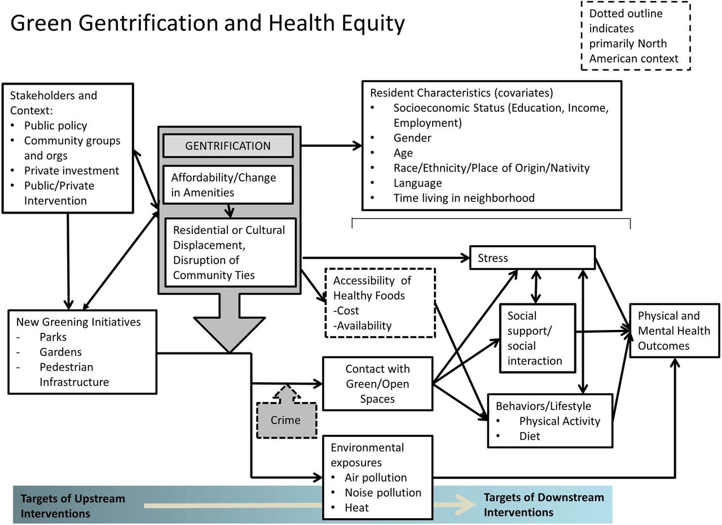

Slide 11
Local Food
Urban gardening and food access
Low income areas have half as many grocery stores as high income areas and less access to fresh produce leading to food deserts (Treuhaft and Karpyn, 2010)
This problem can lead to unhealthy diets resulting in obesity, heart disease, and sets the stage for unhealthy diets in the future
This is a problem in low income areas because many people may not have health care or cannot afford to receive medical help
  The implementation of urban gardens and the creation of programs that increase assistance for purchasing fresh produce can help these issues by working to alleviate food deserts
Katie C
Notes:
Assistance for purchasing fresh food

Slide 12

Local Food
Urban gardening
Urban gardens/community gardens will in turn benefit low income areas by...
  reducing waste from packaging of food
  reducing CO2, bringing neighbors together
  Creation of green jobs
  promoting healthier lifestyles
  Reducing the demand for food that comes from “big farms”
KNOX is a program in Hartford, CT that converts empty lots into gardens in the city. City Growers in Boston does the same and the produce is used in local schools and hospitals. In Boston. Veggie Rx (which began in Dorchester) in Washington and Oregon prescribe produce to low income folks. Wholesome Wave in connecticut doubles food stamps and prescribes produce to people in need of fresh food
There are approximately 60 community gardens serving the city of Boston
Katie C

Slide 13
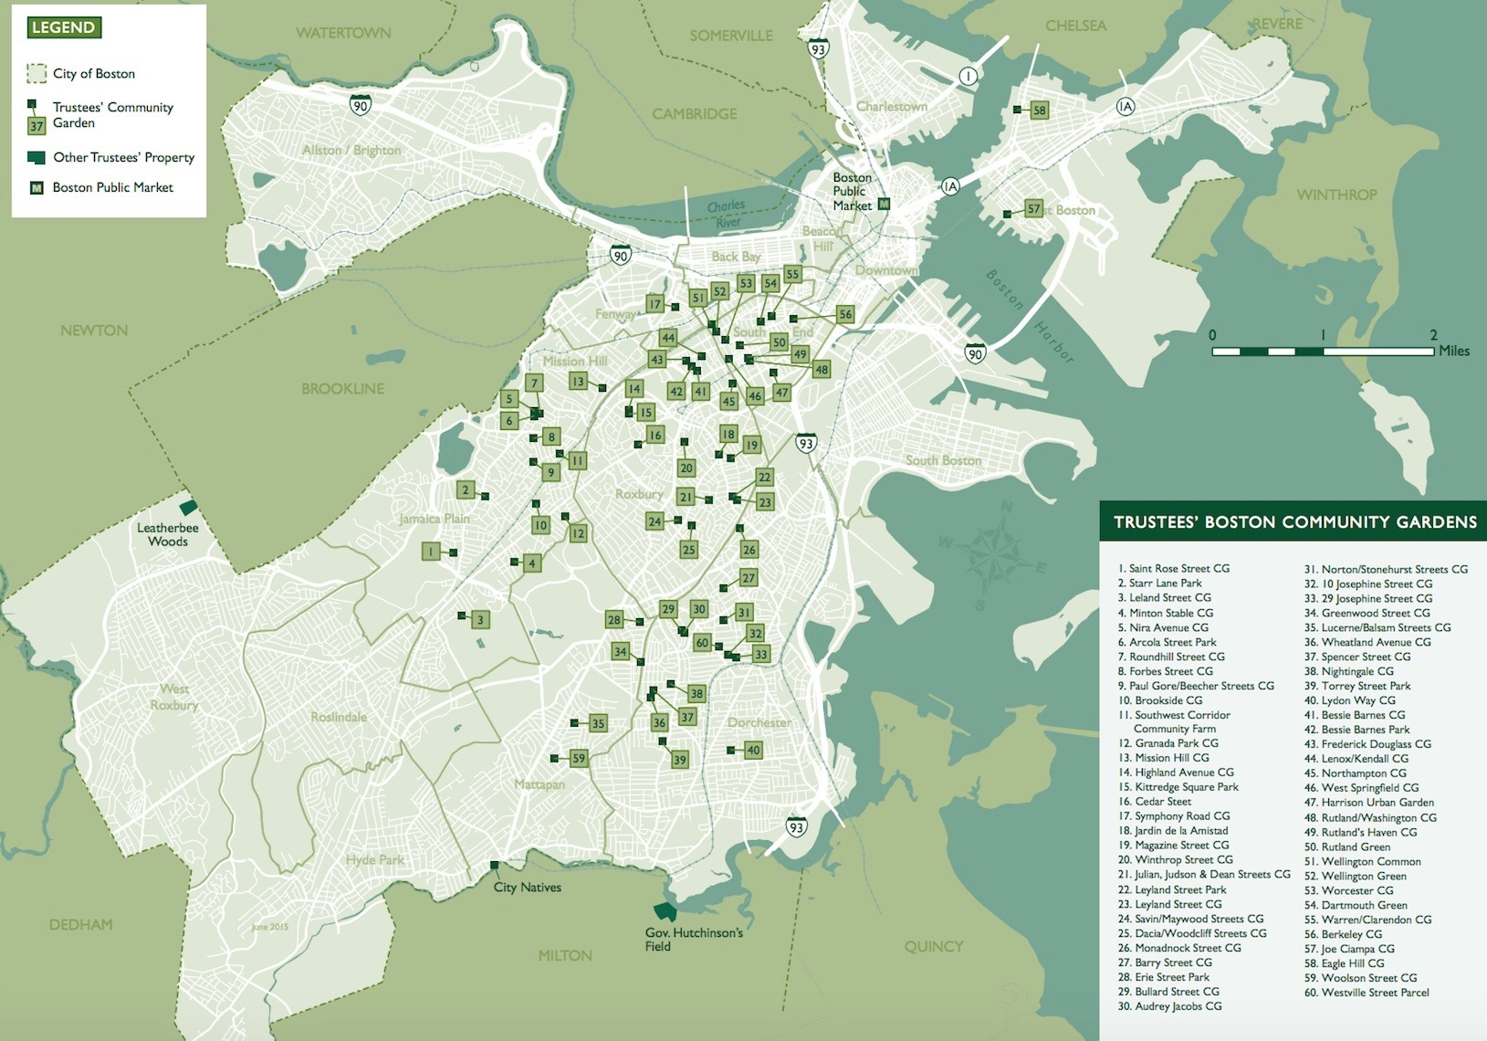
“Gardens Property Guide”
Notes:
Hope center did a study that found that 36% of college students did not have access to proper food

Slide 14
Local Food
Farmers markets
The food from urban gardens not only benefits low-income communities but gardeners can sell this produce in farmers markets for profit by applying to become a vendor (“How to take part in a farmers market”)
Many people believe that farmers markets/local produce stands are more expensive and end up buying produce at the grocery store
  However, on average produce is priced the same at supermarkets and farmers markets (Pritchard, 2017).
Katie C

Slide 15
Local Food
Farmers Markets
The creation of more farmers markets, the expansion of food stamps into farmers markets, and subsidies for vendor fees would help alleviate food disparity in low income communities and benefit low income families
In MA the Amherst, Orleans, Easton, Roslindale, Quincy, and Springfield markets accept food stamps
Boston offers successful examples:
  Boston Public Markets downtown on weekends
  Copley Square farmers market.
Katie C
Notes:
Davis California perm. Farmers market. Reduces cost of set up (food for all)

Slide 16

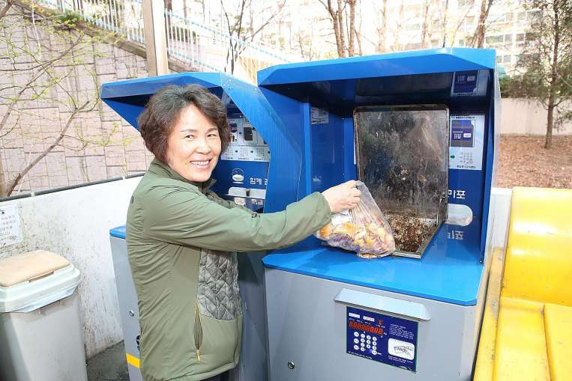
Local Food
Composting
Composting in any urban environment is often doubted for reasons such as its general effectiveness and fears of poor pest management, allowing for this necessary waste disposal method to be underappreciated and underutilized on a mass scale. In the US, over 90% of wasted food ends up in landfills, producing futile methane gas.
Incorporating composting into urban living
  Cooperatives
    CERO utilizes investment crowdfunding
    Allay concerns of pests
Recommendations
  Example of success in South Korea
    RFID systems
Notes:
Lydia
https://www.straitstimes.com/asia/east-asia/south-korea-cuts-food-waste-with-pay-as-you-trash
Radio frequency identification devices

Slide 17
Residential Building Efficiency
Green roofs
Most low income areas lack green rooftops, which efficiently utilizes the limited space of urban environments, however, there are many benefits to having them
Similarly to the benefits of urban gardening and increasing tree canopy the benefits include better air quality, access to fresh produce, CO2 storage, offsets the heat island effect, can create jobs, and promote healthier lifestyles (Johnston S. et al).
Chicago made it a goal to implement 6,000+ rooftops after several people had died during a heat wave (currently have about 500 rooftop gardens)
Recover Green Roofs is a company in Boston that provides green rooftops to homes, however, it is aimed at wealthier clientele. There needs to be a push to implement green roofs into lower income areas.
We suggest incentivising landlords to allow roof access for rooftop gardens or providing subsidies to companies that provide free green roofs to low income homes. Greening of rooftops requires roof repairs which would benefit the renters/homeowner as well.
Katie C
Notes:
Repair to roofs and flat roofs. Maintenance. Landlord?

Slide 18
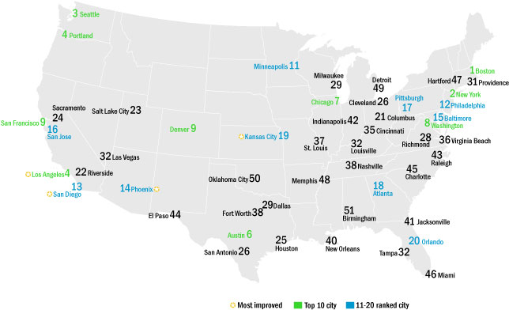
Residential Building Efficiency
Boston Leadership
Boston Success
  Most energy-efficient U.S. city according to the City
Energy Efficiency Scorecard by the American Council
for an Energy-Efficient Economy (ACEEE)
    Received 84.5 out of a possible 100 points
Why is Boston an efficiency leader?
  Helps homeowners understand incentives and steps in bureaucratic process, such as ABCD
    Ex: assistance with filling out required forms
  Ensures small repairs are done before insulation retrofits occur
  Provides 100% full funding to low income (0-60% income bracket) families
Notes:
Katie W
The American Council for an Energy Efficiency Economy, Boston is the leader in energy efficiency - scoring above other major U.S. cities like New York, Seattle and San Francisco. We’ve found that Boston, and Massachusetts, has a variety of programs and departments that provide incentives for low income residents to make energy efficiency retrofits to their homes. This includes marketing the 100% funding coverage for eligible low income residents or homeowners, loans for multifamily residential buildings, and providing separate funding for small repairs that can be done and are necessary prior to weatherization retrofits.
Sources
https://www.buildings.com/article-details/articleid/21149/title/boston-tops-energy-efficiency-scorecard
https://www.boston.gov/departments/environment/history-renew-boston
https://aceee.org/local-policy/city-scorecard

Slide 19


Residential Building Efficiency
Boston Leadership
Boston’s Future
  Provide incentives to developers who build so-called “net-zero” projects, largely through the zoning code
The 2019–2021 Three-Year plan
  An additional investment of $200 million in energy efficiency
  Propose more efforts that target renters, moderate income customers, and non-English speakers
  A holistic approach to customer-focused energy efficiency
    Utilizing energy more efficiently through the adoption of air source heat pumps, batteries, etc.
Notes:
Katie W
The 2019 to 2021 three year plan, organized by the energy efficiency advisory council, is currently being reviewed and hopefully on its way towards diversifying and expanding funding for energy efficiency related programs. The programs, at all stages, have already been found to be successful. From marketing to both tenants and homeowners and multifamily landlords, a large portion of homes in the state have been retrofitted with necessary energy saving insulation and other weatherization tools. The new plan is hopefully going to expand upon what they’ve accomplished with more funding to target groups that haven’t been able to get the
Sources
Pdf. 2019-2021 three year plan
PAs incorporate new strategies that help customers switch to renewable energy and clean energy technologies.
https://www.buildings.com/article-details/articleid/21149/title/boston-tops-energy-efficiency-scorecard
https://www.boston.gov/departments/environment/history-renew-boston

Slide 20
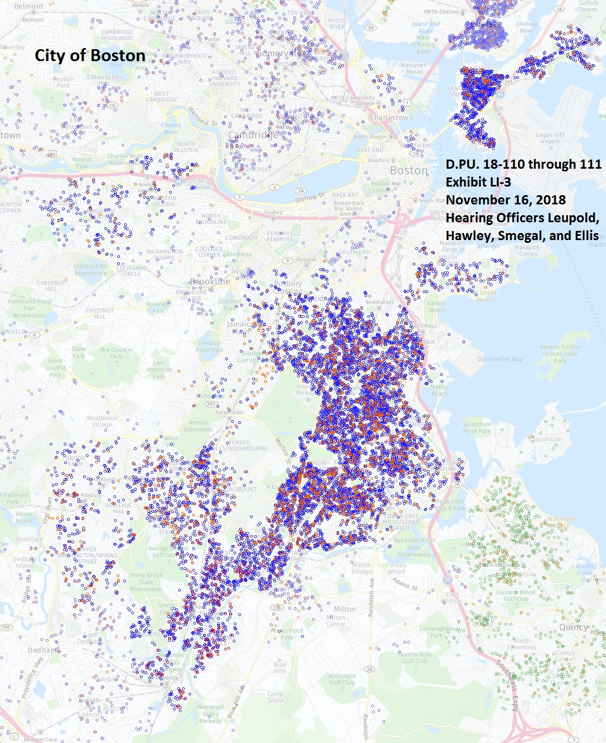
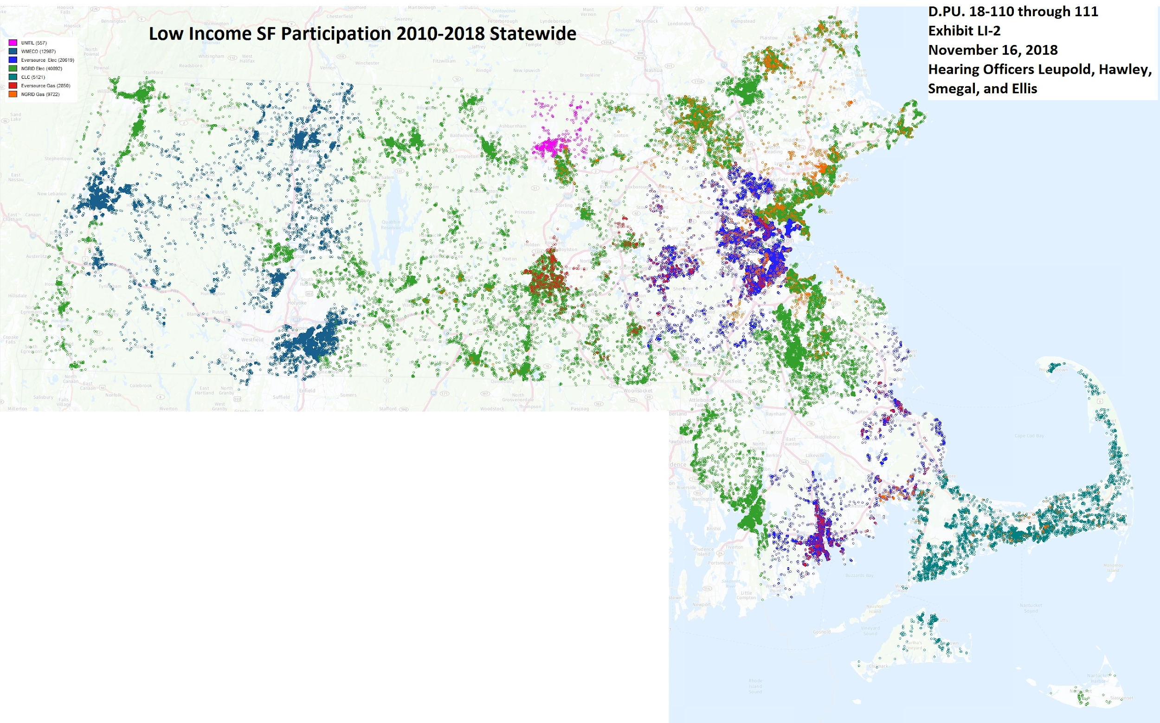
Notes:
These maps are referenced from the submission LEAN, or the Network made to the three year plan. These maps, shows the low-income household participation in LEAN and other weatherization/fuel assistance programs both in Boston and all over Massachusetts. The varying colors represent the utilities who worked with the residents. The point of these maps show how successful Massachusetts is already, but there there is more work to be done; throughout the semester we compiled a list of recommendations for Boston’s programs that can increase the amount of penetration to be even higher.

Slide 21
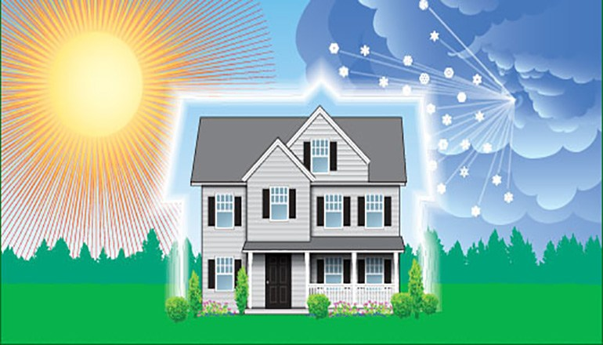
Residential Building Efficiency
Recommendations for Further Success
Expand 100% funding to moderate income brackets
  Currently barrier: 60-80% income residents typically can’t make upfront payments
  Enables residents with fluctuating incomes to take part
Diversify funding allocation
  Fix current barrier for deferred homes: pay for larger fixes
  Post Retrofit: ongoing monitoring in residences
  Introduce energy efficient appliances to properly insulated homes
Address and monitor indoor toxic chemicals
  Use and install safe insulation (toxic spray foam)
  Check for proper air ventilation around the home post insulation
Notes:
Katie W
The first recommendation, which is supported by various departments and organizations that we’ve spoken with, is to expand 100% full funding for energy efficiency programs to moderate income residents. Individuals in this income are currently in limbo in terms of using these programs - depending on the time of year, there is the potential for some of these residents to be outside of the designated eligibility based on the number of people in their homes, a resident getting a new job, or some other circumstance. With this in mind, eligibility does not coincide with the ability to make upfront payments for necessary but not required insulation retrofits to a home, so they are unable to take part in the program. We recommend that all residents up to the 80% income bracket level are eligible for 100% full weatherization and other energy efficiency funding programs in order to maximize the number of people helped by these programs.
The second recommendation, which coincides with the increased funding, is to diversify the allocation of money per residence to more than smaller fixes pre-weatherization and the weatherization itself. For homes that may be deferred due to required larger fixes for insulation to be effective, this currently would be out of the homeowners or landlords pocket - which delays weatherization by months or years. Having funding for these homes with larger leaks or mold can effectively help an entire grouping of people who otherwise would be deferred. After any weatherization is completed, we also recommend the option of further monitoring in the homes in order to ensure that there aren’t any leaks or other issues that increase the heating bill and also waste energy unnecessarily. We will touch upon monitoring more later in this presentation. On top of weatherization and proper insulation, introducing other energy efficient appliances is a good way to decrease the energy costs and amount of energy being used in a residence that has potentially used the program in the past.
Indoor toxic chemicals are a potential hazard when installing insulation and can reach high indoor levels if a home is not properly ventilated. In order to ensure that installers and residents do not experience negative side effects when using these services, it is essential to consider what materials are being used to insulate, and to make sure installation is being done with proper safety precautions. Even after the home is insulated, doing tests to check for proper whole - house ventilation should be a requirement for the safety of the residents.
These recommendations are directed both at Boston, Massachusetts and other states around the country.
60-80 = these income brakcet residents don’t have the upfront money, which is a barrier
Large costly repairs are a barrier - which is a barrier due to deferrals
As you make it tighter, air ventilation need to be monitored
https://www.kttn.com/weatherization-service-for-homes-available-through-community-action-partnership/

Slide 22
Residential Building Efficiency
Recommendations for Further Success
Increased outreach to landlords
  Focus on small, 6-8 multi-family residences and landlord associations
  Inform landlords of full funding (for eligible residents) or loans (multi-family)
Pin programs to residences as well as residents
Integrate Passiv housing training and development into new construction
Enhance capacity of multilingual communications
  Program resources, customer service representatives, home auditors, etc.
Establish relationships between separate branches of energy efficiency programs and public health agents
  Bridge the gap between energy efficiency and public health impacts of poor insulation, ie. asthma
  Become versed in all housing related programs available - provide references to customers
Notes:
Katie W
Inform landlords of full funding (single home with eligible residents) or loans (multifamily)

Slide 23
Healthy Homes
Asbestos and Indoor Air Quality Monitoring
Asbestos
  Identification, encapsulation (with disclosure-- so people know it’s there), (if encap doesn’t make sense) removal where necessary, assurance that work is done by licensed professionals
Ventilation and indoor air quality monitoring
  Improve ducts and other system maintenance
  Conscious in-facility storage of chemicals-- off-gassing materials
    VOCs, flame retardants/stain resistant materials
  Building manager should be responsible for ensuring these are monitored appropriately
Mold
  Take responses that addresses root cause: water intrusion, leaks, & condensation
Pesticides
  Use of Integrated Pest Management (IPM) professionals in replacement of chemical solutions
Notes:
Katie W

Slide 24
Neighborhood Maintenance
Climate adaptation - Green Infrastructure
Urban green Infrastructure
  Otherwise need to talk about coastal flooding and mitigation
Examples of Urban Green Infrastructure:
  Green roofs
    albedo - heat island effect
  Rain gardens
  Permeable pavements, bioswales

Slide 25
Neighborhood Maintenance
Climate adaptation - Green Infrastructure
Flooding- (SeaPort District)
Vertical flow constructed wetlands
    Used to treat water for suspended solids
    Urban context -> mitigate flood risk, water is retained in wetlands, in cohorts with wetland restoration efforts
    Recommended “best management practice” for controlling urban runoff

Slide 26
Neighborhood Maintenance
Sidewalks
Obvious disparities in sidewalk quality in high-income areas vs. low-income areas (Irons, 2018).
Broken sidewalks discourage walking and are inaccessible to people with disabilities
Better transportation = more class mobility (Kanter, 2015)
Broken sidewalk repair requests: Boston govebsite, Boston 311 website and app, Commonwealth Connect App
Greater public awareness to repair request options
Ex. Safe Sidewalks LA
Notes:
Don’t worry that the picture covers text (no need to move it!), it is animated and will only come in after we click the screen***
(Irons, 2018)
(Jacobs. 1961)
https://mayors24.cityofboston.gov/ → (hit “submit report” → “broken sidewalk”)

Slide 27
Expanded Transit
More bike lanes and extended train lines
Lower income areas will often be on the outskirts of cities, and are moving more into the suburbs, due to the cheaper cost of living. This makes commuting via public transit a necessity, however, these areas often have inadequate transit
We suggest creation of more bike lanes, bike sharing programs, clean busses, and the expansion of train lines into these neighborhoods to benefit low-income areas by providing transit to work and school ultimately helping escape poverty,making neighborhoods more energy efficient, help folks save money, and provides health benefits (Kanter, 2015).
Often people think that an expansion of transit will lead to gentrification but it is more of a by-product
Katie C

Slide 28
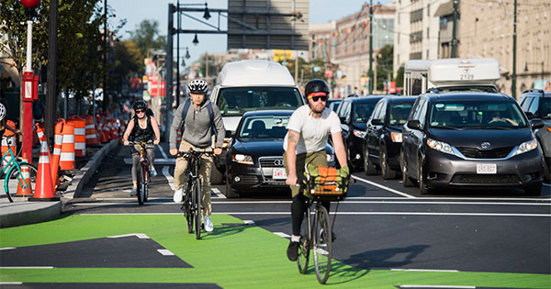
Expanded Transit
More bike lanes and extended train lines
In Memphis, TN they have worked on adding bike lanes to the city in order to help the poor escape poverty (Anderson, 2013).
Boston has proposed a plan to extend the blue line to Lynn and there has been a city wide effort to increase the amount of bike lanes. Bike sharing options like Blue Bikes, which have hourly, daily and annual rates have also become a viable option for all commuters. There recently has been a silver line expansion, too.
  Example: Commonwealth Ave. separated bike lanes
Katie C
Notes:
http://www.bu.edu/today/2017/protected-bike-lanes-commonwealth-ave/ silver line expansion
People worry that bike lanes will cause gentrification rather than a by-product. They should be encouraged and be prioritized in EJ communities

Slide 29
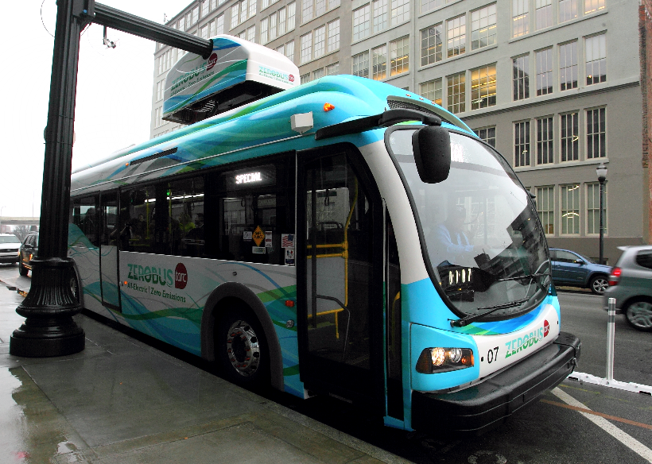
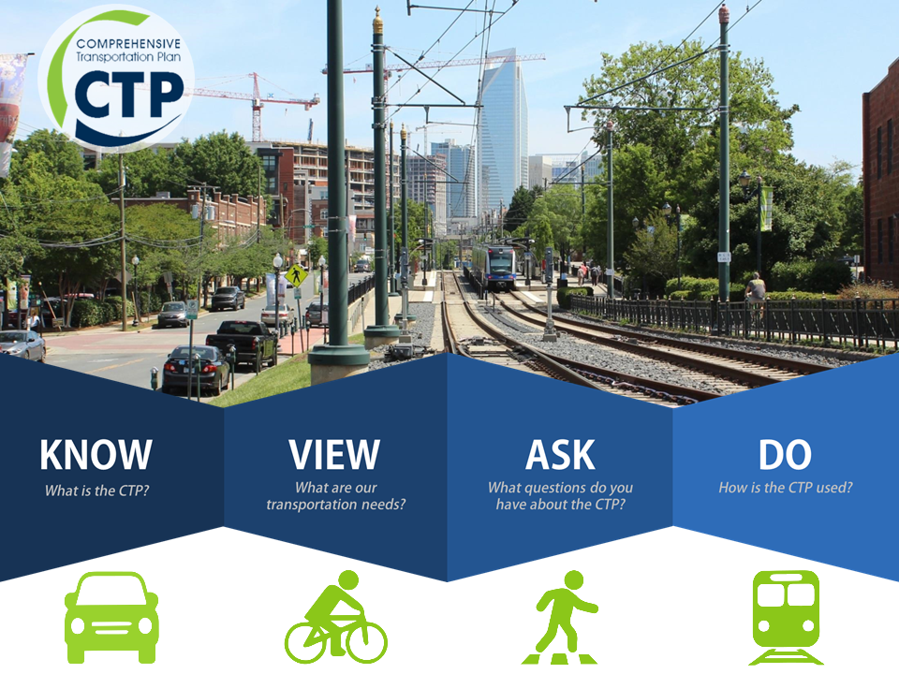
Clean Transit: Electric Buses
Urban-friendly alternative to diesel engine buses
Minimal wear on the engine
No energy loss during engine idling
Opportunity to be “fueled” by renewable energy, etc. (Kuhne, 2010)
Reduction of tailpipe emissions
Monitored charging increases bus efficiency by ~40% (Mass DOER, 2018)
Public focuses, all encompassing transportation policy
Notes:
Katie W
Electric Buses provide a plethora of advantages for cities. The upfront cost of electric buses are mitigated by the minimal wear on the engine, which extends the overall life of each electric bus. These buses also don’t lose energy when the engine idles, which would typically occur frequently, as buses need to consider stop signs, idling at red lights and making each stop on the designated route. Using electric buses also leads to reduction in total tailpipe emissions, which put a dent into the total emissions reductions of chemicals like CO2 and NOx throughout the city. The emissions from electric vehicles can be further reduced if renewable energy, such as wind or solar, is used to power these buses. This can be a government incentive to push for even more renewable energy available for electric bus refuelling stations and also for other EV private vehicle refuelling stations. When buses are effectively monitored whilst being charged, ensuring that the buses aren’t being excessively charged can increase the total efficiency of each bus up to 40% even more than initially intended. While all of these benefits are useful to the entire city, the public should be involved in all steps of this transition and environmental justice communities should be represented when considering which routes electric vehicles should take.
Need to add “the problem”, talking about the 2050 emissions
https://www.mass.gov/files/documents/2018/04/30/Mass%20DOER%20EV%20school%20bus%20pilot%20final%20report_.pdf
Less tailpipe emissions means less particulates, CO2, NOx, SOx, VOCs
- number of buses that already have converted
- how it helps with air quality
- lessening maintenance
- all encompassing transportation policy
> alternative transport planning, planning for the needs of the public
- air quality benefits, practical considerations
Greenroots, “MTBA should prioritize electric Transit in Chelsea and other EJ Communities”
Source: https://insideclimatenews.org/news/18102017/these-city-bus-routes-are-going-all-electric
Adding how they’re aa sensible purchase, how they’re inexpensive etc.

Slide 30

Clean Transit: Electric Buses
What other cities are doing & what Boston can do!
Chicago Transit Authority, Chicago IL
  2012 plan to add 300 new electric buses + overhaul >1,000 current buses out of the 1,800 fleet
    $25,000 annual savings in fuel costs for each bus
    $55,000 annual projected savings in reduction of auto emissions
Metropolitan Transportation Authority, San Francisco CA
  Plan to eliminate emissions from bus fleet by 2030
Massachusetts Bay Transit Authority, Boston MA
  Climate Action Plan: aims to cut greenhouse gas emissions by 80% by 2050
  >300 buses are reaching the end of their life (12 yrs) MBTA and DOT are looking into routes best suited for electric buses; imperatives to prioritize EJ stops (Dharmaraj, V. and Power MB, 2018)
Notes:
The Chicago Transit Authority provide an excellent example for the overlap between monetary, environmental and public health benefits that electric buses in urban transit can provide. Chicago began developing their transition to electric buses in 2012 using the method of both adding new electric buses to their current fleet and retrofitting over a thousand of their current buses to make them more fuel efficient and emit less particles and other forms of air pollution. These retrofits were designed to lead to thousands of dollars in savings for the city directly by cutting fuel costs for each bus. There are also a variety of ….
San Francisco recently decided to make the progressive goal to totally eliminate emissions producing buses from their fleet of multiple thousand buses by 2030.

Slide 31
Potential for Increased Clean Energy Development
Brownfield Development: Community Solar
Community solar offers opportunities for EJ communities to turn over local brownfield sites while generating clean, cheap electricity. Benefits include:
  Accessible to renters and condominium owners, suitable rooftop is not needed
  Clean jobs, energy security, more reliable grid, less greenhouse gas emissions
  Increase property value surrounding brownfield
Federal and state governments offer many incentives for brownfield development and community solar:
  Mass Solar Loan Program Manual: State provides interest rate buy-downs and loan guarantees, with emphasis put on low-income solar
  The Brownfields Redevelopment Fund: Low-interest loans and grants for site assessment and cleanup in the List of Economically Distressed Areas
  SMART: Awards higher incentives to solar projects serving low-income customers
Notes:
Aseel + Sam

Slide 32
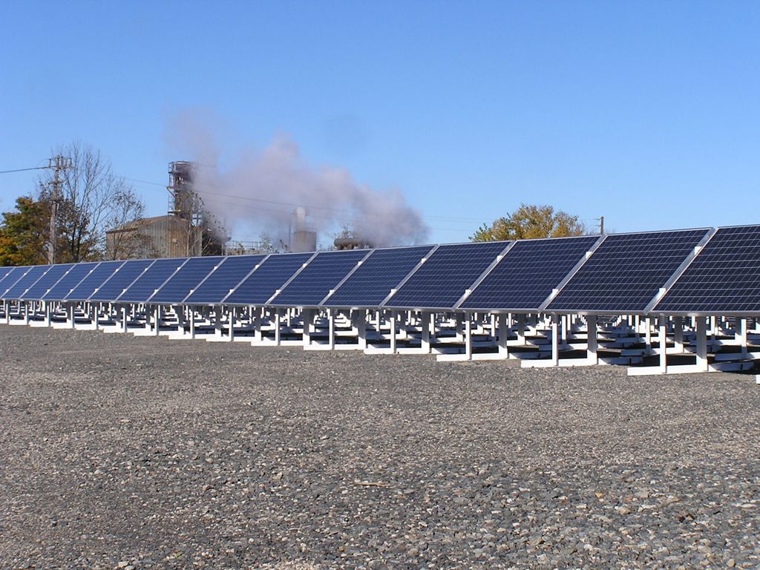
Access To Clean Energy
Brownfield Development: Community Solar
Massachusetts Case Study: Brockton Brightfields (Brockton, MA)
  Officially opened on October 26, 2006, on the site of the former Brockton Gas Work
  Consists of 1,395 photovoltaic panels on a 3.7-acre site
  Has generated nearly $145,000 in annual revenue for the city, which goes towards paying off the cost to build and maintain the brightfield.
    It is estimated that the loan will be paid off in full by 2026
Affirmative efforts are needed to develop more such examples
Notes:
De Sousa, C. and Spiess, T.B. (2009) “Brockton Brightfield, Brockton, Massachusetts: A Sustainable Brownfield Revitalization Best Practice” University of Illinois at Chicago. https://brownfields.org.uic.edu/research-results/documents/BrocktonBrightfield-finalforposting-May102013.pdf
After last bullet point, add the difficulties found over the semester

Slide 33
Bringing in Green Jobs
Economic Development
Incentivize bringing jobs and economic well-being into low-income areas
New Market Tax Credit
  $8 of private investment for every $1 of federal funding
  Has helped finance over 5400 businesses
  New Markets Tax Credit Extension Act of 2017 proposes to extend the program permanently
  Low-income areas work with Community Development Entities to fund development or real estate projects
  Investors receive federal tax reduction
Tax Cuts and Jobs Act of 2017
  Incentivizes investment in for-profit projects
Notes:
Boston advocates

Slide 34
Bringing in Green Jobs
Economic Development
Transformational Development Initiative
  Funding for development in “Gateway Cities” of Massachusetts
  Focuses on community engagement, strategic district focus, and local collaborative partnerships
  TDI Assistance, Cowork, Fellows, Local
Comprehensive and expanding program that should be monitored and repeated

Slide 35
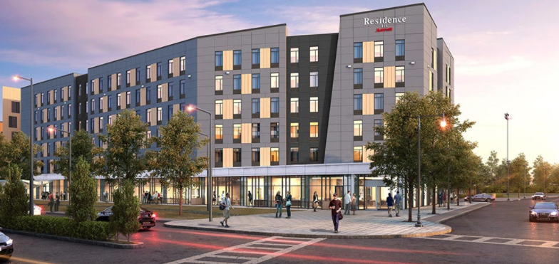
Bringing in Green Jobs
Economic Development
Plan for Melnea Hotel, funded by Affirmative Investments and the NMTC in Dudley Square
Competition is intense and barriers to entry exist
Selection process could include environmental and job allocation concerns
Increase funding and make accessible

Slide 36
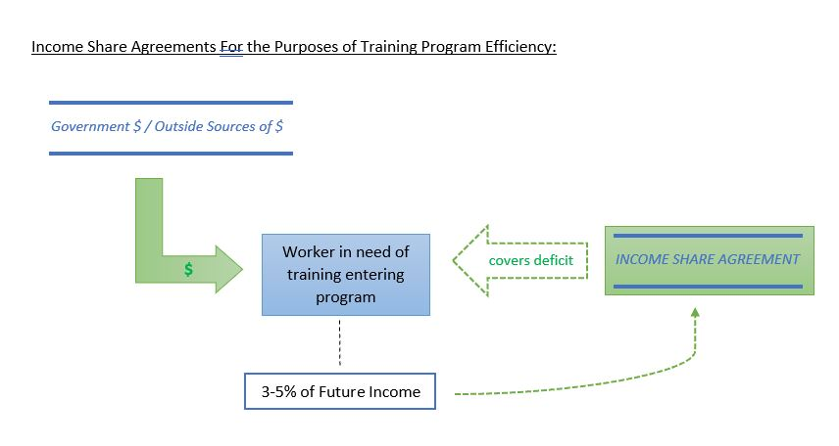
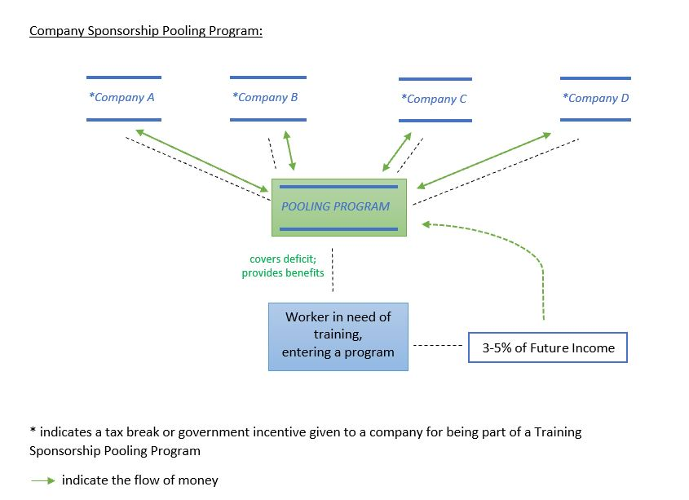
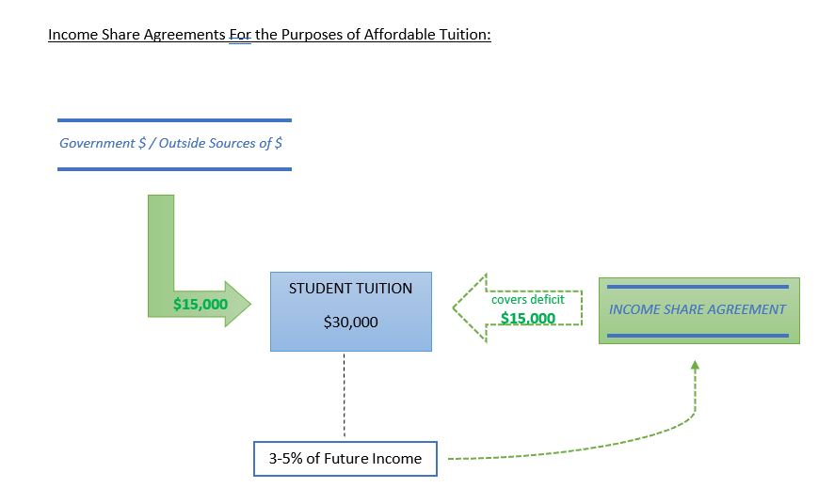
Bringing in Green Jobs
Workforce Development
Implement program that targets low income areas by creating partnership between institutions and private companies
  Goals
    Convening employers to inform the public of job expectations
    University involvement
    Implement Income share agreements (ISA) and Pooling
    Include Non-credit Training Programs
  Benefits: win-win outcome for all

Slide 39
Monitoring
Community monitoring techniques will allow better estimates of pollution sources and threatened areas
  Goals
    Affordable technology
    Expansion on current work
    Outlining procedure
    Community participation
Air, water, soil, and noise monitoring all stand to benefit public health and knowledge of polluting agents
Notes:
Existing monitoring does not tell us enough

Slide 40
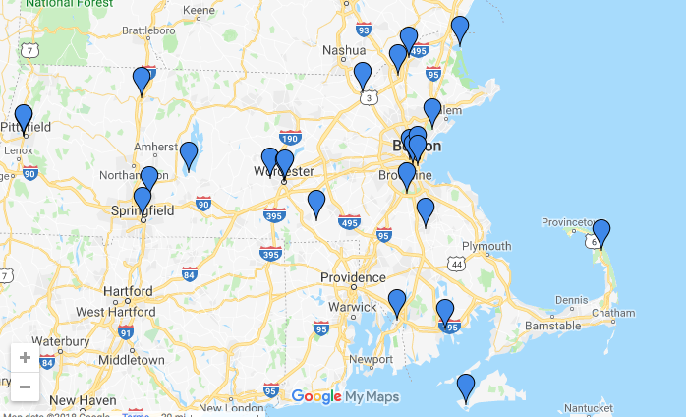
1 Monitor for Lead
MassDEP graphic

Slide 41
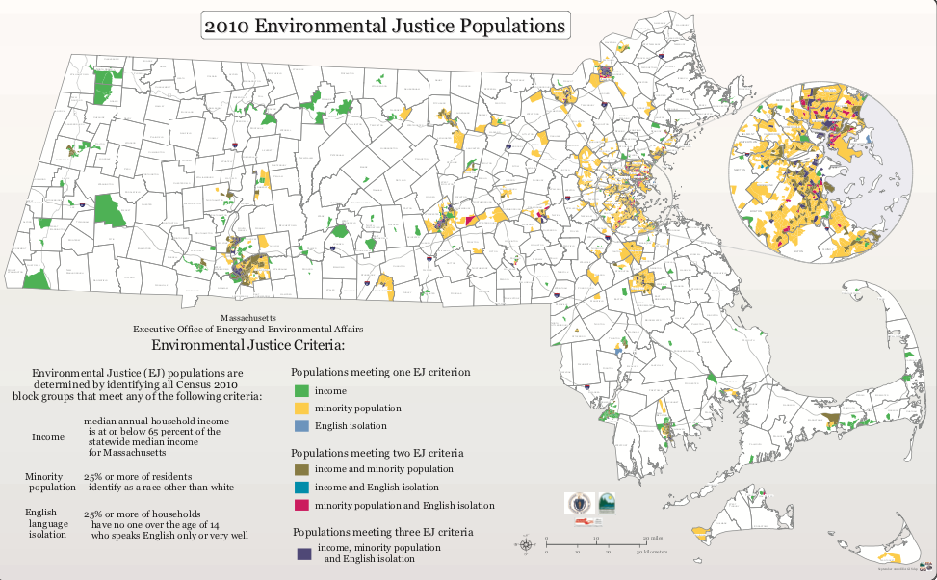
https://www.mass.gov/info-details/environmental-justice-communities-in-massachusetts

Slide 42
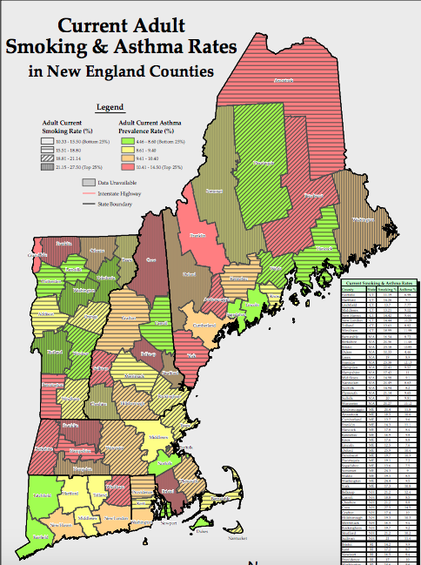
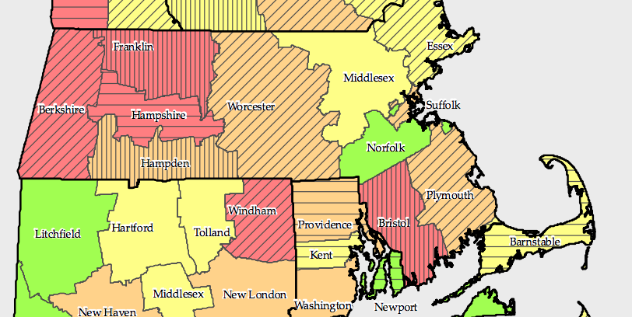
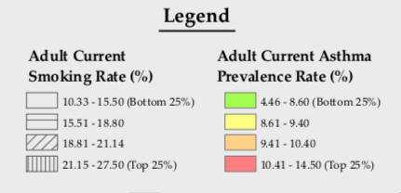
From EPA NEPIS page

Slide 43
Monitoring
People living below the poverty line have 35% higher burden from PM emissions than the rest of the US population (Willis 2018)
  Non-white populations have 28% higher chance of health burdens, especially due to particulate matter pollution (Willis 2018)
Asthma is more prevalent in low income communities (Pacheco et al. 2014)
Monitoring can identify causes
EPA has provided guidelines for monitoring
  Demonstrates expectation of community work
  Consult experts
  Repeat trials
  Follow up with more accurate methods

Slide 44
Monitoring
Water and Soil Monitoring
  Extension programs
  Mass DEP
  Affordable and necessary
Soil
  Plants, such as sunflowers, radishes, poplar and willow trees remove contaminants in the soil
  Lead can affect root crops and hinder urban gardening
  Phytostabilization: Composting can remove lead to an extent (Blaustein 2017)
Noise Monitoring
  Annoyance and Public Health
  Mounting evidence of other health effects including higher incidence of stroke and other cardiovascular effects (Munzel et al 2014)
  NIOSH App

Slide 45
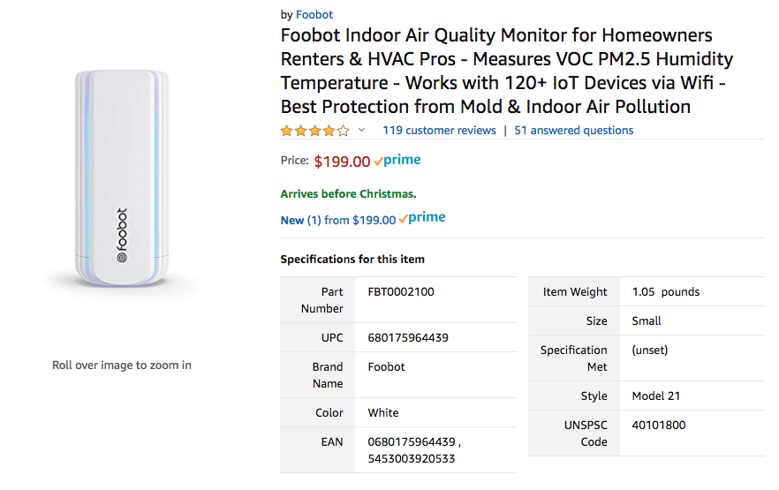



Temtop, Foobot, Data Logging VOC Meter all available on Amazon
CO2, PM 2.5, VOC, Ozone, Carbon Monoxide, Nitrous Oxide
uHooair.com
Notes:
HCHO (Formaldehyde)

Slide 46
History and Future Directions
EPA Community Toxics Monitoring Project
  Ended in 2013
  Gave grants to communities
  Identified sources
Technology will improve and become more affordable and accessible
Process will happen more quickly if demand increases
Notes:
Boston advocate renewal

Slide 47

Civic Engagement: What is it?
Without involvement of community members, harder to gather support to perform projects involving monitoring, urban greening
Community members must be informed about local government, be empowered to ask questions
Goal: Participation of group or individual to address issues of public concern, promote quality of community

Slide 48

Civic Engagement: What can Cities do?
Engage with all races, ethnicities, ages, etc. brings everyone in communities together to enforce positive change
Find community representatives trusted to constructively and proactively inform citizens about any issue related to their health and the health of the environment
Make all outreach information multilingual and provide translators at public forums
Notes:
Katie W
Source: https://secure.ngpvan.com/tWQiLEAn4U6dMWcUf2Vxzw2

Slide 49


Boston and Beyond: Environmental Justice Representation
Government Departments
Boston Public Health Commission: Center For Health Equity & Social Justice
  Workshops /training on health equity and community outreach
  Health Equity Advisory Committee: residents representing Boston communities
Non-Profits
The Green Justice Coalition, the Conservation Law Foundation, etc.
  The Environmental Justice Act (H2913/S426): The Environmental Justice Advisory Council
Notes:
These organizations do exist, and the city should be partnering with these existing non-profits to further the impact it can have
The conservation law foundation is new england based
See if
Talk to the boston public health commission

Slide 50

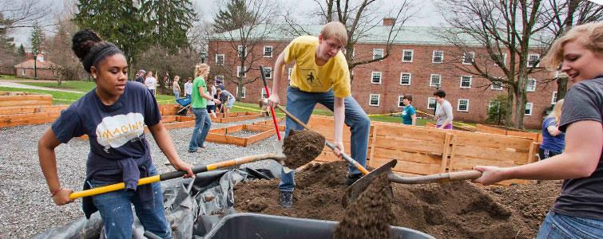
Partnering
By increasing the interactions and partnerships with organizations such as these, Boston can strengthen aspects of environmental education, awareness and can more effectively involve citizens in the political process
Affirmative effort is needed to proactively inform members of EJ communities
Notes:
Partnering can build trust with organizations within the community
Image (left):https://binged.it/2LkfR9V
Image (right): https://binged.it/2Lgd1CZ

Slide 51
Funding
Environmental Bond Bill (March 3, 2018)
  $1.4 billion bond bill focused on climate change resiliency
Municipal Vulnerability Preparedness (MVP) Grant Program
  Provides financial support to municipalities in Massachusetts for climate adaptation planning assessing risks in vulnerable communities
  Funding can aid communities in improved transportation, reduced flooding and stormwater management, urban greening, and residential efficiency projects

Slide 52
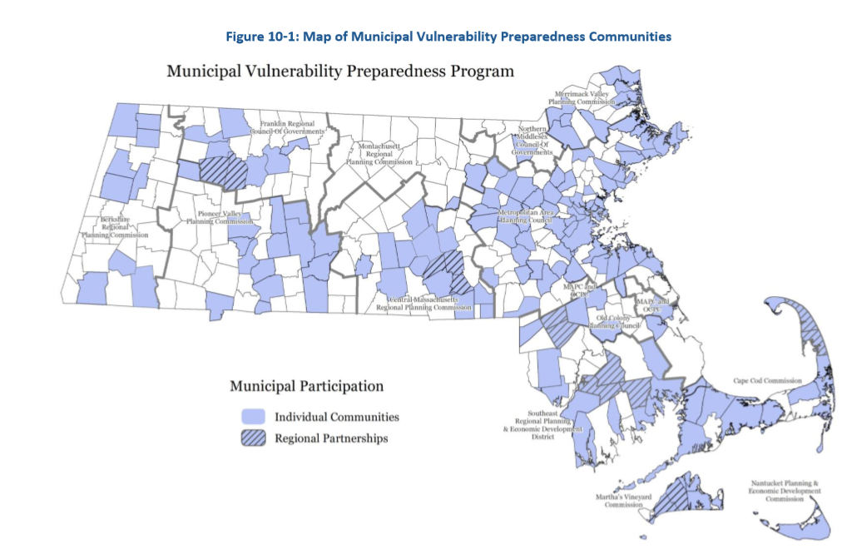
Notes:
Image from Mass.gov (Municipal Vulnerability Preparedness Program) https://www.mass.gov/service-details/mvp-program-information

Slide 53

Tools for Engagement
coUrbanize
  Developed at MIT
  $500/month
Mission: connect community members to share projects and receive more immediate and representative feedback
Host online community forums
Reach a broad audience while saving money and staff time
Notes:
Image: https://binged.it/2LgjQo3

Slide 54
Our purpose
Some believe green lifestyles are for the wealthy; we believe all people have the right and ability to live in an environmentally-conscious neighborhoods. Our research shows there are many ways to transform impacted neighborhoods into greener communities.

Slide 55
Sources
AECOM (2018). “Chapter 10: Coordination of Local Hazard Mitigation and Climate Adaptation Planning” Massachusetts State Hazard Mitigation and Climate Adaptation Plan. <https://www.mass.gov/files/documents/2018/10/26/SHMCAP-September2018-Chapter10.pdf>
Anderson M (2013) “Why Memphis is using bikes to break its poverty cycle” https://peopleforbikes.org/blog/why-memphis-is-using-bikes-to-break-its-poverty-cycle/
Blaustein, Richard. "Phytoremediation of Lead: What Works, What Doesn’t." BioScience 67.9 (2017): 868. Print.
Blumenthal, Sherie. “Sunflowers to the Rescue!” Farmers' Almanac, Farmers' Almanac, 16 Mar. 2017, www.farmersalmanac.com/sunflowers-to-the-rescue-15614.
Chicago Transit Authority (2018) Electric Bus. Retrieved from https://web.archive.org/web/20180206213131/http:/www.transitchicago.com/electricbus
Coombs K et. al (2016) “Indoor air quality in green-renovated vs. non-green low-income homes of children living in a temperate region of US (Ohio)” Science of The Total
Environment, 554-555, 178-185.

Slide 56
Sources (cont.)
coUrbanize: <https://www.courbanize.com/>
Dharmaraj V and Power MB (2018) “MBTA Should Prioritize Electric Transit in Chelsea and other Environmental Justice Communities”. GreenRoots Chelsea. http://www.greenrootschelsea.org/news/2018/8/1/mbta-should-prioritize-electric-transit-in-chelsea-and-other-environmental-justice-communities
“Gardens Property Guide” www.thetrustees.org http://www.thetrustees.org/assets/documents/places-to-visit/boston-community-gardens.pdf
Health Equity and Social Justice. Boston Public Health Commission. http://www.bphc.org/whatwedo/health-equity-social-justice/Pages/Health-Equity-Advisory-Committee.aspx
Irons M (2018) “Boston’s rich and poor neighborhoods show sidewalk repair disparity” https://www.bostonglobe.com/metro/2018/03/04/sidewalk-analysis-city-finds-inequality/qvnLJIMyVCfRxJKjKwrzYK/story.html

Slide 57
Jacobs J (1961) “The Death and Life of Great American Cities”
Jacqueline W.T. Lu, et al., “Biological, social, and urban design factors affecting young street tree mortality in
New York City,” Cities and the Environment 3 (2010).
Johnston, S. et al. (2010). Chicago Climate Action Plan.
McPherson, E.G., J.R. Simpson, P.J. Peper, S.E. Maco, and Q. Xiao. 2005. Municipal Forest Benefits and Costs in Five US Cities. Journal of Forestry. 103(8):411-416.
Nelson, L.J. (2017) L.A. Metro wants to spend $138 million on electric buses. The goal: an emission-free fleet by 2030. LA Times.. Retrieved from https://www.latimes.com/local/lanow/la-me-ln-metro-electric-buses-20170721-story.html
“How to take part in a Farmers Market” www.bos.gov https://www.boston.gov/departments/food-access/how-take-part-farmers-market
Kaneter R (2015). “Public transportation can be a ride out of poverty” https://www.bostonglobe.com/opinion/2015/05/25/public-transportation-can-ride-out-poverty/KtzBMWFo1Xpsqks7NfbYxL/story.html
Kuhne R (2010). “Electric Buses - An energy efficient urban Transportation Means.” https://ac.els-cdn.com/S0360544210005566/1-s2.0-S0360544210005566-main.pdf?_tid=b4e92a42-8e49-45ac-b75b-be7be1836ac3&acdnat=1543769863_4958aadb1700ddc4612b8d2b97311a9a
Treuhaft S, Karpyn A (2010). “The Grocery Gap” http://thefoodtrust.org/uploads/media_items/grocerygap.original.pdf

Slide 58
Presentation by:
Aseel Alharthi
Katherine Calandriello
Peiying Huang
Samantha Morton
Julia Nassar
Zachary Popp
Lydia Silber
Matthew Tate
Katelyn Wittkowski
GE532 - Research for Environmental Groups
Class taught by Professor Richard Reibstein
Presentation on 12/12/2018

