Slide 1

Community-Scale Greenhouse Gas Accounting Methodologies
By: Trenton Mulick
A Product of GE 532 Research for Environmental Agencies and Organizations
Instructor: Rick Reibstein

Slide 2

Who am I?
Trenton Mulick
Boston University Rising Senior
BA in Earth and Environmental Sciences
  Expected May 2020
Joined this class because of previous scientific research last semester, wanted to learn more about research for professional organizations
  Passionate about researching and fighting climate change, this project immediately drew my attention as it was directly part of the fight to reduce greenhouse gas emissions

Slide 3
Approach
Focused on community-level methodologies
  Ignored business and university level greenhouse gas accounting methodologies
First looked at timeline and history of greenhouse gas accounting
Identified major organizations and protocols associated with each
Reviewed what protocols cities and communities actually use today
Compared major accounting protocols
Identified tools and additional resources associated with each

Slide 4
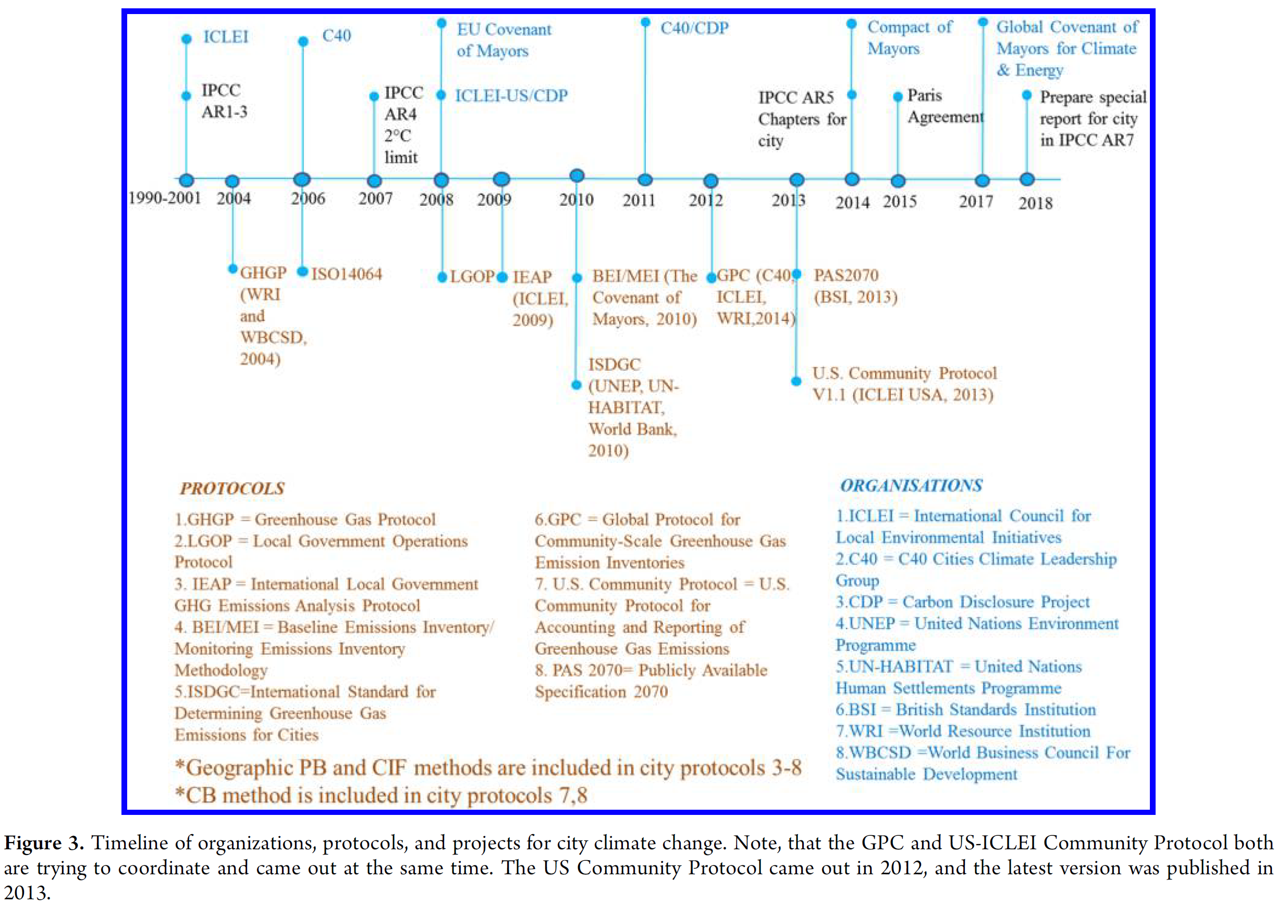
Chen, Guangwu et al. “Review on City-Level Carbon Accounting.” Environmental Science & Technology 53 (2019): 5545-5558.
Notes:
IPCC 2006 report, first major report to standardize GHG inventory methodologies, (not on the timeline) provides overall guidance on how to make a GHG protocol
Pre 2012 many different protocols and lots of issues on comparability between the protocols
2012 GPC released adopted by C40
2017: EU Covenant of Mayors and Compact of Mayors combine to form Global Covenant of Mayors for Climate & Energy, adopt GPC

Slide 5

Carbon Disclosure Project
Largest global self-reporting initiative for companies and communities managing their environmental impacts
Collects self-reported greenhouse gas (GHG) emissions
Publishes survey responses of all reporting cities publicly
Partnered with ICLEI and C40

Slide 6
2018 Survey Results
Question #7.3: Does your city have a city-wide emissions inventory that aligns with the Global Protocol for Community-Scale Greenhouse Gas Emissions Inventories (GPC)?
n = 93 cities or communities
U.S. Only
Notes:
Source: https://data.cdp.net/Governance/2018-Full-Cities-Dataset/vzxs-ejjs
Accessed June 19, 2019
Also to note: all 5 self-reporting counties answered yes (Santa Fe County, Boulder County, King County, WA, Metropolitan Government of Nashville and Davidson County, Broward County, FL)

Slide 7
2018 Survey Results
Question #7.4: (If not using GPC) Please give the name of the primary protocol, standard, or methodology you have used to calculate your city’s city-wide GHG emissions
n = 21 cities or communities U.S. only
Notes:
Source: https://data.cdp.net/Governance/2018-Full-Cities-Dataset/vzxs-ejjs
Accessed June 19, 2019
ICLEI does not recommend the International Emissions Analysis Protocol anymore

Slide 8
2018 Survey Results
Looking only at Massachusetts Cities and Towns
City or Town | Protocol Used
Boston | GPC
Cambridge | GPC
Medford | GPC (Copied Cambridge)
Somerville | GPC
New Bedford | GPC
Lexington | City Specific (Transitioning to “Industry Standard”)
Notes:
Source: https://data.cdp.net/Governance/2018-Full-Cities-Dataset/vzxs-ejjs
Accessed June 19, 2019

Slide 9

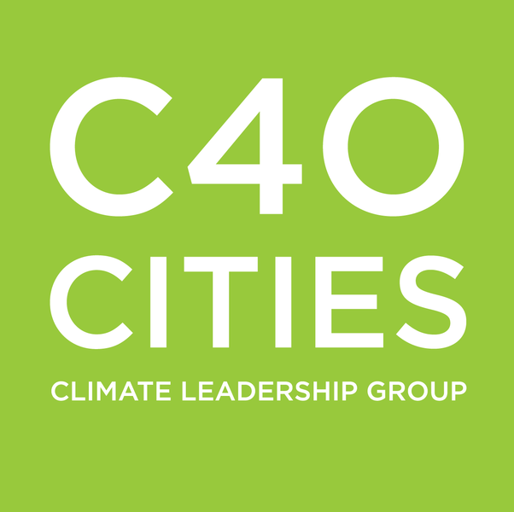

Global Protocol for Community-Scale Greenhouse Gas Emission Inventories (GPC)
Most widely used GHG reporting standard in the U.S. and internationally
Draft pilot released in 2012, testing with 35 cities began in 2013, final version published in 2014
Meant to serve as an international standard for GHG accounting in an era of many separate GHG accounting frameworks
Required framework for C40 and the Global Covenant of Mayors for Climate & Energy
Notes:
C40 began with with 40 cities, now has 94 affiliated cities
Covenant of Mayors has 9,000+ affiliated cities

Slide 10
Global Protocol for Community-Scale Greenhouse Gas Emission Inventories (GPC)
“An accounting and reporting standard for cities”
“… the accounting framework can also be used for boroughs or wards within a city, towns, districts, counties, prefectures, provinces, and states”
  GPC p. 20
“the term ‘city’ is used throughout this document to refer to any geographically discernable subnational entity, such as a community, town, city, or province”
  GPC p. 10

Slide 11
GPC Greenhouse Gases Covered
Covers all 7 Kyoto Protocol Defined GHGs
Carbon Dioxide (CO₂)
Methane (CH₄)
Nitrous Oxide (N₂O)
Hydrofluorocarbons (HFCs)
Perfluorocarbons (PFCs)
Sulfur Hexafluoride (SF₆)
Nitrogen Trifluoride (NF₃)
  Added in 2013 to second Kyoto Protocol Commitment period

Slide 12
GPC - Sectors
Classifies emissions into 6 main sectors
  Stationary Energy
  Transportation
  Waste
  Industrial Processes
  Agriculture, Forestry, and Other Land Use
  Other Scope 3

Slide 13

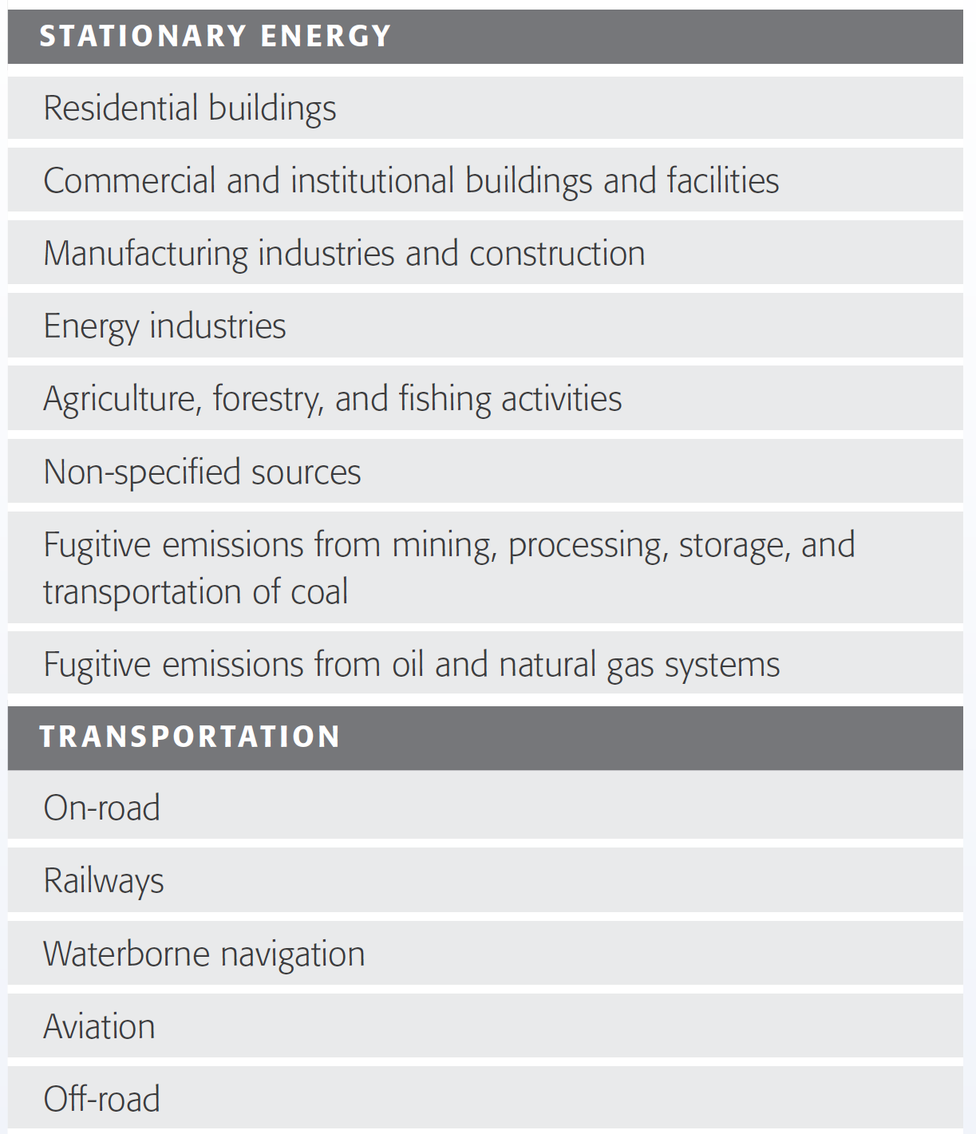
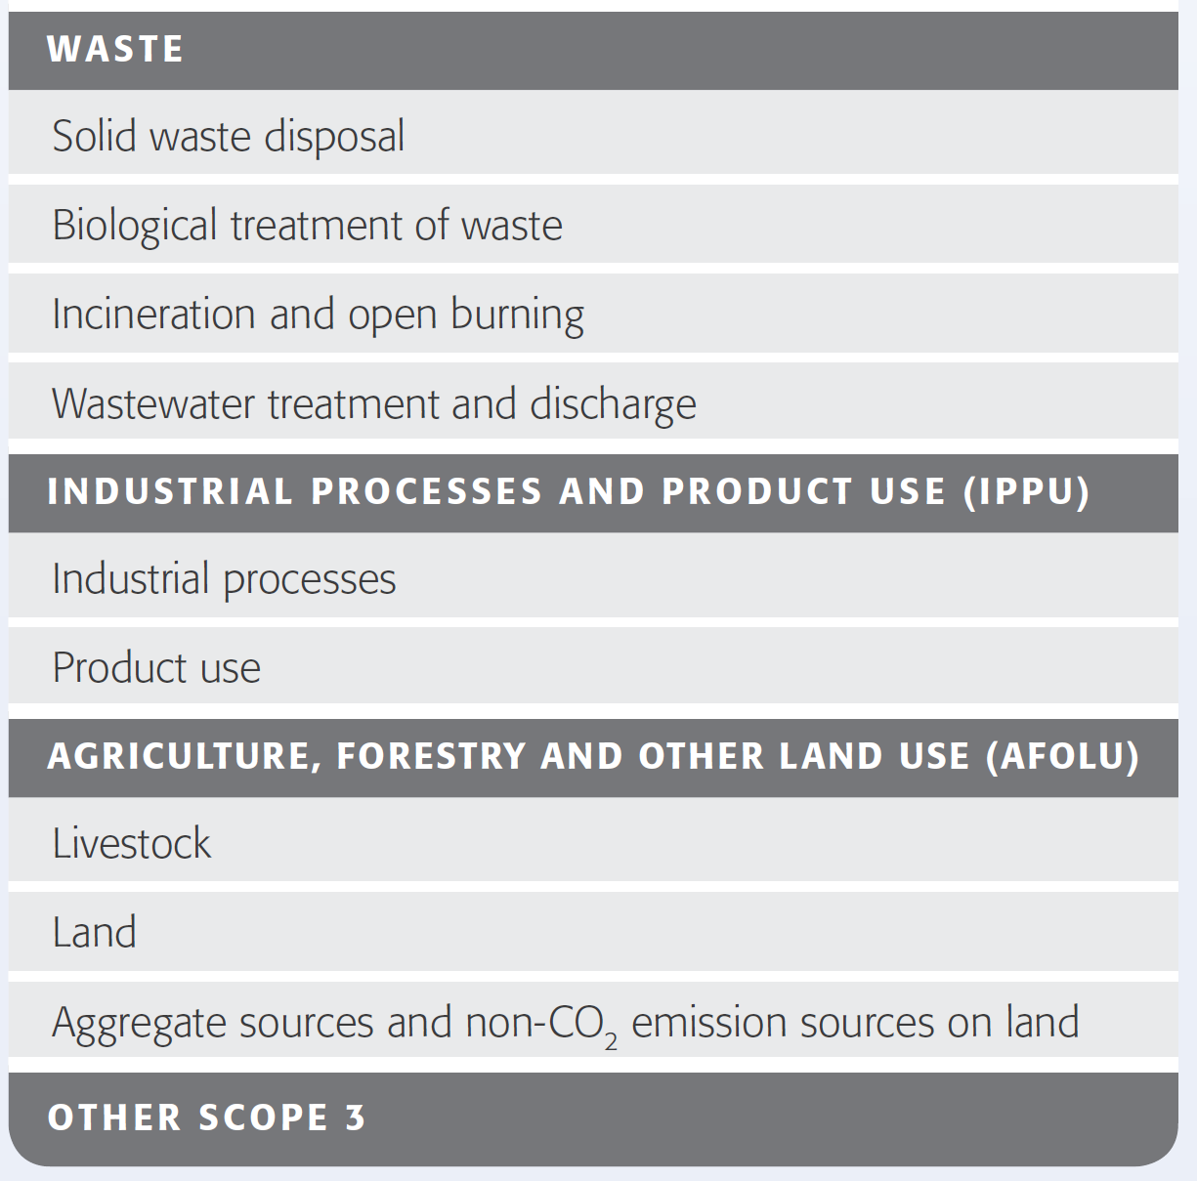

Slide 14
GPC - Concept and Definition of Scopes
GPC categorizes emissions from all sectors into 3 different scopes
  First standard to adapt the scopes concept into a city emission format
Scope | Definition
Scope 1 | GHG emissions from sources located within the city boundary
Scope 2 | GHG emissions occurring as a consequence of the use of grid-supplied electricity, heat, steam, and/or cooling within the city boundary
Scope 3 | All other GHG emissions that occur outside the city boundary as a result of activities taking place within the city boundary
Notes:
Scopes originally designed as a concept in 2004 Greenhouse Gas Protocol for corporations, written by WBCSD and WRI

Slide 15
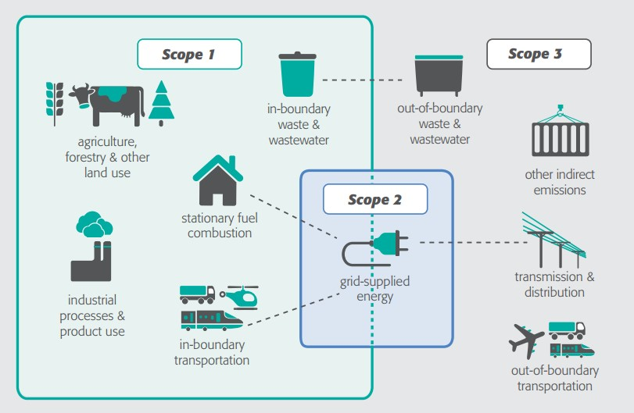
Notes:
Out-of-boundary transportation: emissions from the trip with either end point occurring within the geographic boundaries

Slide 16
GPC - Aggregation
Designed to be able to aggregate multiple city inventories at subnational and national levels
  Helps improve data quality of a national inventory
  Allows the measurement of the contribution of city mitigation actions to regional or national GHG emission reduction targets
  Identifies innovative transboundary and cross-sectorial strategies for GHG mitigation
Could be helpful for state of Massachusetts since many towns are already reporting GHG emission inventories using GPC

Slide 17
GPC - Reporting Requirements
Requires reporting of emissions by gas, scope, sector and subsector
Then add up all emissions using two approaches:
Scopes Framework
City-induced Framework
Totals all emissions by scope 1, 2, and 3
Totals all emissions attributable to activities taking place within the geographic boundary of the city
Covers selected key emission sources with which standardized methods are available

Slide 18
GPC - Reporting Requirements
City-Induced Framework has option to select between two reporting levels:
BASIC
BASIC+
Scope 1 and Scope 2 emissions from:
  Stationary Energy
  Transportation
Scope 1 and Scope 3 emissions from:
  Waste
More challenging data collection and calculation processes
Emissions from
  Industrial Processes and Product Use
  Agriculture, Forestry, and Other Land Use
  Transboundary Transportation
Aligns with IPCC
Notes:
Further information on differneces between BASIC and BASIC+ on Figure 2, p.13 of GPC report

Slide 19
GPC - Other Considerations
Does not require a specific tool to use to create a GHG inventory
  Many tools do exist that comply with the GPC
Self or 3rd party verification can be done
Guidance and download for entire GPC report on website
  https://ghgprotocol.org/greenhouse-gas-protocol-accounting-reporting-standard-cities
Global Covenant of Mayors provides an online training course
  https://ghgprotocol.org/global-covenant-mayors-online-training-course
The World Bank provides a City Climate Planner Certificate Program
  Focuses on “becoming an urban GHG inventory specialist”
  http://www.worldbank.org/en/topic/climatechange/brief/city-climate-planner-certificate-program

Slide 20

GPC - Possible Tools and Resources
Video tutorials, case studies, development handbook, etc.
  https://resourcecentre.c40.org/resources/measuring-ghg-emissions
City Inventory Reporting and Information Systems (CIRIS)
  Excel-based tool to report and manage greenhouse gas emission inventories
  https://resourcecentre.c40.org/resources/reporting-ghg-emissions-inventories
    Video tutorials and downloads
ICLEI ClearPath
  Web-based tool produced by ICLEI USA for creating greenhouse gas inventories
  Can be used to create a GPC compliant inventory
  Multiple levels
  http://icleiusa.org/clearpath/

Slide 21
U.S. Community Protocol for Accounting and Reporting of Greenhouse Gas Emissions
Version 1 published in 2012, updated version published in 2013
  Around same time as GPC
Solely developed and maintained by ICLEI-USA
Most widely-used non GPC framework in the U.S.
  Provides guidance on interested governments to complete an inventory that also fulfills GPC requirements
Tailored for data sources likely available to U.S. local governments

Slide 22
U.S. Community Protocol - Gases
Covers 6 Kyoto Protocol defined GHGs
  Carbon Dioxide (CO₂)
  Methane (CH₄)
  Nitrous Oxide (N₂O)
  Hydrofluorocarbons (HFCs)
  Perfluorocarbons (PFCs)
  Sulfur Hexafluoride (SF₆)
  Nitrogen Trifluoride (NF₃)
    Added in 2013 to second Kyoto Protocol Commitment period, after publication of the protocol

Slide 23
U.S. Community Protocol – Carbon Sinks
Does not provide guidance on reporting or quantifying any GHG benefits such as
  Actions that have been or could be taken to reduce emissions
  Carbon offset projects
  Carbon stocks or sinks (e.g. forests)
  Carbon sequestration projets
  Purchased carbon credits
  Renewable energy credits
This information can be included in a report, but must be presented separately from gross GHG emissions data

Slide 24
U.S. Community Protocol - Scopes
Does not explicitly use a scope 1, 2, and 3 framework
Instead divides emissions into two categorizations
In-boundary GHG Emission Sources
Activities Resulting in GHG Emissions
Any physical process inside jurisdictional boundary that releases GHG emissions into the atmosphere
The use of energy, materials, and/or services by members of the community that result in creation of GHG emissions either directly or indirectly

Slide 25
U.S. Community Protocol – Required Emissions Inventory Process
5 Required Emission Generative Activities
  Use of electricity by the community
  Use of fuel in residential and commercial stationary combustion equipment
  On-road passenger and freight motor vehicle travel
  Use of energy in potable water and wastewater treatment and distribution
  Generation of solid waste by the community
Strongly encourages including other sources and activities
Not consistent with major IPCC emission source categories

Slide 26
U.S. Community Protocol
Expansive and detailed appendices on specific emission calculation methods and guidance for a variety of sectors
  Built Environment Emissions
  Transportation and Other Mobile Emissions
  Solid Waste Emissions
  Wastewater and Water Emissions
  Agricultural Livestock Emissions
  Emissions Associated with the Community’s Use of Materials and Services
  Consumption-Based Emissions

Slide 27
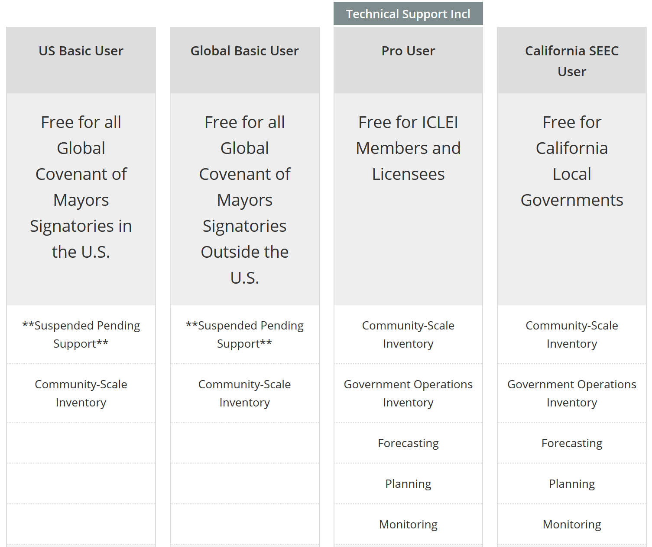
U.S. Community Protocol - ClearPath
Notes:
ClearPath Main Page with video: http://icleiusa.org/clearpath/
Registering for ClearPath: http://icleiusa.org/clearpath/clearpath-user-options/

Slide 28
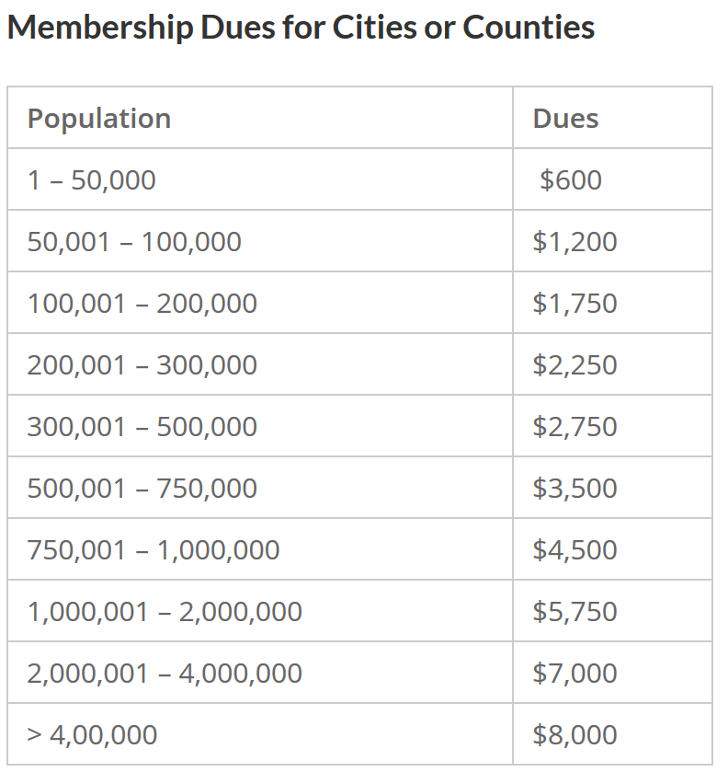
U.S. Community Protocol - ClearPath
Barnstable County Population (as of 2017):
213,444
Notes:
http://icleiusa.org/membership/join-iclei/

Slide 29
Overall Comparison
 | GPC | U.S. Community Protocol
Authors | WRI, C40, ICLEI | ICLEI-USA
Gases | 7 | 6 (Excludes NF₃)
Consistent with Major IPCC Source Categories | Yes | No
Reporting Frameworks | BASIC, BASIC+ | Many Optional Ones
Emission Categorization | 6 Major Sectors with Subsectors | 5 Emission Generation Activities with more optional ones
Detailed Guidance on Calculation Methodologies | No | Yes
Guidance on Setting Reduction Targets | Yes | No
Online Resources | Extensive | Limited

