Slide 1
State of Nanotechnology Use in Massachusetts
Greylin Nielsen
GE 521: Research for Environmental Agencies and Organizations
Instructor: Rick Reibstein
June 25, 2019
Notes:
-current student at BU SPH studying toxicology.
-Studying nano for the past month as part of a research based class at BU

Slide 2
Outline
Background
Health and safety concerns
Data collection efforts in Massachusetts
Conclusion and recommendations
Discussion
Notes:
-most have background in nano, so will go over briefly.

Slide 3
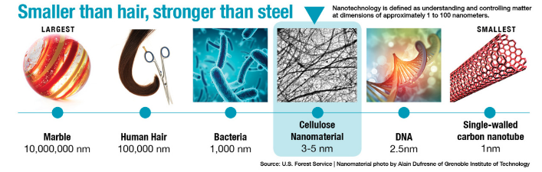
What are Nanomaterials?
Substances with lengths of 1-100 nanometers one or more dimensions
Vary in size, shape, chemical composition, structure
Possess different properties than bulk materials of the same composition
Novel properties have allowed innovations in diverse sectors
Notes:
Can be naturally occurring or engineered, however this presentation will focus on engineered nanmaterials. That size is 100,000 smaller than the diameter of a human hair
Can be metals or organic materials.
Some of the different properties include greater reactivity, strength, conductivity, and fluorescence.

Slide 4
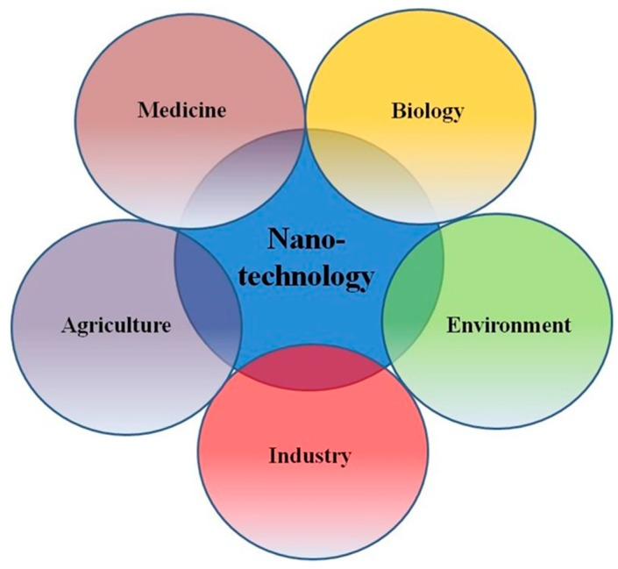
How are Nanomaterials Used?
Adjary et al., 2018
Notes:
Found in a wide variety of products.
One important use is coatings, they can be used to coat electronics, glasses, etc to make them anti-reflective, filter, water repellant, scratch resistant, etc . Can be used to make clothing antimicrobial, wrinkle and stain resistant. Additives to make sports equipment light weight and durable.
Automotive—reduce rolling resistance in tires, fuel additives, thermoelectric materials for temperature control, boost chemical reaction in catalytic converters.
Medical—gold nanoparticles used to detect targeted sequences of nucleic acids, therapeutics with targeted effect, research into regenerative medicine.
Energy→ nanocell, improve efficiency of fuel production from raw materials,
https://www.nano.gov/you/nanotechnology-benefits
Medical field
Diagnostic uses, drug delivery, medical devices, research
BIOLOGY→ Biodetection of pathogens
Environment and Enerfy
Environmental remediation, water filtration, photovoltaics and energy harvesting, batteries, low resistance wires, fuel production
Consumer products
Coatings for electronics, clothing, sports equipment, automotive products, personal care products, cosmetics, electronics
AgricultureEnvironment
Nanoagrochemicals, nanofertilizer, nanocomposites in food storage containers

Slide 5
Human Exposure to Nanomaterials
Occupational Health Considerations
  Nanomaterials can be explosive with low ignition energy (<1mJ)
  Nanomaterials will remain airborne
  Nanomaterials follow airstreams and can be easily collected with properly functioning fume hoods, HEPA filters, vacuum filters
Public Health Considerations
  Nanomaterials are used in numerous products that people use daily
  Lack of exposure data
  Lack of industrial release data for nanomaterials
Notes:
Nanomaterials don’t settle out of the air, rather they remain airborne.
NIOSH recommends using chemical fume hoods and high efficiency particulate air filtered exhaust ventilation
Fume hoods and filtration systems must be functioning properly to provide adequate protection.

Slide 6
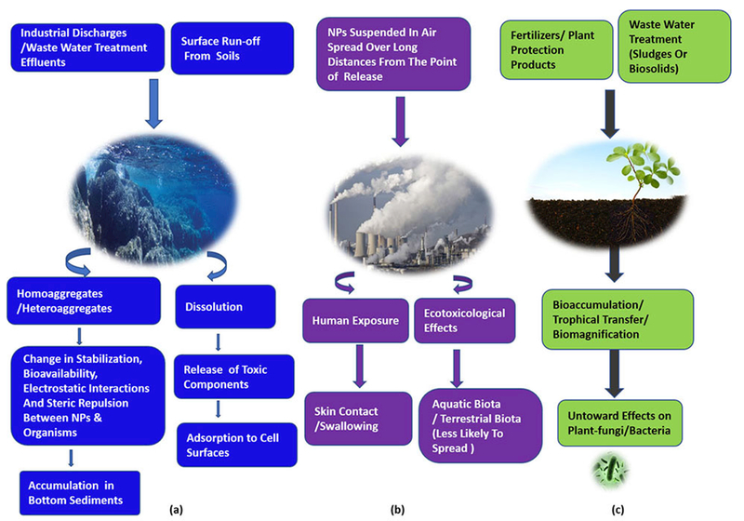
Gupta & Xie, 2018
Notes:
Just to emphasize the potential of human exposure, this schematic is a good depiction of how nanomaterials enter the media the public interacts with daily beyond consumer products we use. Though not a focus of the work I did, it also points to the potential for ecotoxicity.
Agglomeration reduces the risk→ homoagglomeration.

Slide 7
Toxicity Concerns due to Nanomaterial Properties
Small size = Easily cross cell membranes to disrupt subcellular processes
Higher chemical reactivity = Increased production of reactive oxygen species
Surface coatings = Easy distribution throughout systemic circulation, reaching multiple target organs including the brain
Notes:
If ROS production disturbs normal redox state of cells, that can damage cell components such as proteins, lipids, DNA.
Easily cross cell membranes means they are fairly easily→ interact w/ mitochondria. MAY cross skin barrier, usually thought of as relatively impermeable.
Importantly: Materials considered toxic at the bulk level should be considered toxic at the nano level
Materials not considered toxic and the bulk level may still be toxic at the nano level
Cell culture assays show that numerous
Savolainen et al., 2010. Risk Assessment of engineered nanomaterials and nanotechnologies—A review.
Inhaled nm can reach a number of different target organs including brain, liver, kidney, immunological system, vessel walls following inhalation. Can result in pulmonary inflammation. Induce an inflammatory response. Nano level titanium dioxide is more effective in induing pulmonary toxicity than coarser particles in experimental animals.
CNT can induce mesothelioma in mice (>asbestos comparison).

Slide 8
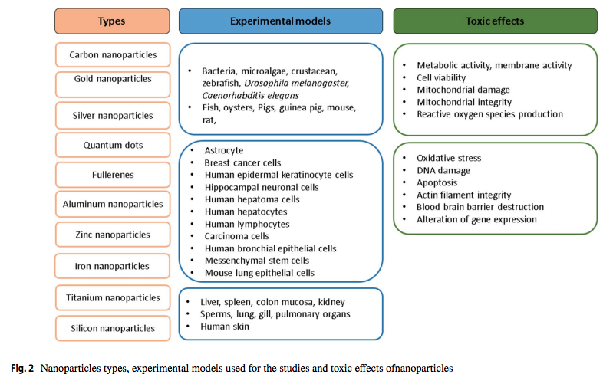
Review of In Vitro and In Vivo Toxicity Studies
Kumar, Sharma, & Maitra, 2017
Notes:
This slide is just showing that toxicity studies of multiple nanomaterials using different models point to some concerning toxic effects on cells and organisms.
However, the lack of standardization in how toxicity is assessed makes it difficult to understand which nanomaterials present the greatest threat.
Additionally, beyond using different experimental models, most studies are using different concentrations, and even different sized materials.
It makes it very challenging to compare toxicity of different nanomaterials.
And on the organismal level, concerns assoictaed with multiwalled carbon nanotube exposre = pulmonary fibrosis, mesothelioma.
The desirable properties of nanomaterials also present possible concerns for human health.
Highly reactive
Silica nps: induce inflammation-mediate cytotoxicity in cells and are genotoxc in cell lines. Mag of response is neg correlated w/ size of particle. Short term exposure to silica nps induced adverse effects in lungs, kidney, liver, brain. Inalation and ingestion distributed to lungs, liver, spleen , kidney, brain.

Slide 9
Comparing Toxicity of Nanomaterials*
Cadmium
Copper Oxide
Zinc Oxide
Iron oxide
CNTs
Molybdenum disulfide
Titanium oxide
Aluminum
Silica
Silver
Gold
Polymeric materials
Notes:
“These studies have used different in vitro and in vivo test models, different sources of test nanomaterials, different methods for nanomaterial characterization, and different experimental conditions. Therefore, these data are hard to interpret”
Metals
Neither?
Gold (but depends on side chain and stabilizer)
Cytotoxic
Silver. Also accumulates in multiple target organs (lungs, kidney, spleen, liver, brain). Toxicity dependent on coating.
Genotoxic
Titanium oxide--> DNA damage, genotoxicity, lung inflammation. Induce oxidative stress and form DNA adducts. Toxic effects on immune function, liver, kidney, spleen, myocardium, lipid homeostasis
Both
Aluminum→ DNA damage, alter mitochondrial function, inc oxidative stress, alter tight junction expression at BBB. 10-400 ug/mL)
Copper oxide→ disturb cell membrane integreity and induce oxidative stress (also, in vivo studies w/ rats show severe liver, kidney, spleen toxicity. Concern due to IUDs!!!
Zinc oxide→ DNA damage, cell membrane damage and oxidative stress. Complete cell death (49 mg/mL,300mg/kg)
Iron oxide NPs→ generate ROS which can damage DNA and cause lipid peroxidization.
Vicario-Parés, U., Castañaga, L., Lacave, J.M. et al. Comparative toxicity of metal oxide nanoparticles (CuO, ZnO and TiO₂) to developing zebrafish embryos. J Nanopart Res (2014) 16: 2550. https://doi.org/10.1007/s11051-014-2550-8
CU oxide>Zn> TiO. Toxicity on zebrafish embryos (alter hatching and increase presence of malformations)
Cadmium Sulfide>Molybdenum disulfide>tungsten sulfide
Zhu, X., Zhu, L., Chen, Y. et al. Acute toxicities of six manufactured nanomaterial suspensions to Daphnia magna. J Nanopart Res (2009) 11: 67. https://doi.org/10.1007/s11051-008-9426-8
Effects on D. magna mortality.
nZnO, SWCNTs > C₆₀ > MWCNTs > nTiO₂, nAl₂O₃
Zhu X, Lin Z, Duan Z, Ruiqi Q, Li Y, Lang, Y. Comparative Toxicity of several metal oxide nanoparticle aqueous suspensions to Zebrafish (Danio rerio) early developmental stages. Journl of Environmental Science and Health Part A. 2008; 43(3): 278-284. https://doi.org/10.1080/10934520701792779
Developpmental toxicity in zebrafish:
Zn disturbs development, titanium dioxide and aluminum do not
Nonmetals
Neither
Polymeric materials.
Cytotoxic
Silica→ induce oxidative stress, hepatotoxic
Genotoxic
Both
CNTs→ size dependent. Multi walled CNTs Can induce carcinogenic effects similar to asbestos after injection into the peritoneal caviy compared with single walled CNTs that are easily removed by macrophages. Fullerenes accumulate in liver, kidney, bones, spleen. Fullerenes have mixe impacts on dna strand breakage

Slide 10
Massachusetts Efforts to Collect Information About Nanomaterial Users and Manufacturers
Cambridge Public Health Dept. Survey
Office of Technical Assistance & Technology Survey
Toxic Substances Control Act Section 8a Reporting
Registered Nanomaterials Companies in MA

Slide 11
1. Cambridge Public Health Dept. Survey
Sent to 24 companies and universities in Cambridge in 2007
Received 8 responses
Identified 3 organizations that manufacture, handle, or process engineered nanoscale materials

Slide 12
1. Cambridge Public Health Dept. Survey Responses: Nanomaterials Used
Multiwalled carbon nanotubes
Colloidal solutions of gold, silver, silica, silver iodide
Cadmium selenium, silica, silver iodide quantum dots
Polystyrene particles
Silicon solutions and powder
Gold and silver salts
Organo-copper and manganese compounds
Carbon nanotubes from silicon, methane, argon
Nanoparticles from polyacetic gylocolic acid and polyvinyl alcohol
Diamond particles
Titanium oxide, polymethlyl methacrylate, polystyrene

Slide 13
1. Cambridge Public Health Dept. Survey Responses: Health and Safety Information
Consistent use of gloves and fume hoods to minimize occupational exposure
Inconsistent nano-specific precautionary measures
Inconsistent exposure monitoring and health surveillance
Notes:
Elicited some information about health and safety information based on 2 responses
Left with a slightly concerning picture—we know some of the more toxic nanomaterials (silica) are being used, but practices are inconsistent with health and safety precautions.
Inconsistent nano-specific precautionary measures such as hazard training, labelling of nanomaterials on MSDS sheets and in waste streams.
Inconsistent exposure monitoring and health surveillance

Slide 14
2. MA Office of Technical Assistance (OTA) Nanomaterials Survey
Initiated due to requests for information from environmental, occupational health, and public health organizations
Information gathering goals:
  Understand nanomaterial manufacturing and use in MA
  Assess best practices, worker safety and environmental protections
  Gather information about disposal and control methods
Significant effort to maximize outreach
Opened December, 2017, and still active
  https://umasslowell.co1.qualtrics.com/jfe/form/SV_cO836sayokSXzNP
Notes:
Impetus: OTA received 13 written requests from environmental, occupational health, and public health organizations asking for help
Outreach efforts included
Questions on the survey: do you manufacture in MA, do you use nano, do you do R&D w/ Nano? Asked about NAICS, asked about final products, asked about nano materials and methods. Asked about weight generated/year. Asked about disposal weights, does the facility have a risk management program for nano? Do you have any health or safety concerns about using these materials?

Slide 15
2. MA OTA Nanomaterials Survey: Results
Viewed 165 times
Received 54 responses
About 13 current manufacturers and/or users in MA

Slide 16
2. MA OTA Nanomaterials Survey: Nanomaterial Industry
Manufacturing: coatings and semiconductors
Healthcare: pharmaceutical companies, biomedical research, hospital research
Academic and higher education institutions
Chemicals research and development
Biological research
Military defense

Slide 17
2. MA OTA Nanomaterials Survey: Safety Information
Received 14 responses from nanomaterials users
  37.5% (n=5) had risk management plans
  37.5% (n=5) had health and safety concerns about nanomaterials
Received 5 responses from companies that manufacture or plan to manufacture nanomaterials
  40% (n=2) had risk management plans
  20% (n=1) had health or safety concerns about nanomaterials
Notes:
The rest did not, were unsure, or declined to respond.
Summary? ACC thinks it may be because many companies don’t know they use nanomaterials in their business.
Disconnect between risk management plans and current safety concerns is somewhat reflected in in insurance information. We know that some companies are purchasing supplemental insurance for nanomaterials use, possibly to protect against future concerns with nano

Slide 18
3. Toxic Substances Control Act (TSCA) Section 8a Nanomaterials Reporting
One time information gathering rule to better understand nanomaterials use in commerce
Requested information about:
  Specific chemical identity, production volume, methods of manufacture, processing, use, exposure, and release information, health and safety data
Reporting deadline was August 14, 2017
Notes:
https://www.epa.gov/reviewing-new-chemicals-under-toxic-substances-control-act-tsca/control-nanoscale-materials-under

Slide 19
3. TSCA Section 8a Results
Received only 70 responses nationwide
Results are not yet publicly available
No responses from Massachusetts?
Notes:
https://www.epa.gov/reviewing-new-chemicals-under-toxic-substances-control-act-tsca/control-nanoscale-materials-under#info%20rule

Slide 20
4. Database searches for Nanomaterials Users in MA
Goal: Locate additional tools to identify nanomaterials users in MA
As of 2017, Research and Development in Nanotechnology has a separate NAICS code (541713)
Database searches at multiple business libraries produced no results under this code in MA
  Mergent, Inc., ReferenceUSA
Notes:
North American industry classification system
ReferenceUSA, Mergent
“ReferenceUSA offers the most up-to-date data available in the market.”
“Mergent., Inc is a leading provider of business and financial data on global publicly listed companies”

Slide 21
4. Database searches for Nanomaterials Users in MA
S&P Capital IQ
  Available at BPL, Baker Library at Harvard Business School
Allows search within business descriptions
Keyword search using “Nano*”
Notes:
This is a market intelligence platform that provides research, data, and analysis on private and public companies

Slide 22
4. S&P Capital IQ results
Identified 707 companies in the United States
A total of 40 companies in Massachusetts
Variety of industry classifications
  Information Technology (35%, n=14)
  Health Care (32.5%, n=13)
  Materials (20%, n=8)
  Industrials (10%, n=4)
  Consumer discretionary (2.5%, n=1)
Notes:
Examples of each category:
Information technology→ Scanning electron microscopes manufacturers, photovoltaic cells producers, nanoscale surface modification, semiconductors, nanophotonics hardware, anti-reflective and anti-smudge coatings, photocatalytic technology for energy storage, circuits, material science, solar cells,
Materials→ produce paper resistant to oil and grease, materials for consumer products, coatings for aeronautical purposes (de-icing), specialty additives to paper, colloidal materials (w/ info!!!), polyurethane coating and adhesives, electronics,
Health Care→ nanocolloid supplements, surgical instruments, drug discovery research, biosensoring?, diagnostics, bioactive coatings for antifouling, antimicrobial, and pharmaceutical uses, cancer therapeutics, drug delivery,
Industrials→Touch panel technology, wiring, coatings, nanofiltration, nanocoatings and filters for fuel applications, nanocarbon ultracapacitors,
Consumer discretionary→ military and airforce information. Fuel combustion uses.
This list is LIMITED→ only identified companies that had the keyword nano in their business description. Likely not capturing academic research, or companies who may use nanomaterials to achieve their primary business goal.

Slide 23
Materials Used
CNTs
Fullerenes and fullerene derivatives
Colloidal antimony, silica, alumina, zinc oxides, zirconia
Silver nanomaterials
Nanostructured silicon
Nanostructured titanium
Polymeric materials

Slide 24
4. S&P Capital IQ results
Data Collection Efforts in MA
Cities with the most nano activity
  Woburn (n=8)
  Cambridge (n=6)
  Boston (n=5)
  Westwood and Marlborough (n=2)
55% of facilities are located in towns/cities with EJ communities

Slide 25
Take Home Message
Companies in MA are manufacturing and using nanomaterials, some of which are hazardous
The most recent estimate of 40 companies is likely low
Manufacturers and users are uncertain about whether nanomaterials pose a threat to human and environmental health
In 2007 and 2017, companies reported inconsistency in their use of precautionary health and safety measures
Notes:
Presentation feedback: Add sources for the definitions. Novel properties, but new concerns.
Toxicity concerns→ functionalization. Make combinations of elements. Mention functionalized particles. Rank the nanomaterials by toxicity. Mention different concerns for different materials.
Remind after Cambridge→ 12 years ago. Information level is limited. A little better with response to the OTA survey.
Academic research--> doesn’t show up in the business report. Requirement for chemical hygiene programs and mandate there will be safety procedures. Chemical Hygiene plans.
MA OTA results→ small percentage of known producers using health safety practices.
TSCA→do they all have exemptions?
NAICS code→ no responses at 3 diff libraries.
Cities where primary production is taking
Be clear on what isn’t in the list for companies.
Take home message→ not an exhaustive list. Not everyone is alerting users to nano. Don’t know if they’re labelling their waste. Don’t have emissions reporting through EPCRA. Tiny materials, not crossing the threshold. OSHA constituent threshold (not crossing it either).
Questions: Hajima from OTA. Laura from clean water action (what do we do with this). Sam lipson. Mike Ellenberger. Molly Jacobs from sustainable production. Janet from finance/insurance. MA dept of public health.
What are the worst problems we need to worry about. How does the state build up capacity to respond to this. How do we educate public health and state officials to respons. How do we educate inspectors to ensure facilities and neighborhoods are safe.
Concerns
We don’t have enough info about what’s going on
We know activity is going on.

Slide 26
Conclusions and Future Directions
Another data collection phase to determine whether precautionary measures have improved?
Expand ambient air pollution monitoring to include ultrafine particles in communities housing nanomaterials users/manufacturers
Provide known users and manufacturers with resources for best practices for safe use of nanomaterials
Notes:
NIOSH story…most community ambient air pollution monitors don’t capture ultrafine particles.
Conclusions+future directions. Increase ambient air MONITORING.

Slide 27
References
Ajdary M, Moosavi MA, Rahmati M, Falahati M, Mahboubi M, Mandegary A, Jangjoo S, Mohammadinejad R, Varma RS. Health Concerns of Various Nanoparticles: A Review of Their in Vitro and in Vivo Toxicity. Nanomaterials (Basel). 2018 Aug 21;8(9):634. doi: 10.3390/nano8090634. PubMed PMID: 30134524; PubMed Central PMCID: PMC6164883.
Bahadar H, Maqbool F, Niaz K, Abdollahi M. Toxicity of Nanoparticles and an Overview of Current Experimental Models. Iran Biomed J. 2016 Jan;20(1):1-11. doi: 10.7508/ibj.2016.01.001. PubMed PMID: 26286636; PubMed Central PMCID: PMC4689276.
Gupta R, Xie H. Nanoparticles in Daily Life: Applications, Toxicity and Regulations. J Environ Pathol Toxicol Oncol. 2018;37(3):209-230. doi: 10.1615/JEnvironPatholToxicolOncol.2018026009. PubMed PMID: 30317972; PubMed Central PMCID: PMC6192267.
Hallock, M. F.; Greenley, P.; DiBerardinis, L.; Kallin, D. Potential Risks of Nanomaterials and How to Safely Handle Materials of Uncertain Toxicity. J. Chem. Health Saf. 2009, 16, 16−23
Kumar V, Sharma N, Maitra SS. In vitro and in vivo toxicity assessment of nanoparticles. International Nano Letters. 2017; 7: 243-256. https://doi.org/10.1007/s40089-017-0221-3
Nano.gov. Benefits and Applications. Cited 2019 Jun 20. Available from: https://www.nano.gov/you/nanotechnology-benefits
Vicario-Parés, U., Castañaga, L., Lacave, J.M. et al. Comparative toxicity of metal oxide nanoparticles (CuO, ZnO and TiO₂) to developing zebrafish embryos. J Nanopart Res (2014) 16: 2550. https://doi.org/10.1007/s11051-014-2550-8
Zhu, X., Zhu, L., Chen, Y. et al. Acute toxicities of six manufactured nanomaterial suspensions to Daphnia magna. J Nanopart Res (2009) 11: 67. https://doi.org/10.1007/s11051-008-9426-8
Zhu X, Lin Z, Duan Z, Ruiqi Q, Li Y, Lang, Y. Comparative Toxicity of several metal oxide nanoparticle aqueous suspensions to Zebrafish (Danio rerio) early developmental stages. Journl of Environmental Science and Health Part A. 2008; 43(3): 278-284. https://doi.org/10.1080/10934520701792779
IMAGES:
  https://mris.edu.in/blog/leading-the-way-through-group-discussions/
  https://greenvillejournal.com/2018/12/05/122800/

Slide 28

Discussion

