Slide 1
Energy Resilience in Puerto Rico
In Partnership with U.S. EPA R2 Brownfields Program
Boston University, EE 538

Slide 2
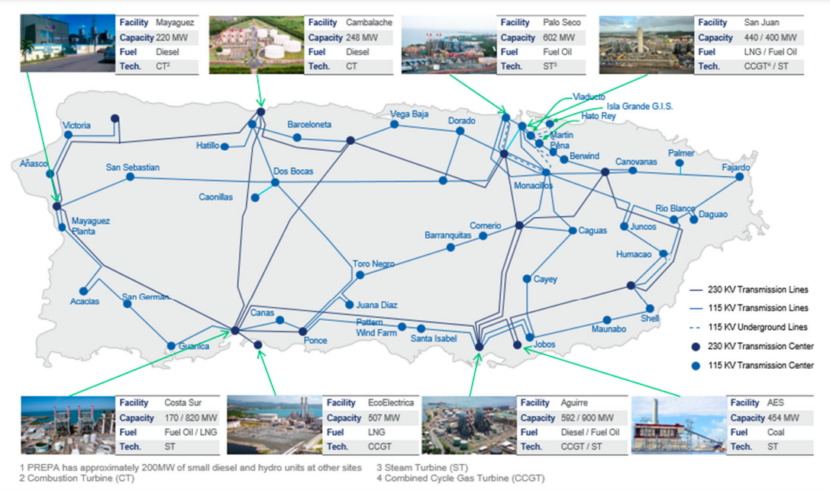
Source: PREPA 2020 Fiscal Plan

Slide 3



Puerto Rico Electricity Organizations
Generation:
Transmission & Distribution:

Slide 4
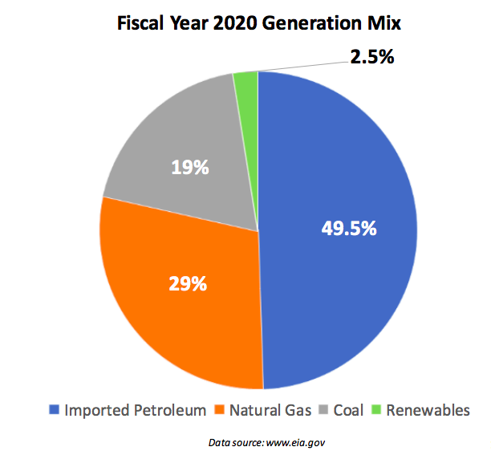
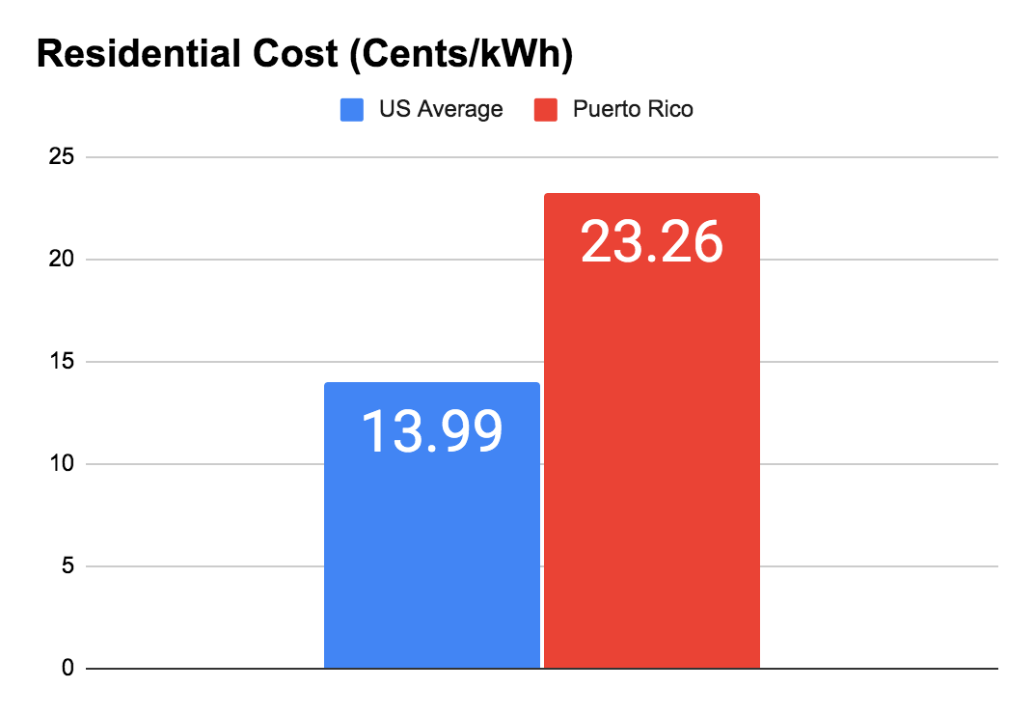
Puerto Rico Electricity Sources and Prices
​​

Slide 5
Puerto Rico Energy Public Policy Act, Act 17-2019
Established a Renewable Portfolio Standard for Puerto Rico:
  PREPA has to obtain 40% of its electricity from renewable resources by 2025
  60% by 2040
  100% by 2050
Additional Requirements:
  Coal-fired generation phased out by 2028
  30% energy efficiency requirement by 2050
  100% LEDs for public lighting by 2030

Slide 6
Renewables Procurement Plan - PREPA 2020 IRP
Procurement Tranche | Solar PV or equivalent (MW) | Solar PV or equivalent (Cumulative MW) | 4-hr Battery Storage (MW) | 4-hr Battery Storage (Cumulative MW)
1 | 1000 | 1000 | 500 | 500
2 | 500 | 1500 | 250 | 750
3 | 500 | 2000 | 250 | 1000
4 | 500 | 2500 | 250 | 1250
5 | 500 | 3000 | 125 | 1375
6 | 750 | 3750 | 125 | 1500

Slide 7
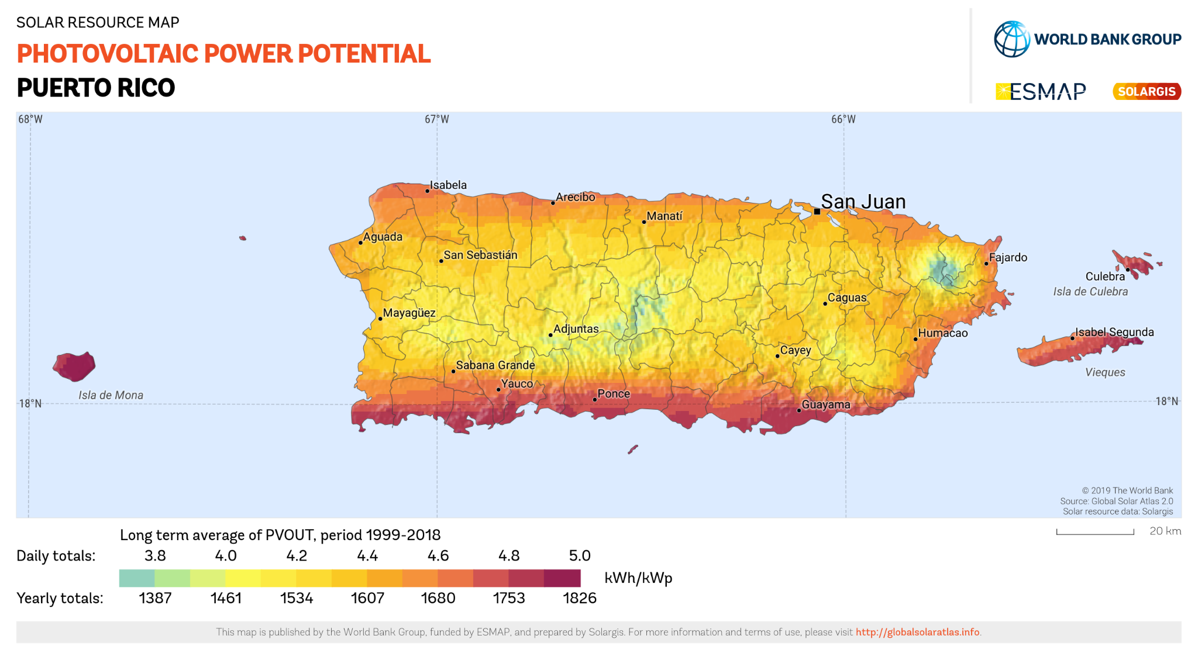
Puerto Rico Renewables Potential

Slide 8
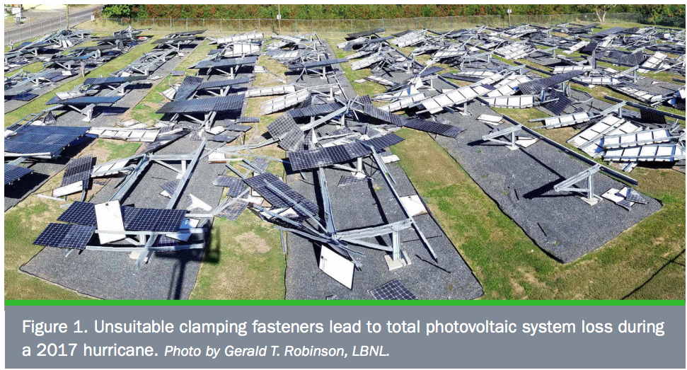

Slide 9
DOE - Solar Photovoltaic Systems in Hurricanes and Other Severe Weather
Recommendations:
Use of torqued and locked fasteners, such as wedge-lock washers
Through-bolt modules instead of using clamping fasteners
Select solar modules with highest wind resistance and debris strength
Three-frame rail mounting system instead of two-frame
Design and material selection of frames and fasteners
Wind-calming perimeter fencing
Elevated pads with drainage and rubber-sealed enclosures

Slide 10
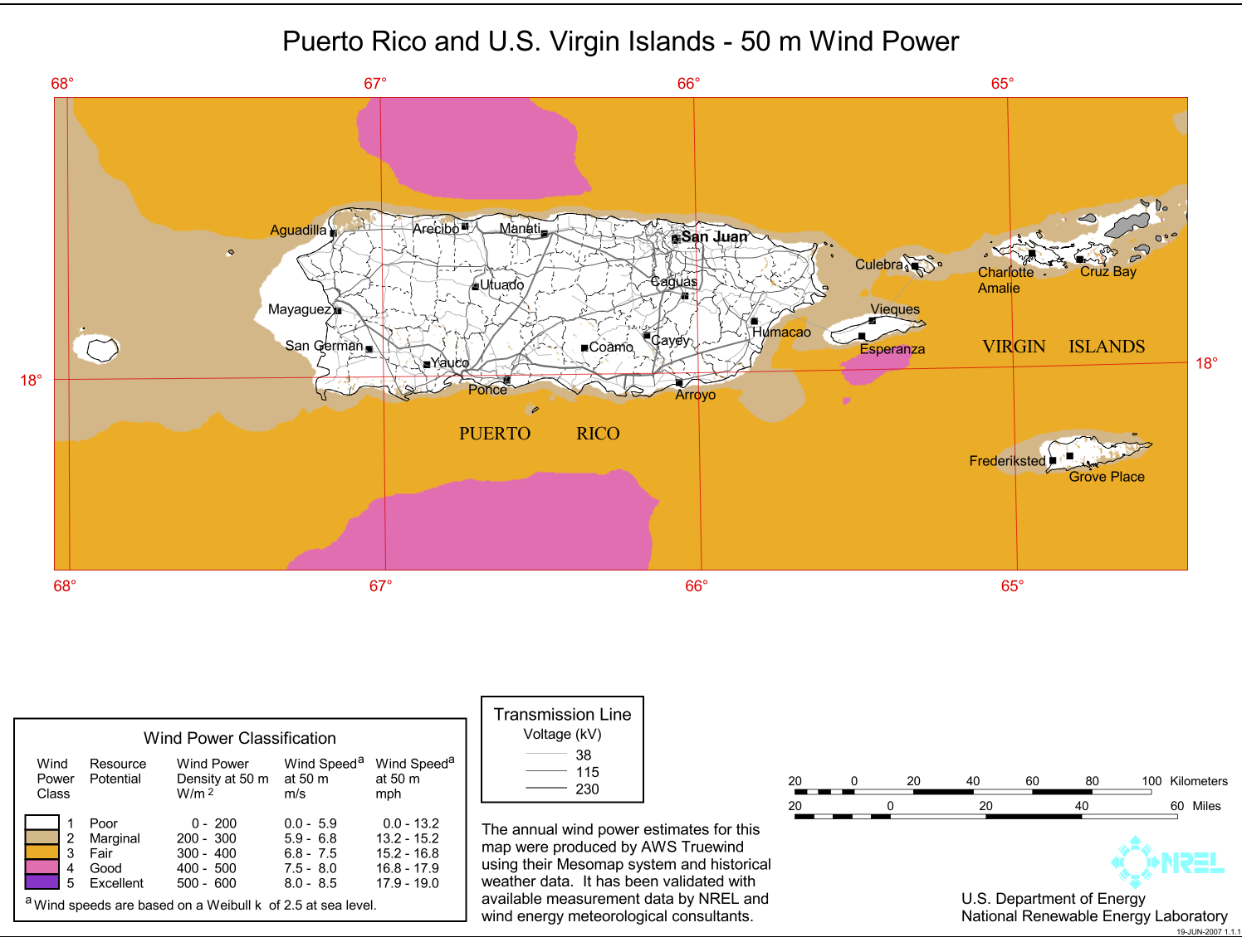

Slide 11
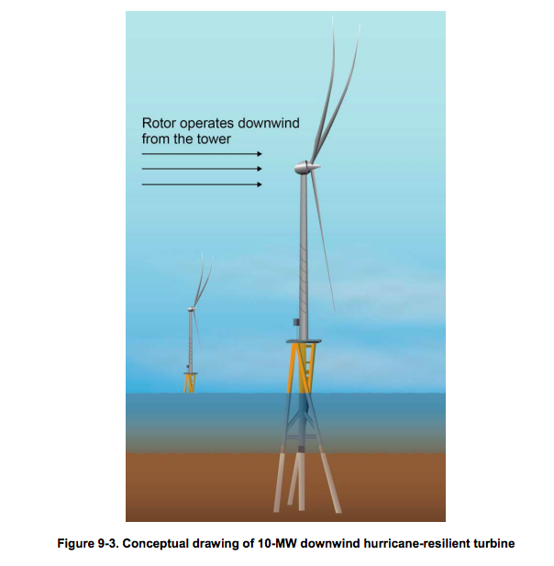
NREL - Hurricane Resilient Wind Plant Concept Study
“Twisted Jacket” base design, similar to those used on oil-rigs that were unscathed during Hurricane Katrina
Downwind design allows flexing of blades and reduces potential of contact with tower

Slide 12


FEMA Funding for Puerto Rico Energy Grid
$9.6 Billion for Puerto Rico’s Grid

Slide 13


HUD Funding for Puerto Rico Energy Grid
$1.9 Billion Community Development Block Grant - Disaster Recovery
To improve resiliency, sustainability, and financial viability for electrical power systems

Slide 14
Difficulties with Renewables Integration
Capacity in T&D system
Backlog of applications and length of processing time
Rejection of projects
Review process
Extreme weather resilience

Slide 15
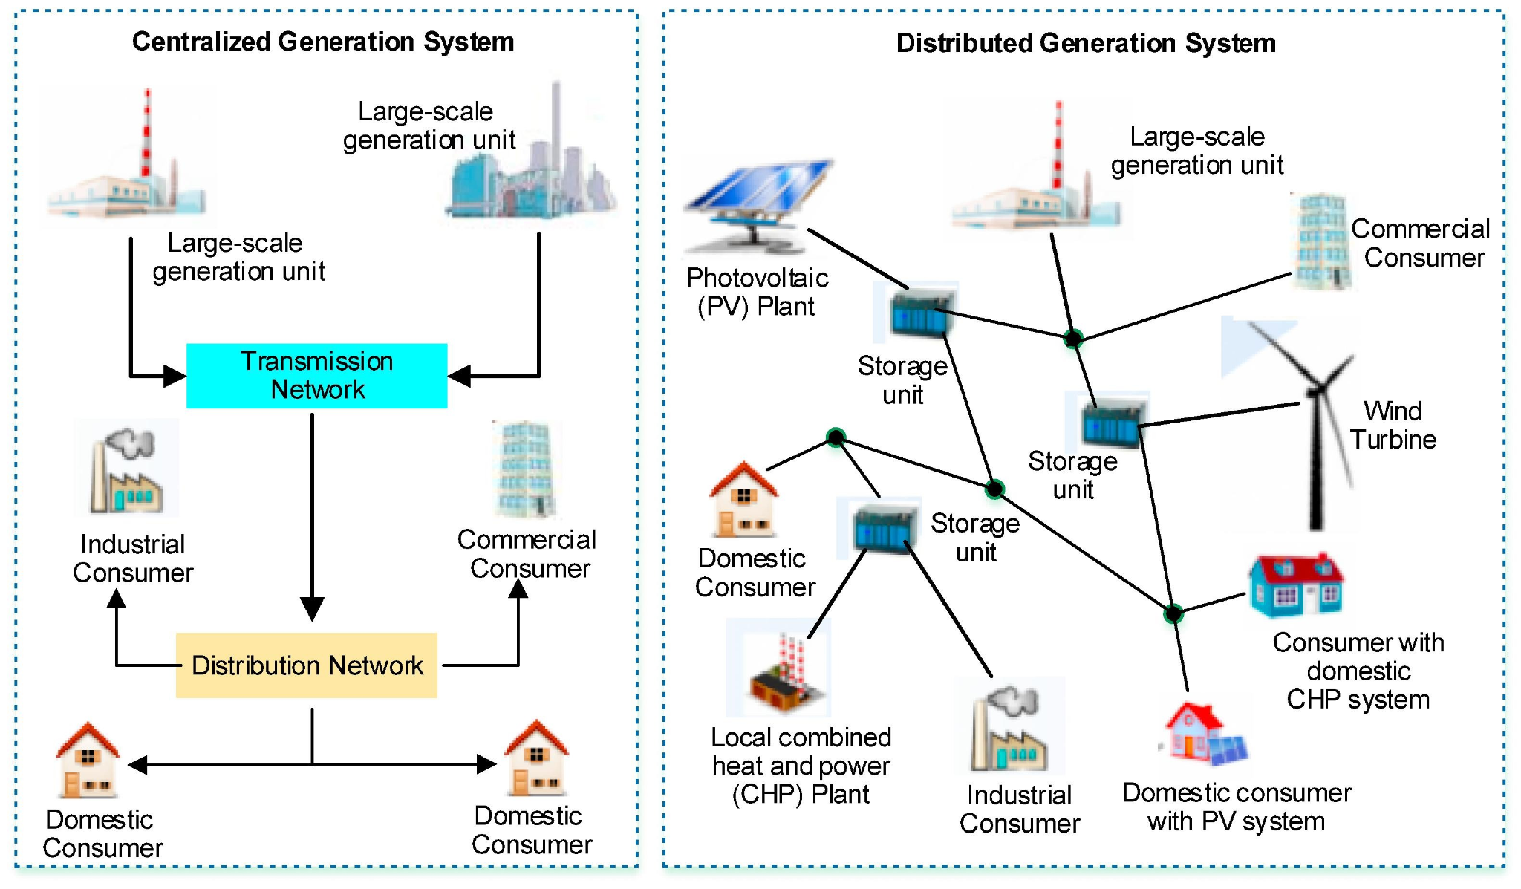
Distributed Generation
Source: Ali Ehsan, Qiang Yang

Slide 16
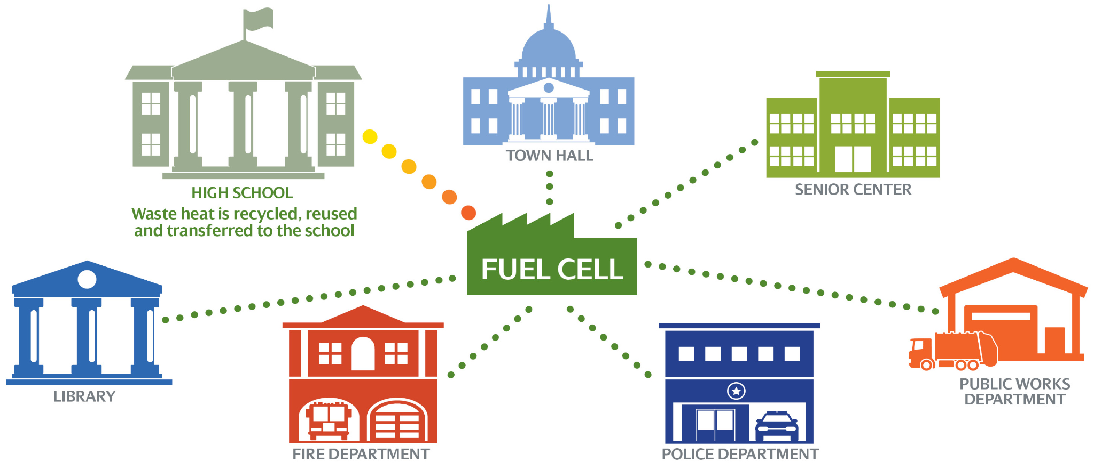
Microgrids
Source: AVANGRID

Slide 17



Culebra Resilience Study (2016) - NREL and EPA
Research team identified locations for solar to power critical infrastructure with renewable energy microgrid system
Analysis found a hybrid microgrid system to be economically viable
Community Foundation of Puerto Rico used findings to apply for EDA grant
Construction to begin early 2022

Slide 18
Considerations
Modernization of grid for reliability and the integration of renewables
Distributed energy solutions and microgrids for critical infrastructure
Wind-proofed mounting of solar, hurricane shutters for panels, and removable solar
Wind turbines designed to withstand hurricane conditions
Shortened review processes to streamline permitting and environmental review for renewable energy development
Increased solar cell and battery recycling facilities
Rebates or tax incentives for homeowners

