Slide 1
Software for Sustainable Cities:
Data management tools to help communities
Serena & Eddie

Slide 2


Power-D.City
Page

Slide 3
Our Agenda For Today
How to understand utility data
Machine Learning & AI
Power-D. City and others
Case Study
Conclusion
Page

Slide 4
How to understand utility data?

Slide 5
Utility Data Request Template
Aggregation Level
by sector (residential, commercial, industrial, municipal) by rate code(small/med/large/commercial) individual meters
Geographic Region
City Town County Diagram/GIS file
Fuel Type
Gas Electronic Oil Propane
Page
Notes:
Background
[Name of community] is requesting energy use data from [utility name] to support their community energy planning needs. This data will be requested at regular intervals, and this document describes the desired content and format for the data that is returned.
Utility Name
[name of company]
Utility Contact:
[name, email, phone number, etc.]

Slide 6
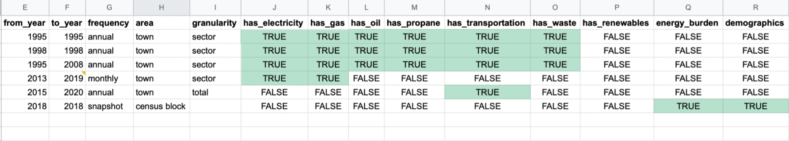
Sample Data Tracker for Brookline, MA
Page

Slide 7
Machine Learning & AI in
Energy Consumption Predictions

Slide 8

Why Using Machine Learning to Manage Energy Data
While working with Power-D City, we have some challenges, and ML helps us through the process…
Too many unneeded columns, some rows have missing informations
Using Python to quickly drop the unneeded columns and auto-fill the missing values
1
Unnecessary Categorical Variables
2
Re-evaluating
Page

Slide 9
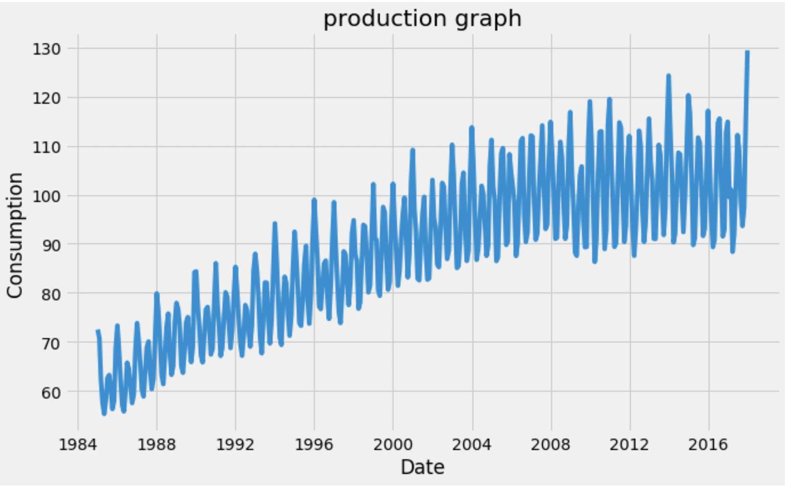
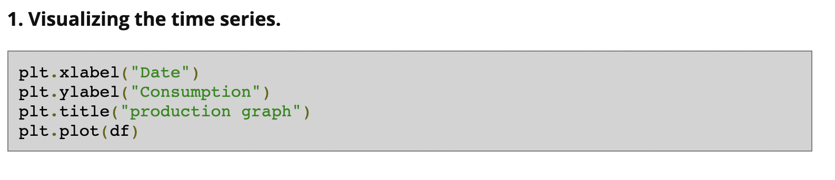
Accurately Predicting and Forecasting Energy Consumption Can Help Communities Track the Goals Better
Benefit of using python to load the energy data
Handle Large Data Volume
Effectively Process Data with Built-in Functions
Page

Slide 10
Power D City and Others

Slide 11

Power-D City
Open-Source Community Energy Dashboard
  Help Community turn energy data into action plans
    Train university students as Community Energy Fellows
    Creating a comprehensive CO2 inventory using energy utility data
    Using a community engagement process to select actions that will meet their goals
    Tracking Progress against their goals by automatically updating the CO2 inventory
Page

Slide 12

ICLEI
Fighting environmental pollution for the UN
Platform they use:
  Free Based Services
  Clear Path
Page

Slide 13

SIMAP
Accounting platform for campuses in universities
Create baseline for universities to keep track of their performances
Page

Slide 14
Case study

Slide 15
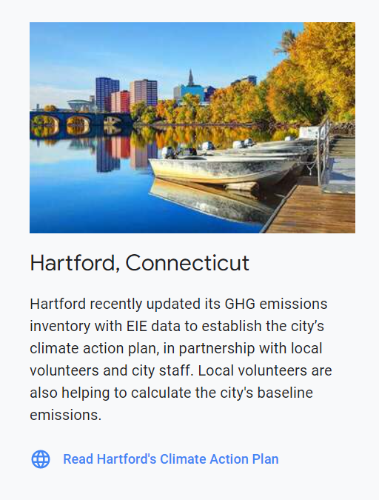
Hartford, CT
Focuses on:
  to increase environmental stewardship, efficiency, and reliability
  to advance commerce and industry citywide
  to guide decisions of the EID
Notes:
https://hartfordclimate.files.wordpress.com/2019/11/eid-comprehensive-plan-final-112119-for-website.pdf#page=6

Slide 16
Conclusion

Slide 17
Questions?

