Slide 1
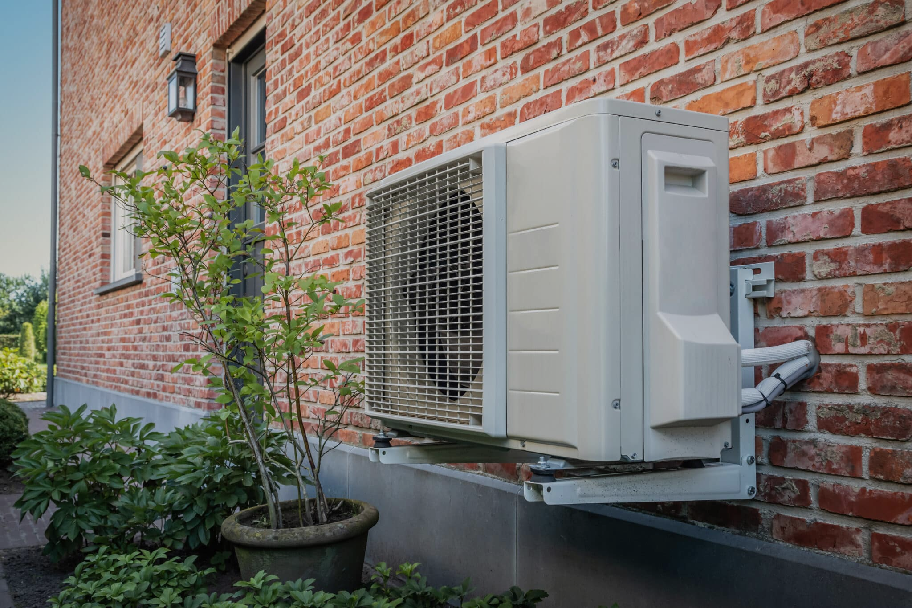
Helping DHCD Evaluate the Installation of Heat-Pumps in Local Housing Authorities
Saahithi Achanta
EE545 - Professor Reibstein

Slide 2
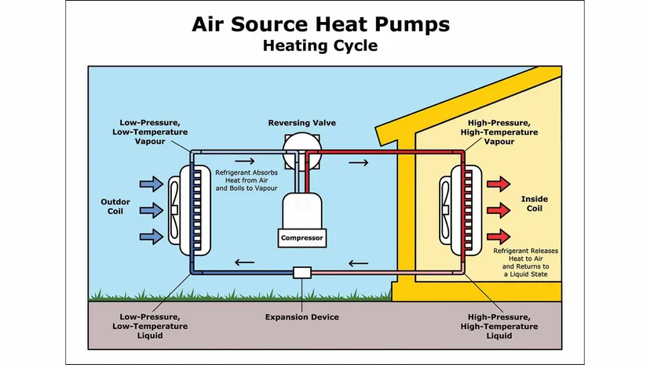
What are Heat Pumps?
Air-source heat pumps pull air from outside and vary the temperature to be warm or cold
Transfers heat instead of burning fuel, more sustainable and only one unit
“The city’s estimated 10,000 units in public housing, which the mayor also pledged will be entirely free of fossil fuels — new and older buildings — by 2030” Boston Globe, 2023

Slide 3
Department of Housing and Community Development (DHCD)
What does the DHCD do?
Installation Cost
Goals to Achieve
Energy use reduction and sustainable sources of energy
Work with MA’s Local Housing Authorities (LHAs)
DHCD uses LEAN and MassSaves to bring installation cost to $0
Originally can cost $6K-$18K
LHAs are responsible for maintenance costs
Struggling to learn the needs of LHAs
Strapped for resources and staff
Competing against non-renewable utility companies

Slide 4
What do you want LHAs to know?
Meeting with the DHCD
Heat pumps can work even in cold environments
Large concern for LHAs is the efficiency of heat pumps. DHCD gave examples of heat pump units working successfully in Maine, Eastern Europe, and more
Maintenance costs are an issue, but what can be done to help?
DHCD offers training for staff to learn about the units, but LHAs find it hard to compromise on the average of $300 spent per month on maintenance
Do LHAs care about sustainability and climate change?
DHCD is pushing for renewable substitutions, but LHAs are still using existing utilities though they are considered out of date and heat pumps offer many subsidies

Slide 5
LHAs - Maintenance Cost
Winchendon, Quincy, Hingham, Marshfield
Staff
Condensate
Accessibility
Life Cycle Cost
Need staff for each unit, must go in themselves regularly
Moisture buildup is risky, condensation gets stuck in the fan
Tenants themselves would need training, <25% would do it
LHAs do not believe the unit costs as they are sold to believe
Monthly, 6 months, and annual check ups
Slime builds up in machines when not treated regularly
Unexpected costs for repair & replacement is not communicated
Many units house elderly or disabled people or families

Slide 6
Heat Pump Experience in Cold Weather
 | Hybrid: Heat Pump with Backup Gas Furnaces | Snowstorm caused 200 heat pumps to overwhelm & short circuit, including backup furnaces (end of cycle use) Engineers in DHCD recommended hybrid
 | What Should be Improved | Instead of using new and existing tech to split efficiency, LHAs would be eager to use heat pumps when all the kinks are out Also happened for fully heat pump system Happy with the unit during summer

Slide 7
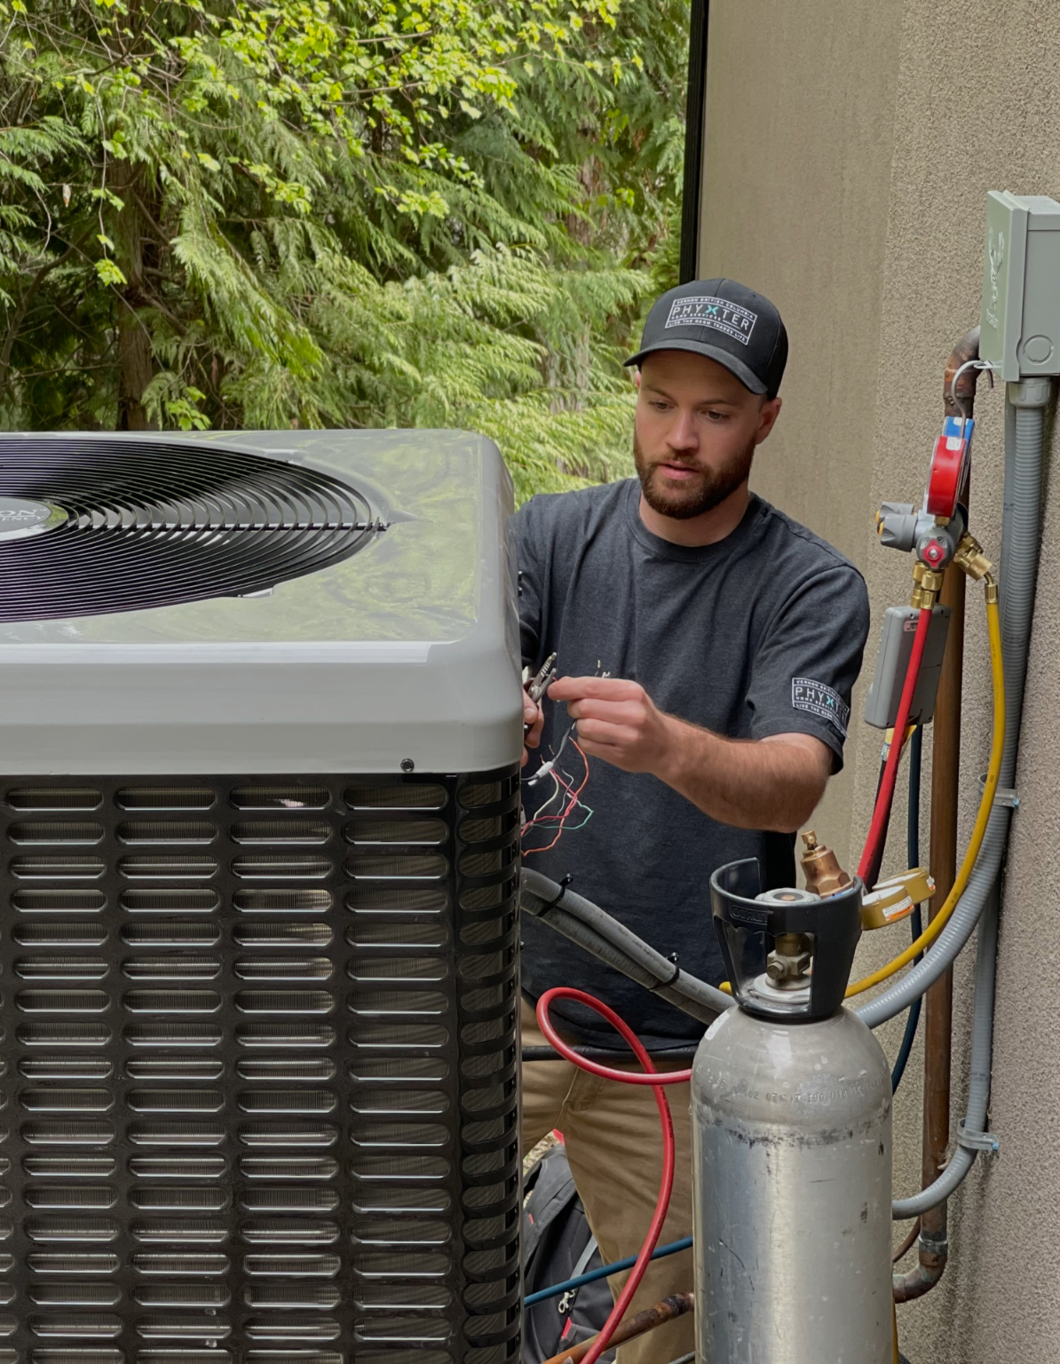
LHA Concerns
DHCD does not understand full cost
If they should incur maintenance cost, they need more training, staff and budget expansion which is not provided
LHAs do care about sustainability
Climate resilience and energy efficiency is a new standard for LHAs, but the current heat pumps and tech are not fitting needs
What should be improved
Need more training and staff expansion
Transparency about life cycle cost
Need heat pumps that can actually weather the cold
General tech and efficiency of heat pump units to avoid so much breakdown and repair

Slide 8
Takeaways:
DHCD Goals:
Heat Pump Goals:
Account for maintenance costs when targeting new subsidies instead of just installation
Expand training programs and accessibility for staff
Make subsidies for more resistant heat pump units
Need to be more innovative with technology to avoid the regular maintenance checks
LHAs are waiting for units that do not have such high life cycle costs
Avoiding condensation, replacement, and repair

