Slide 1
Helping Legislators Get Support for Their Bills To Curb Lead Poisoning
Aubrey Hoes and Hannah Waskelis
EE 538

Slide 2

Severity of the lead issue
Decrease in test scores due to low blood level (Aizer et. al, 2018)
Focus on children under six
  Representative Eldridge’s bill to change terms for inclusivity
Landlord lead abatement programs
  Representative Velis’ proposed bill to
Notes:
A study conducted in Rhode Island found that even a low level of lead concentration in blood in young children can affect test scores
Much discourse surrounding lead poisoning tends to focus on children under the age of 6, however, this tends to leave out the dangers from bioaccumulation in adults
Efforts to shift this narrative that lead poisoning is only a danger to children have begun in MA legislation with Representative Eldridge’s introduction of a bill to change a piece of legislation regarding abatement of accessible structural materials containing lead with the term “premises in which a child under the age of six resides” and replacing it with the line “rental property”
A large contributor to difficulties in advancements in removal has been inadequate funds for landlords to abate
Representative Velis presented an act to establish a lead poisoning prevention trust fund to curb discrimination against families by funding removal (with household incomes of up to 100% of area median)
In addition to roadblocks and limiting language in legislation, MA does not have a discovery rule, meaning that in order to receive aid for lead poisoning you must exhibit symptoms of a direct tie between harm and lead contamination
This is problematic because lead poisoning can take years to display symptoms

Slide 3


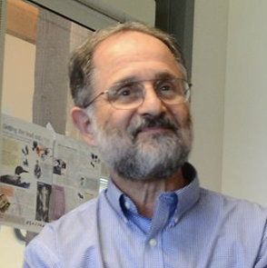

Our Project
Organized an event at the statehouse
Conducted research on legislative gaps
Interviewed field experts
Compiled information for distribution
Established connections with orgs, action groups
Elana Brochin, Program Director
MACDC
Mark Pokras, DVM
Tufts University
Jessica Reyes, Professor
Amherst College
Notes:
For our project this semester, we worked to organize a public event at the MA statehouse to promote legislation regarding lead poisoning abatement
We compiled an information packet with research on lead poisoning, current legislation, and where efforts for the future should be directed using examples from other states

Slide 4
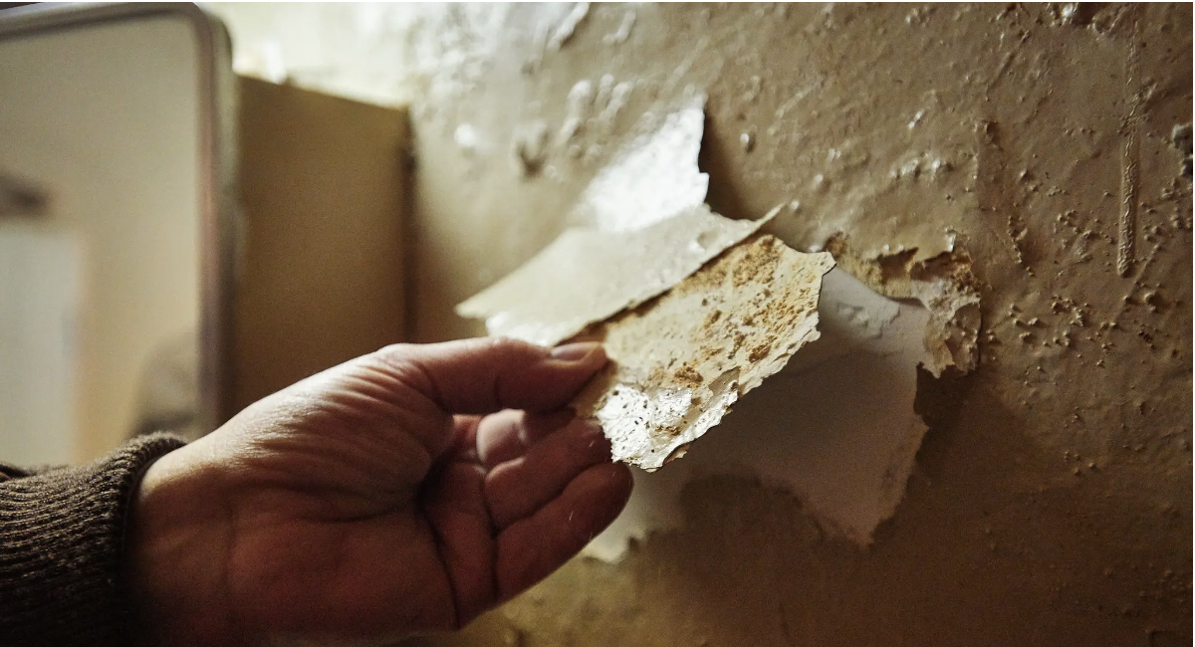
Topic Areas
Lead in munitions and shooting ranges
Wildlife
Schools and childcare facilities
Lead in housing units
  Paint, plumbing, water service lines
Notes:
LEAD IN MUNITIONS INFO
WILDLIFE INFO
Schools and childcare facilities require a lot of attention in the lead issue
Proposed bills have aimed to expand education on lead poisoning and looking at unconventional materials, such as jewelry, toys, and other goods
Lead in housing units is where must attention is focused, primarily for housing units where children under the age of 6 reside

Slide 5
Potential Solutions
Providing access to resources to get funding for lead removal
  National Center for Healthy Housing (NCHH) website providing resources for individuals to get funding to remove lead in their homes
  Environmental Protection Agency website gives useful information in finding funding for lead service line replacement
  HUD Lead-Hazard Control Grant Program website
    Provided $403,761,572 in 2022 to provide families with grants to remove lead (prioritizing low-income households with children under six)
Education on the dangers of lead poisoning
  Representative Hawkins presented a bill (S.260) regarding expansion of elementary and secondary education on climate justice, including lead poisoning
  Representative Peisch presented a bill (H.2248), which includes new consumer goods. Like pottery and jewelry, to the list of educational/publicity programs

Slide 6

Takeaways
Importance of lead abatement
Difficulty in seeking assistance (financial and labor) in removing lead
Massachusetts, once leading the country, lacks crucial lead legislation
Full extent of lead danger has not been politically realized
Change is difficult
Notes:
In our project, we learned a lot about the many forms lead can take besides lead paint and water pipelines
We found that there was not much active legislation that helps homeowners and landlords get compensated for lead abatement
As a result, discrimination against families persists in rental housing units, rather than encouraging lead removal in all units
Additionally, lead removal requires specialized skills and training in safe practices of working with lead, so finding people with these skills is difficult and can put other untrained workers at high risk

Slide 7
References:
Aizer, Anna, Janet Currie, Peter Simon, and Patrick Vivier. 2018. "Do Low Levels of Blood Lead Reduce Children's Future Test Scores?" American Economic Journal: Applied Economics, 10 (1): 307-41. DOI: 10.1257/app.20160404
Massachusetts Legislature. Bills & laws. (n.d.). Retrieved April 24, 2023, from https://malegislature.gov/Bills
Environmental Protection Agency. (n.d.). Success Stories for HUC in Massachusetts. EPA Healthy Urban Communities in New England. Retrieved April 24, 2023, from https://www.epa.gov/newenglandhc/success-stories-huc-massachusetts
Financial help for home repairs. National Center for Healthy Housing. (n.d.). Retrieved April 24, 2023, from
https://nchh.org/resources/financing-and-funding/financial-help-for-home-repairs/
FY 2022 lead hazard reduction grant program. U.S. Department of Housing and Urban Development (HUD). (n.d.). Retrieved April 24, 2023, from https://www.hud.gov/program_offices/spm/gmomgmt/grantsinfo/fundingopps/fy22lhr

Slide 8
Image Citations:
Ferré-sadurní, Luis. “11,168 Children Tested Positive for Lead. the City Didn't Inspect the Homes.” The New York Times, 26 Sept. 2019, https://www.nytimes.com/2019/09/26/nyregion/nyc-lead-exposure.html.
Jessica Wolpaw Reyes. Harvard Stone Program in Wealth Distribution, Inequality, and Social Policy, https://inequality.hks.harvard.edu/people/jessica-wolpaw-reyes.
Mark Pokras, D.V.M. Cummings School of Veterinary Medicine, Tufts University, https://vet.tufts.edu/people/staff/mark-pokras-dvm.
“Elana Brochin .” Linkedin, https://www.linkedin.com/in/elana-brochin-910b2821.

