Slide 1


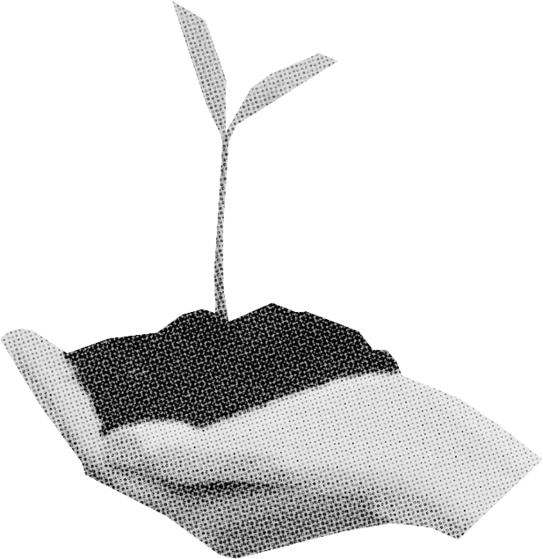
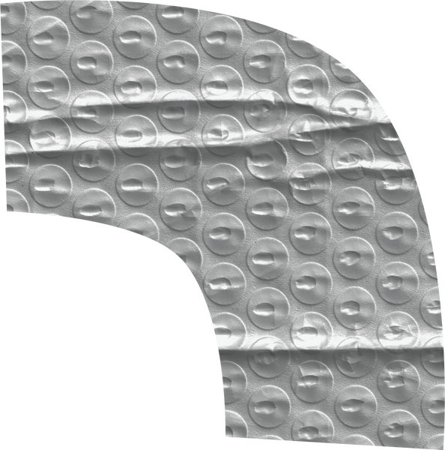
CAS EE 538 project
katherine chang

Slide 2
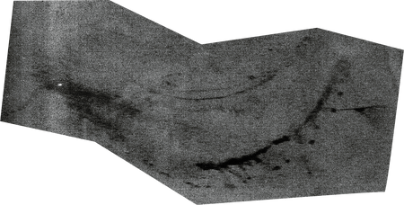

the project
Proposed solutions for a school in Greater LA to help alleviate urban heat islands & its’ impact on young students through solar canopies & cooling pavements

Slide 3
research
Urban Heat Island:
occurs when a city experiences much warmer temperatures than nearby rural areas due to how well surfaces in each environment absorb and hold heat.
Greater LA is a prime example of an urban heat island where cities and suburbs are woven with concrete and asphalt that lead to warmer temperatures than nearby rural areas
Overall, the heat island effect makes the city of LA almost 6 degrees hotter than the surrounding desert
This added heat stress can be really dangerous during heat waves, especially at schools where kids are constantly outdoors.

Slide 4

research cont.
Specifically in California, many students can’t take refuge since they attend campuses with more cement than greenery.
The simple fact that a child’s core is closer to the ground because they are shorter puts them at a greater risk.
Where kids play - whether its on grass and asphalt or rubber and artificial turf - has a big impact on heat exposure.
With synthetic surfaces, it creates microclimates that are similar to tiny heat islands within the heat island of the greater urban area

Slide 5
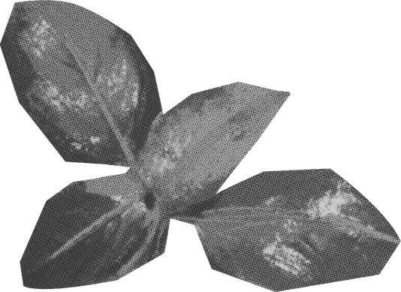
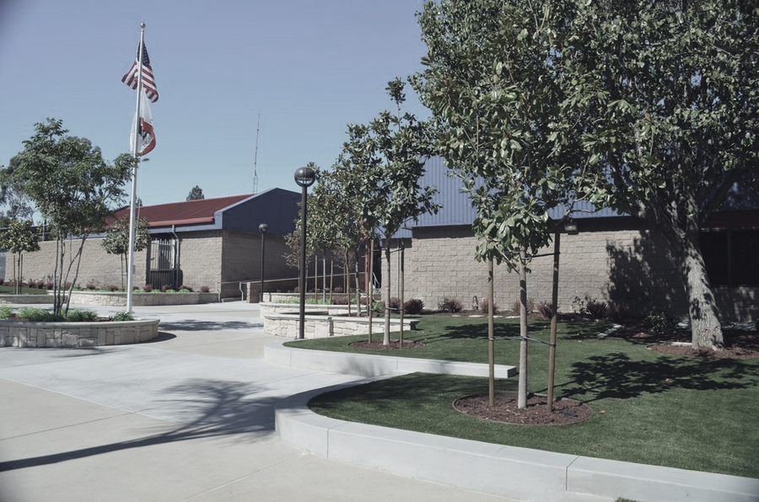
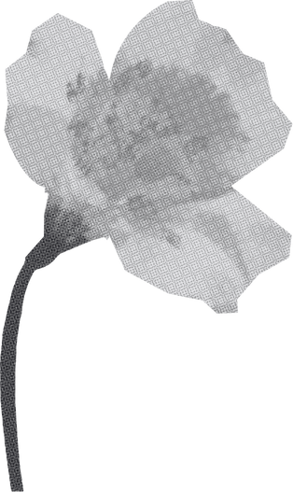
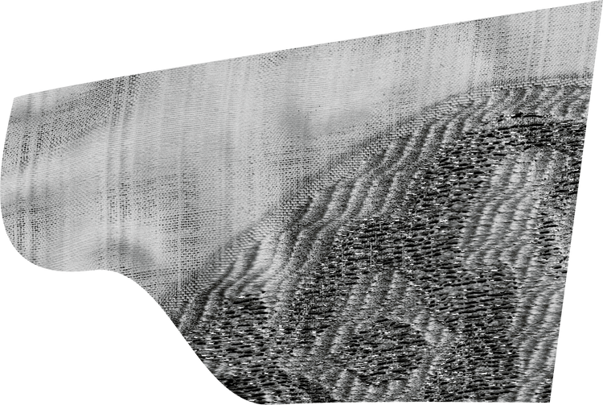
maple hill elementary
1
Location: Diamond Bar, CA
Student Body: 500
Average High: 91 F in August & 88 F in September
3

Slide 6
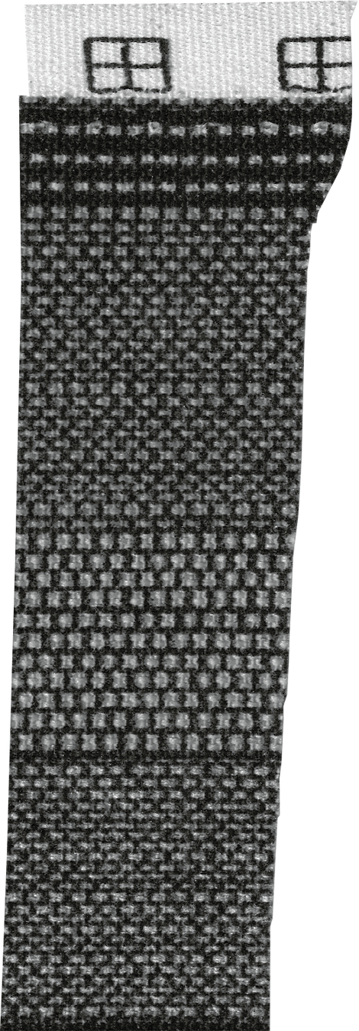
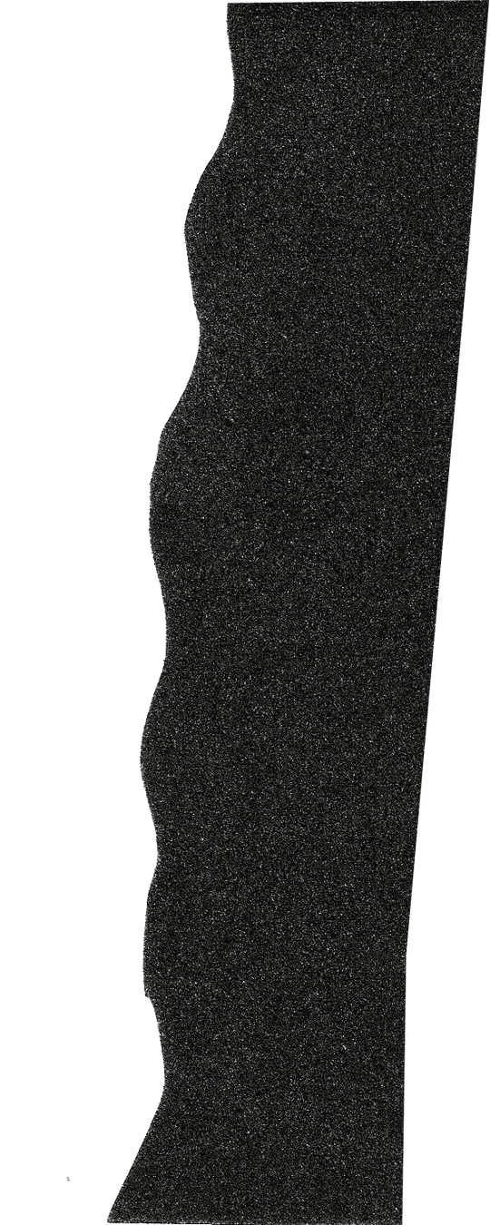

solutions
solar canopies & cooling pavements

Slide 7

solar
canopies
BENEFITS
  protect students from the heat in the summer and rain in the winter
  reduce cost of energy
  great way to teach students about solar energy
COST ESTIMATE:
$38k for one solar canopy

Slide 8
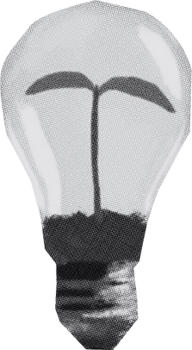

cooling
pavement
COST ESTIMATE:
$33k to cover 6600 sq yds
what it is
cooling pavements are light colored coverings that is made up of light colored pigments and a nano engineered concrete.
lower surface temperature
avoided air conditioning costs
Cooling pavements have the opportunity to lower surface temperatures 10.5 to 12 degrees lower than traditional asphalt
Even with a one degree reduction, schools can save tons of money in avoided air conditioning costs

Slide 9


cost effective alternatives
cooling pavements
solar canopies
add more areas with grass or encourage students to play on grassy areas during heat waves
planting more trees and/or regular canopies to provide as shade for students

Slide 10

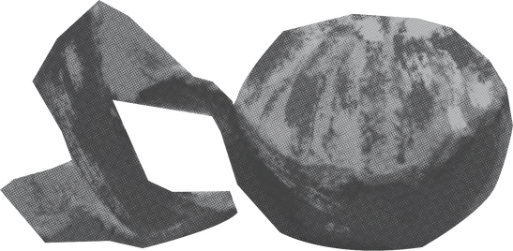
Questions and Discussion
We invite your questions, thoughts, and ideas.

