Slide 1
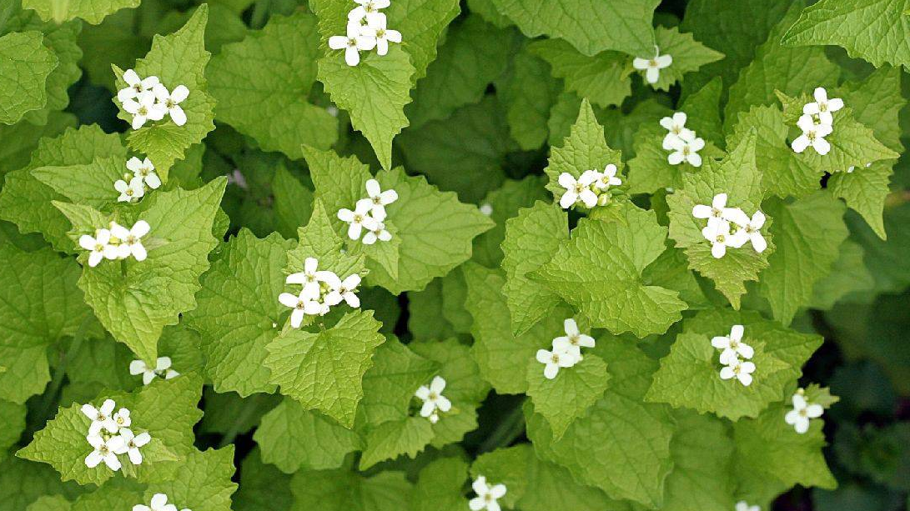
How Towns Can Act on Invasives
Presented by Yihong (Ethan) Xiao
Notes:
https://nyis.info/invasive_species/garlic-mustard/

Slide 2
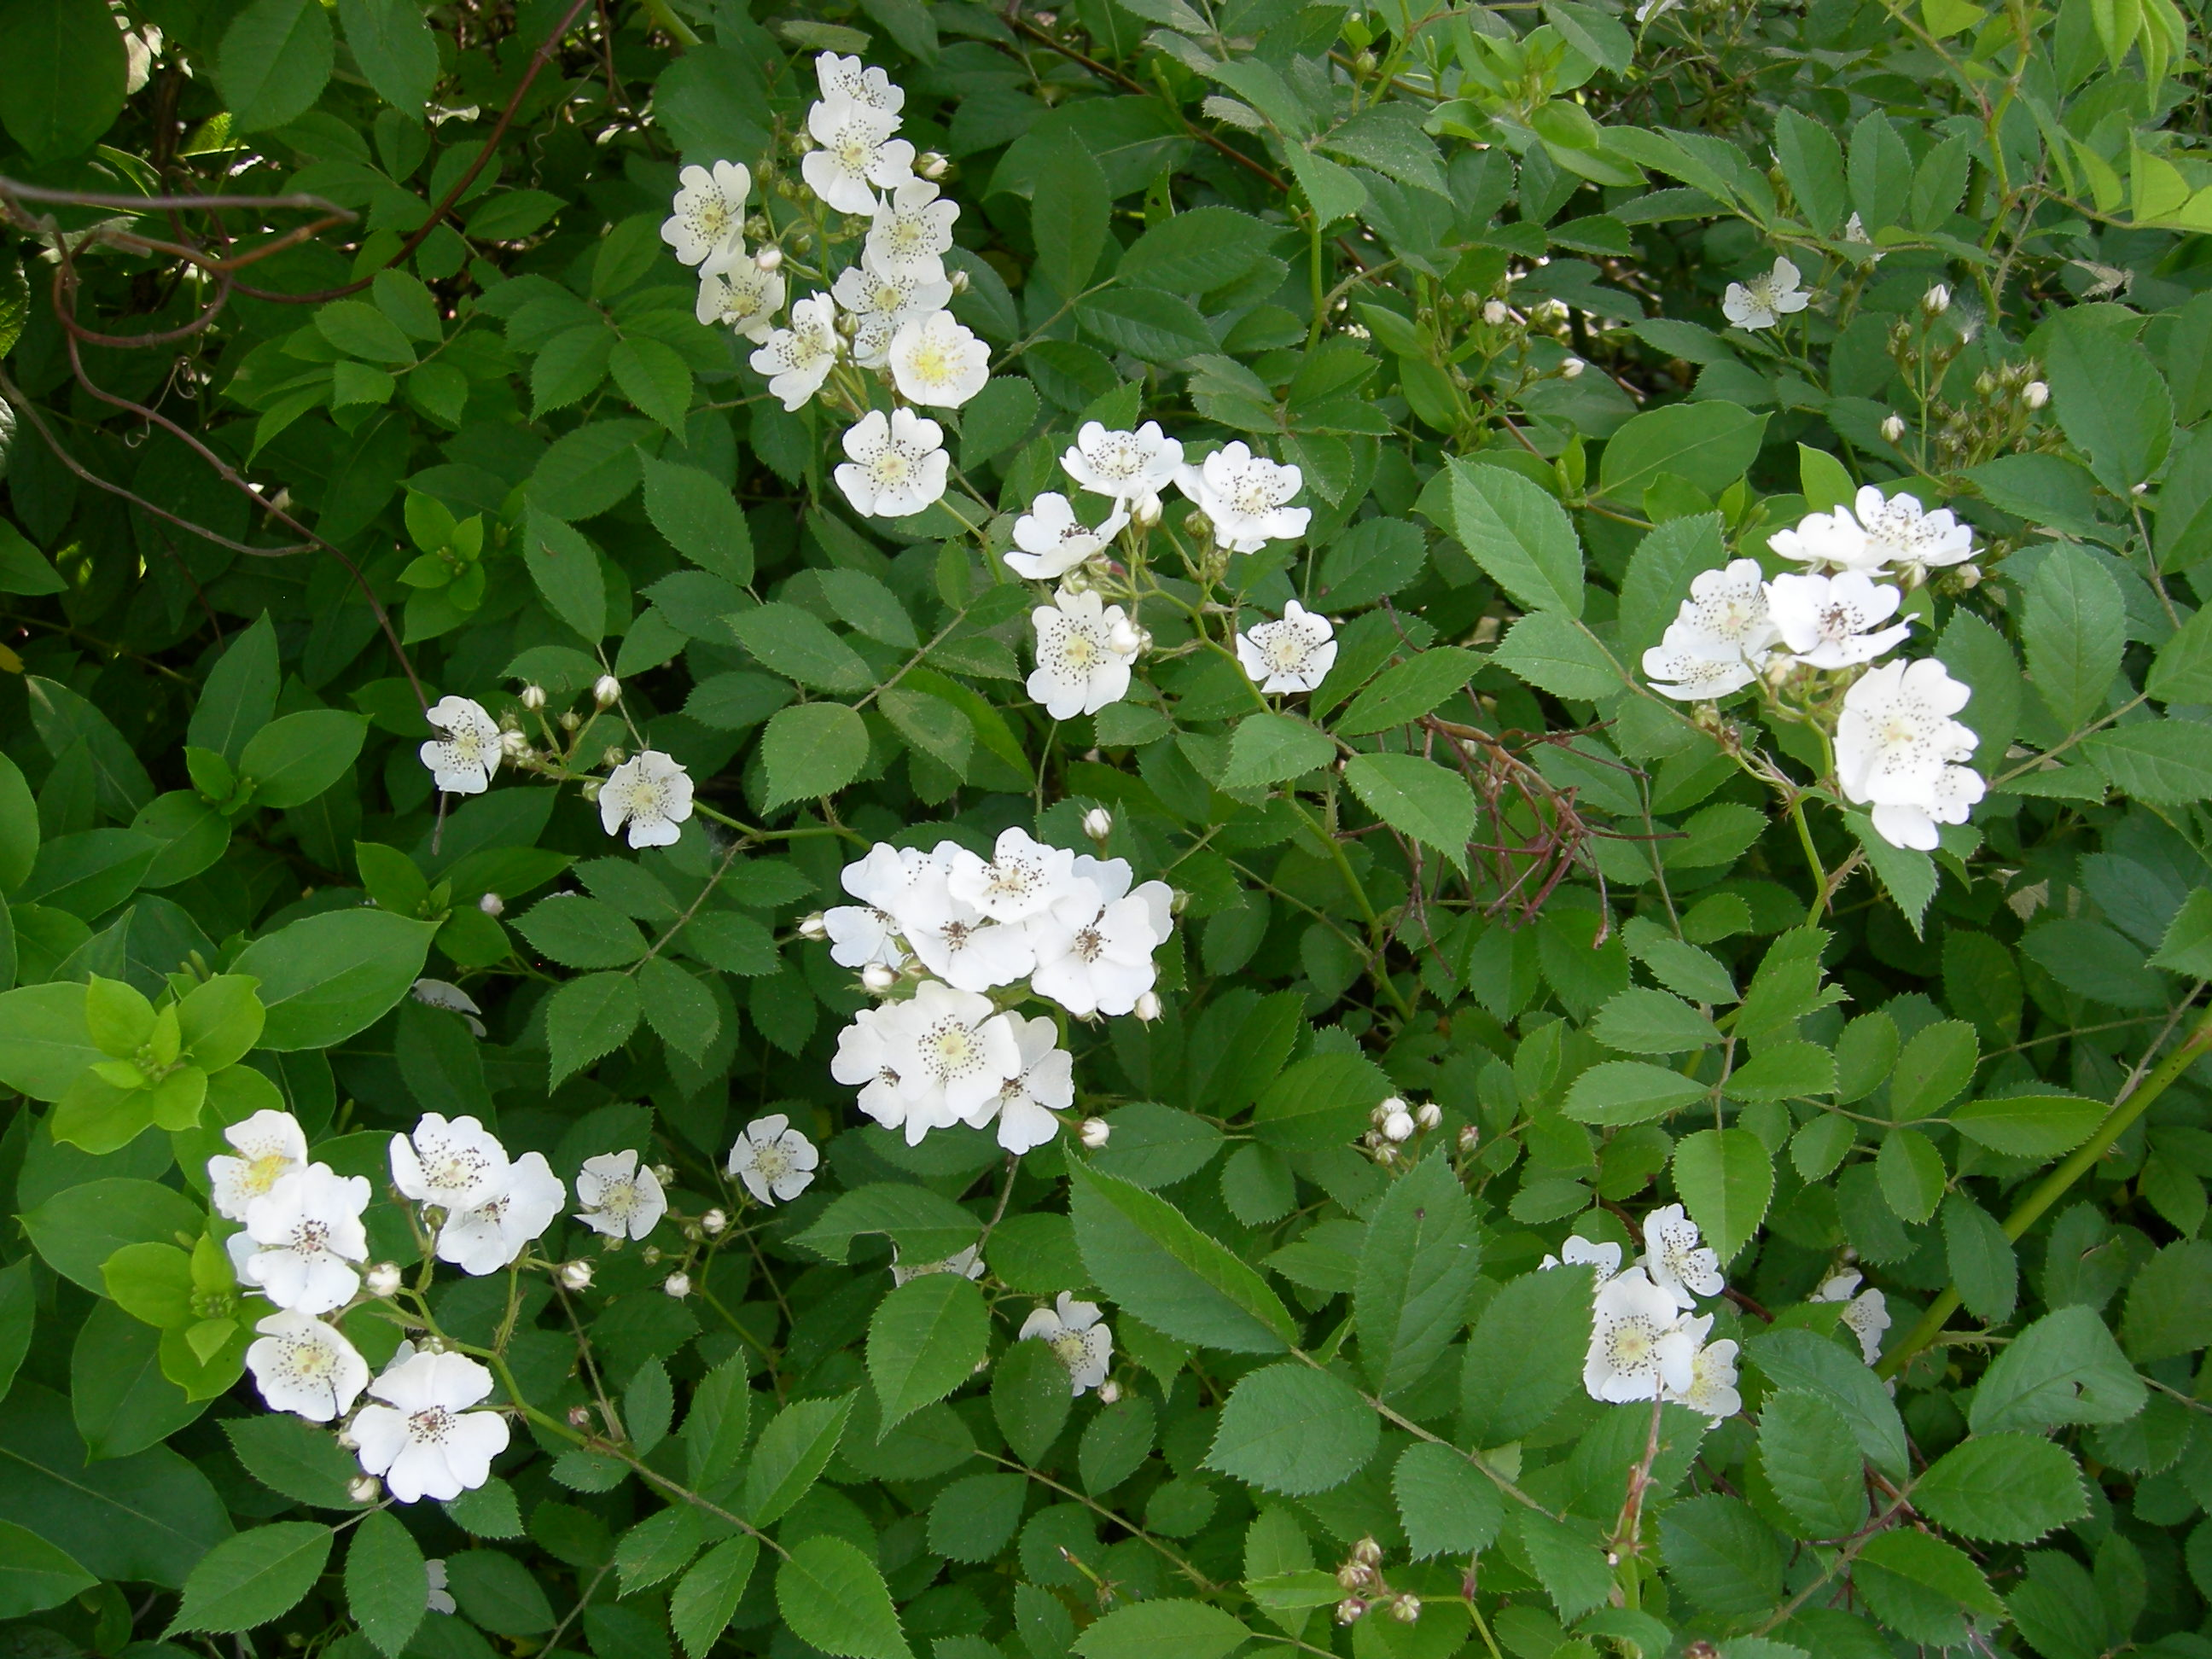
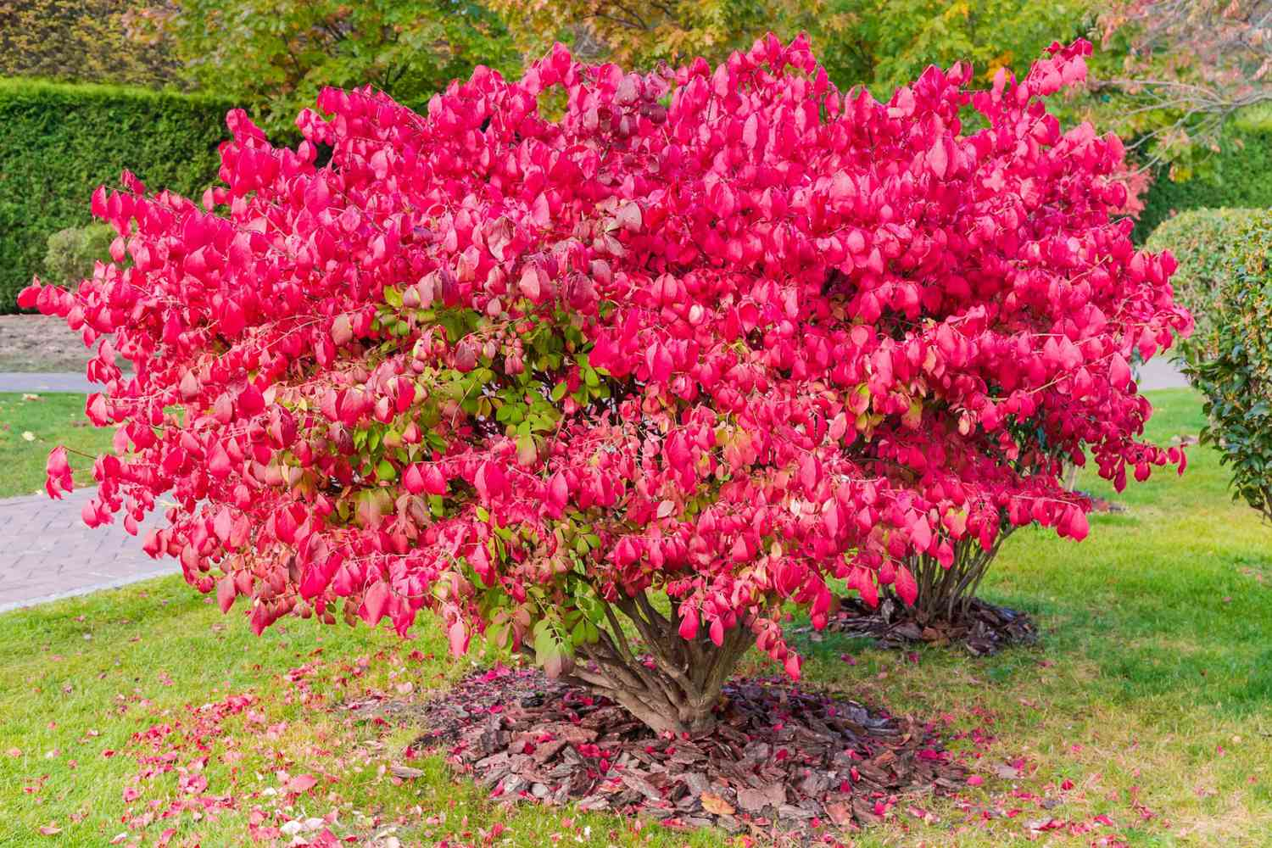
What are Invasive Species?
An invasive species is an organism that is not indigenous, or native, to a particular area.
Not all non-native species are invasive.
To be invasive, a species must adapt to the new area easily. It must reproduce quickly. It must harm property, the economy, or the native plants and animals of the region.
Notes:
https://education.nationalgeographic.org/resource/invasive-species/
https://www.southernliving.com/garden/shrubs/burning-bush-invasive-species

Slide 3

What are the Harms of Invasive Plants?
Reduced Biodiversity:
  Invasive species disrupt ecosystems, leading to habitat loss and food source depletion for various animals.
Habitat Reduction:
  Invasive plants like Japanese knotweed diminish habitat, affecting shade, hindering tree growth, and impacting fish populations.
Tree Canopy Decline:
  Invasive species contribute to falling trees and harm young trees by eliminating essential soil fungi.
  Increased Fire Risk:
  Climbing vines and dense invasive plant patches escalate wildfire risk, making them harder to control.
Notes:
https://www.eurokidsindia.com/blog/how-we-can-explain-biodiversity-to-children.php

Slide 4
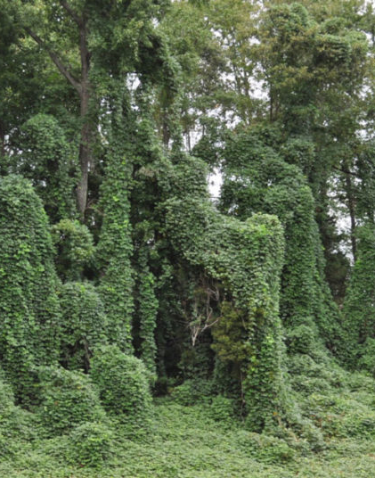
What are the Harms of Invasive Plants?
Damage to Buildings and Aesthetic Values:
  Invasive plants demand resource-intensive removal efforts, impacting infrastructure and increasing financial burdens on cities and consumers.
  Time Consuming in Removal:
    Some invasive species are especially aggressive and demand a lot more time and effort to keep them under control

Slide 5

Why is it Important to People?
A landscape with overgrown invasive plants would harm:
  Property Value
  Aesthetic Value of Garden
  Local Ecosystem and Increase Environmental Risk

Slide 6

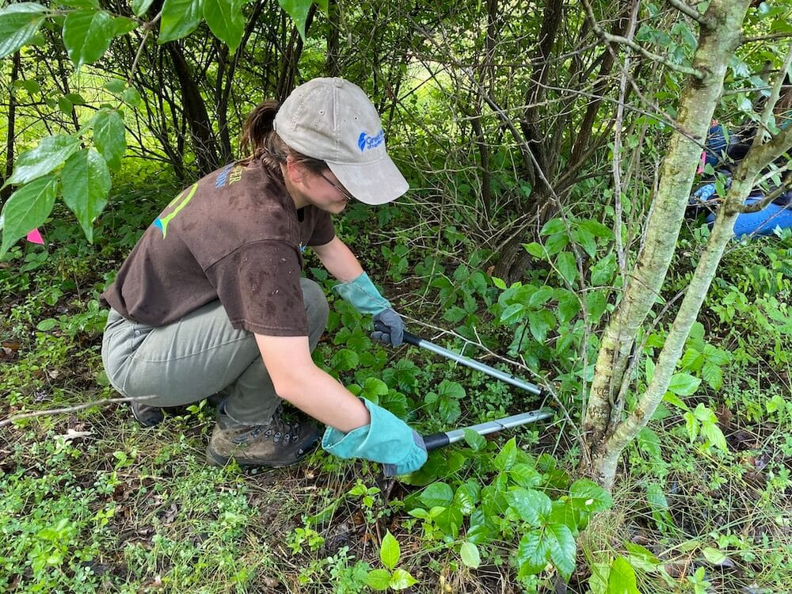
Strategies to Deal with Invasive Plants
Towns should establish a commission and hire professional personnels to target invasive plants
  Either full-time or part-time for the Invasive Plants Specialist
  Reachable through email, walk-in, or phone call
  Works on species ID, guidance and support on the removal, and other related questions
  Design and Implement Field works for invasive plants removal
  Works on educating the public through media and posters
Notes:
https://mrhillmusings.com/2022/04/24/eight-benefits-of-being-a-specialist-teacher/
https://ohioriverfdn.org/habitat-restoration/invasive-species-removal/

Slide 7


Strategy 2
Form the Town, A Public-Oriented Campaign to Educate and Encourage People to Act:
  Stakeholders (Conservation Division) should establish Invasive Species Stewardship programs to target invasive plants
  The Program would recruit volunteers to work on removal of invasive plants, assist educational programs, and help distribution of materials that would educate others about it after learning about invasive plants
  Volunteers can be warm-hearted people, high school students, middle school students, Scout members, and people from the Chapel, etc. (Count towards volunteer service hours)
  Moreover, the specialist will lead the program to provide assistance if needed

Slide 8
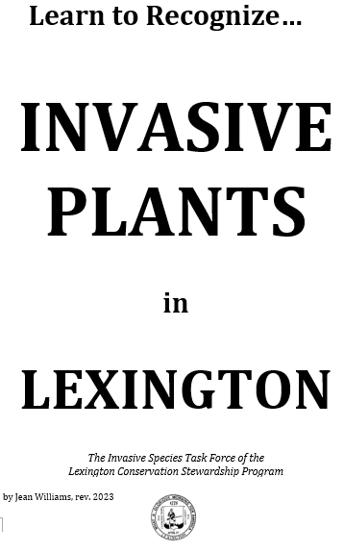
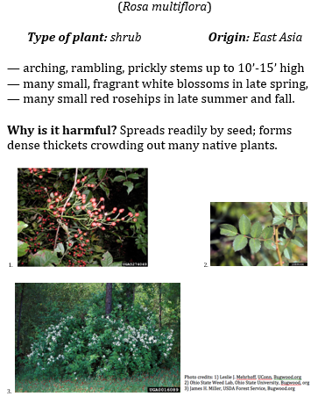
Strategy 3
The Town Should Allocate Resources for Production and Promotion of Invasive Plants ID Guide
  The Conservation Department of a town should fund the creation of invasive species ID guide
    Guide should include category (shrub vs. vine), name, picture, characteristics, seasonality, and specific guide on removal
  If funds are not sufficient, adjacent regions can create one collectively
  Funds should also be used for distribution of the guide, online through media, social media; and offline through production and distribution of posters and flyers
  Illustration on the Left: Invasive Plants in Lexington: The Invasive Species Task Force of the Lexington Conservation Steward Program by Jean Williams

Slide 9
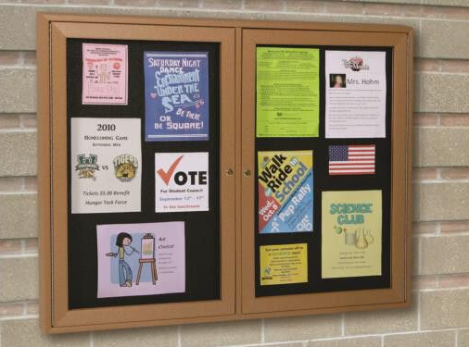

Strategy 4
The Town’s Should Work on Broadcasting the Harm of Invasive Species and Promote Removal of it:
  On bulletin board, local newspaper, social media account of the town, the harm of invasive species and the urgency of removal should be addressed
  The recruitment of the Stewardship program and access to invasive species ID guide should also be mentioned
    Any feedback or advice for the Program and the author of the pamphlet should be encouraged

Slide 10

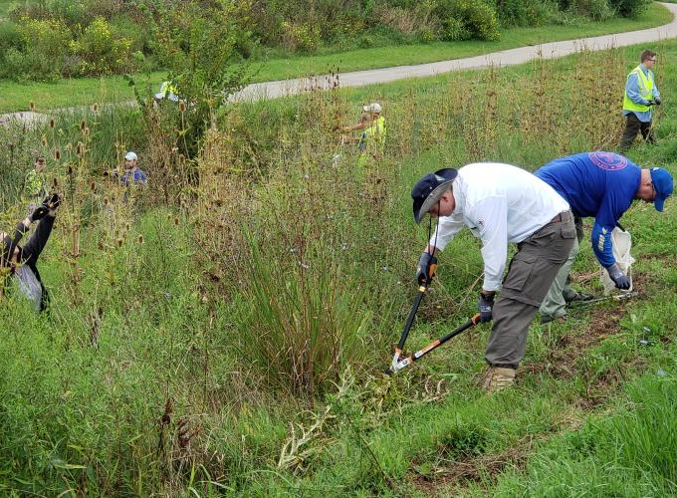
Strategy 5
Create Rules and By-Laws, and Enforce Them:
  At Town Meetings, rules or by-laws should be established about removal of invasive plants
  Rules and by-laws focused on the control of overgrown invasive species would be a relatively minimal effort by town staff because with only some enforcement a message would be sent
  There are only one or two dozen of the most dangerous invasive species to focus on
  With some plants, like bamboo, you can see it escaping and require containment
  Other plants, (garlic mustard) should be removed

Slide 11

Questions for the Audience
What other strategies do you think are effective and efficient in dealing with the problem of invasive plants?

Slide 12
Questions for the Audience
As a stakeholder and expert in this field, do you think invasive plants are an important issue to deal with in terms of its priority?
Honestly, are invasive species worth these efforts and our use of resources to deal with them?

