Slide 1


Sustainable Dennis Community App
Community App
Sustainable Dennis
By: Brad Ellis
Senior at Boston University studying Environmental Analysis and Policy

Slide 2
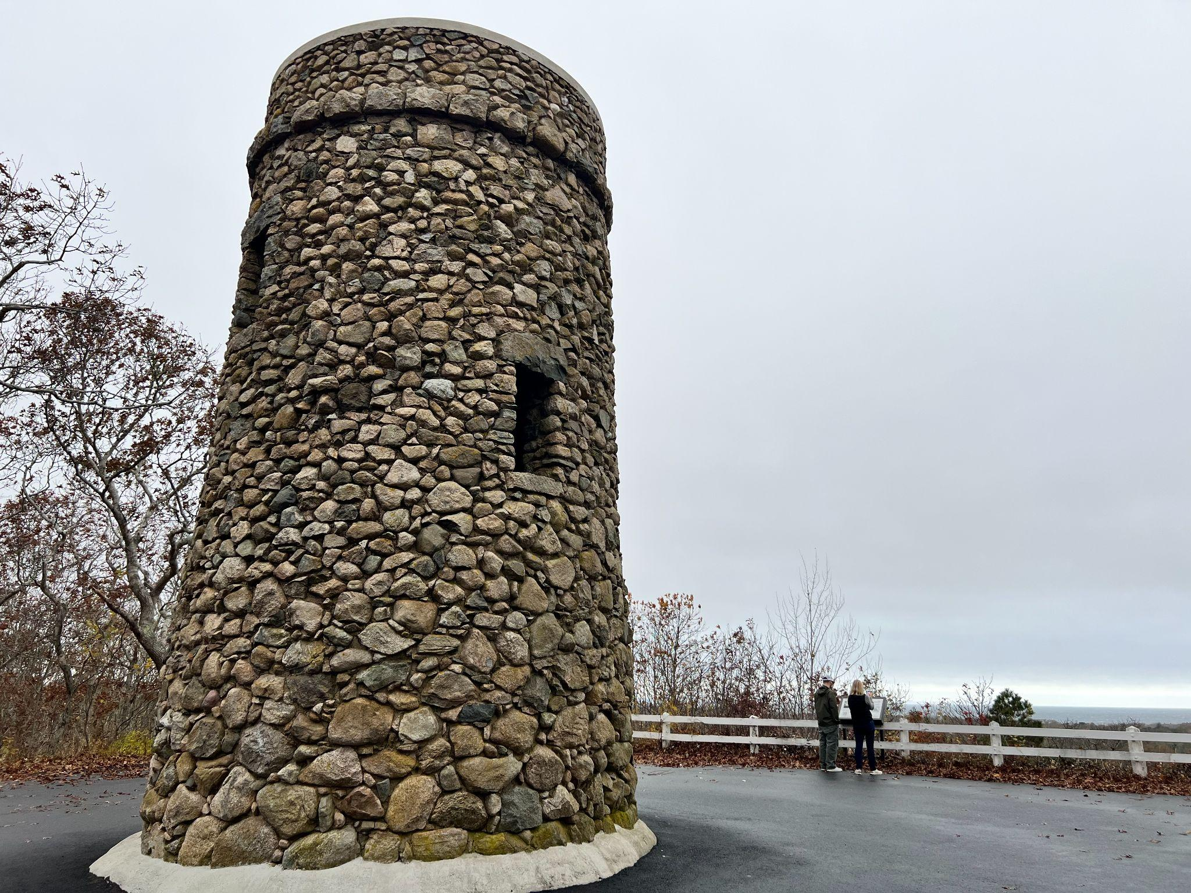
The Idea and its Objective
Design an app for citizens and visitors, with a map of Dennis that shows icons for:
  Public recycling, trash & composting receptacles
  Municipal properties
  Important landmarks & attractions
Drop-down menu giving information about how to and what can be recycled in Dennis
Ability to select & de-select which icons are visible. Users can enable notifications and alerts from the Town, about important community “happenings, eg.
  Hazardous waste collections
  New laws & regulations for solid waste
  Town meetings & elections
  Concerts & other entertainment

Slide 3


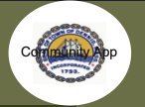
Sustainable Dennis Community App - Roadmap
Phase 1
Phase 2
Phase 3
Future
• Reviewed and approved by Dennis Public works
• Create icon design standards
• Dennis transfer stations and public recycling icons
• These locations will be beaches, parks, and other municipal properties
• Include SEMASS Incinerator/ its impact
• Review app concept with Chamber of Commerce
• Identify local students to work with and enlist school leadership to select and approve icons
This could best be done in a graphic design or art class
Students can also gather a fun fact about each icon they design
• Adding icons for business who help the community recycle old products
• Landmarks such as beaches, trails, and parks will have additional information regarding suggested activities nearby
Car chargers
Restaurants
etc
• Identify resources for continuing use after project hand off on Dec 12
• After Phase 3 the app will be fully designed
• Julie and her connections at the DPW will take lead and find a coder for the apps development
• Once icons are made the map can be updated to include new merchants
• Alert and notification capability for hazardous waste day, town meetings and other important events
• This app would require little maintenance once running
Community App
Sustainable Dennis

Slide 4
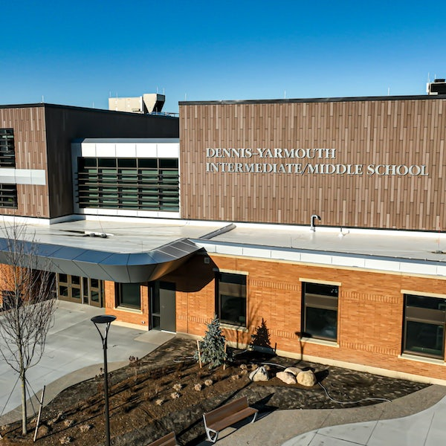
Engaging with the Community
Local high school students could design the icons for each attraction
  This is to both spread the word about the app, but to also involve the community in the app’s creation
Once the app has been downloaded, the Town of Dennis can use it as a means to advertise local community events though notifications
Managing and maintaining the app would require minimal effort while remaining effective due to our minimal and easy to use design

Slide 5

Working with Local Businesses
Merchants will have an opportunity to market digitally
  App users near SeaView Park can view app recommended local activities and restaurants
In creating Icons for local businesses who recycle goods we expect:
  Community members will have increased access to education on where to recycle goods
  Increased traffic to these businesses from both community members and visitors using the app

Slide 6
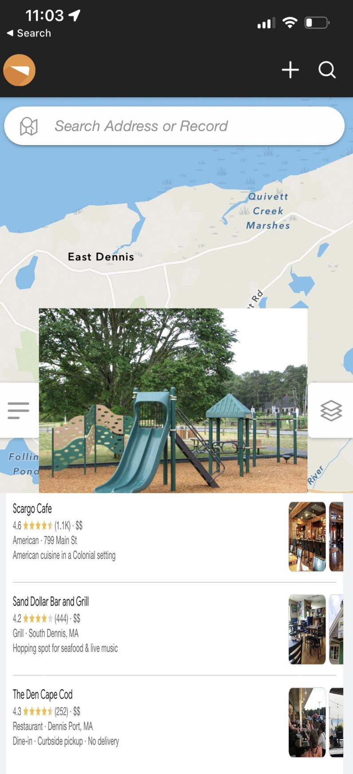

SeaView Park Recommendations Example
While in the app, the user will have the ability to select an icon to get information about the location and recommendations nearby
In this example, the SeaView Park was selected and restaurants are advertised
While this is only a mock-up using screenshots, information regarding each location should be included in the final app

Slide 7
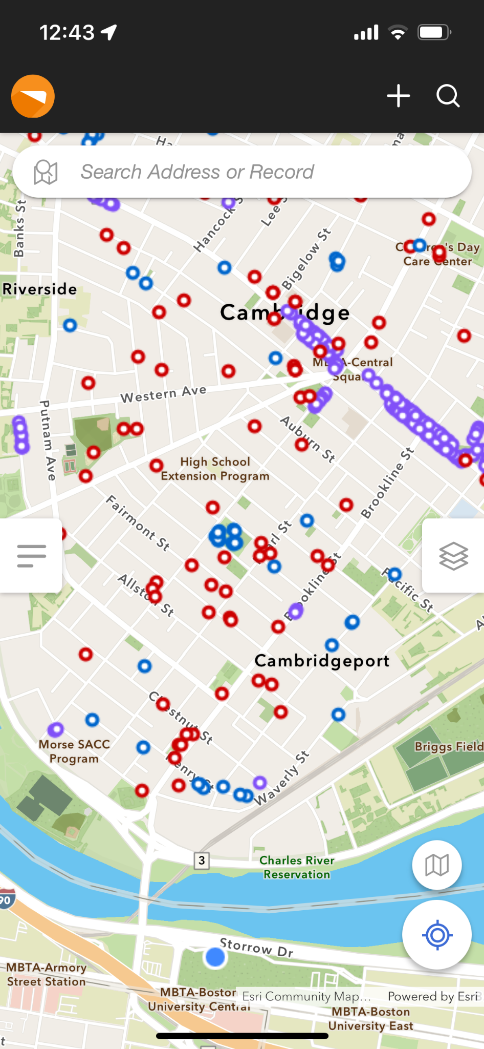
How will the map look?
This is a map of the city of Cambridge using the app CarteGraph One
While the city of Cambridge uses this app for their DPW, using a similar minimal interface with icons similar to emojis, the town of Dennis could make it more user friendly and available to the public
As seen in the bottom on the image, an icon could also be made to display the users location to help them navigate the town

Slide 8
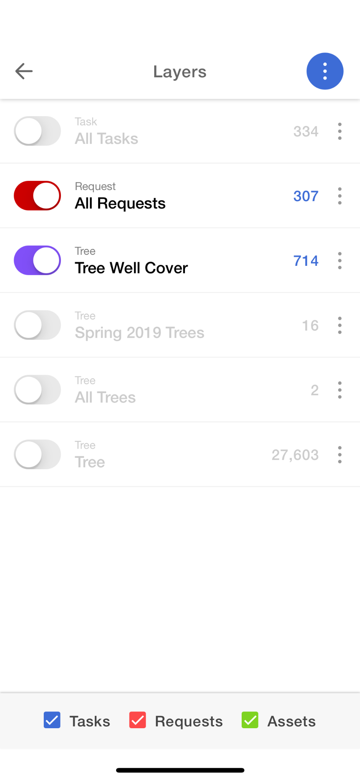
Too many icons?
Users will be given the opportunity to deselect unwanted icons to easily find what they are looking for
Using a minimalist design and an easy to find menu for deselecting icons, the app will focus on being both functional and easy to navigate
Providing an easy way to declutter the map and locate a point of interest, the app will be made to make it as easy as possible for users to find and go to an icon

Slide 9
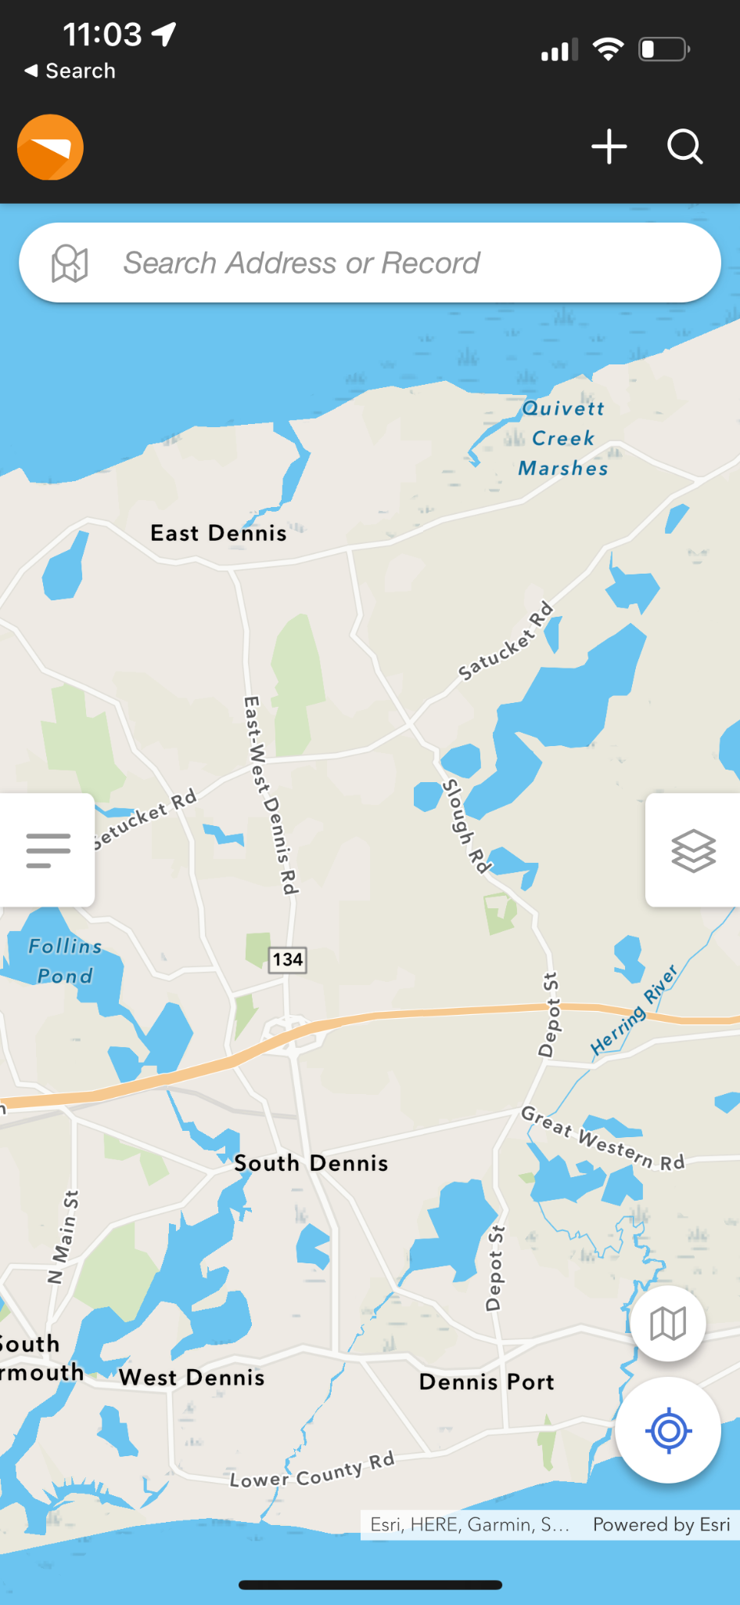
Anticipated Benefits from the App
DPW productivity boosts
Greater community education in Dennis
  Increased recycling
  Lower disposal costs & risks
  Increased conservation of natural resources by citizens visitors
Notifications & alerts
  Helps to keep public informed
  Increased participation in town events
While there are some of the expected benefits, we welcome your input!

Slide 10
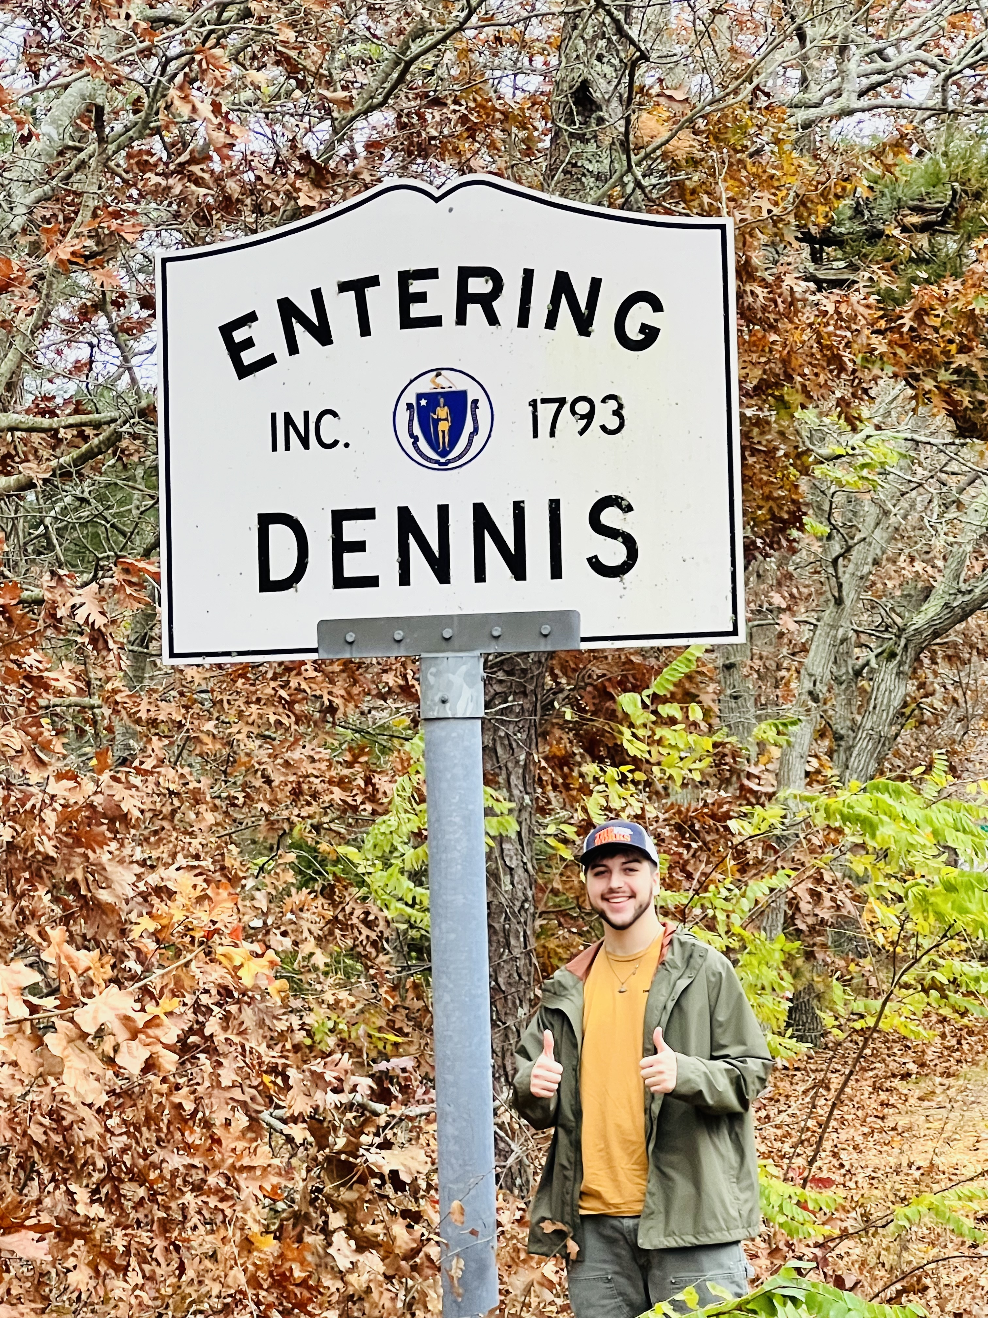
Questions?

