Slide 1

Boston University
EE538 Research for Environmental Agencies and Organizations
Professor Richard Reibstein
Fall 2023: December 04, 2023
REDESIGN OF A WEBSITE SEEKING TO RAISE CONSCIOUSNESS ABOUT LEAD POISONING
Ericka Osses Aravena

Slide 2
leadconversation.net
Focuses on raising awareness and preventing lead hazards in the population.
Goal
Renovate and update the website adapting it to current trends. Focusing on improving the aesthetics and organization of the site.
Features
  Inform and educate
  Raise awareness
  Promoting participation

Slide 3
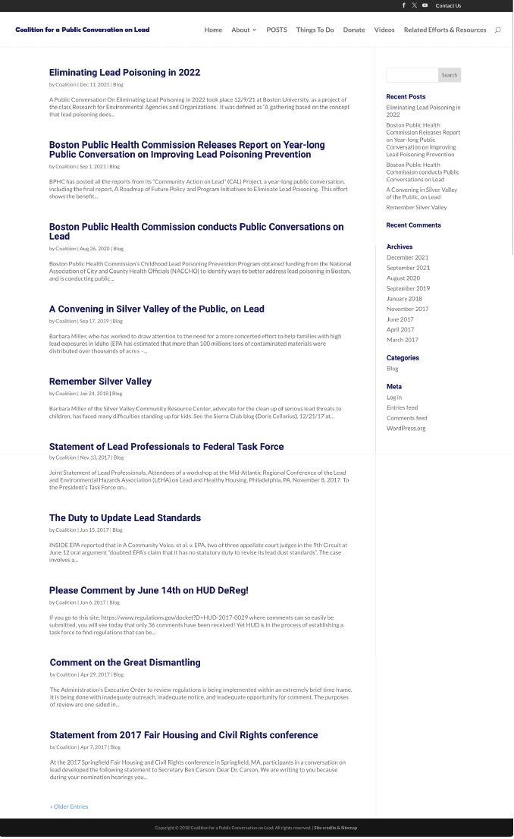
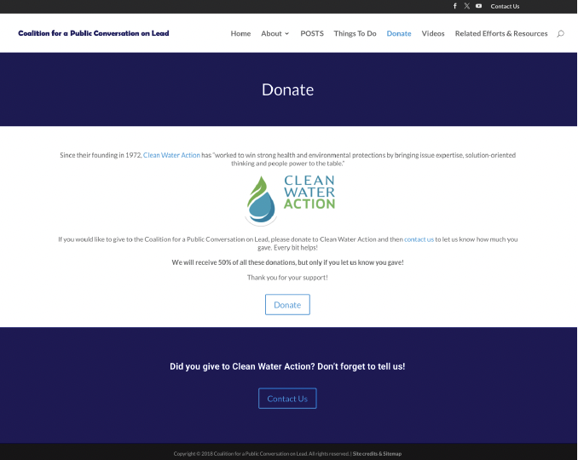
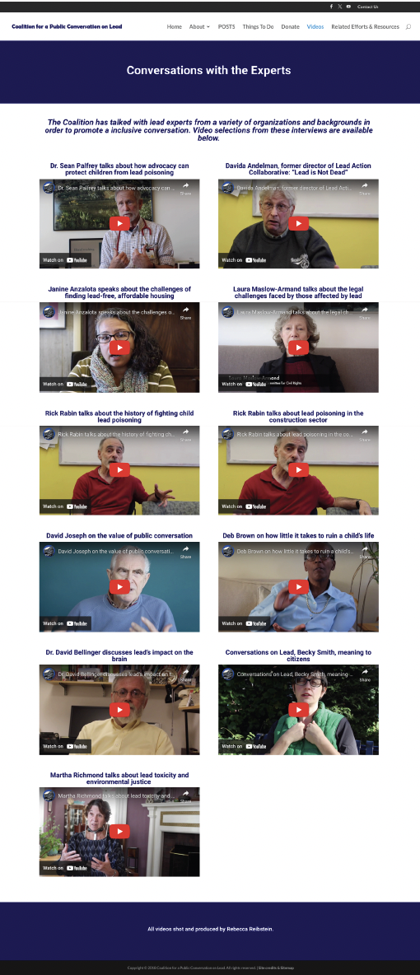
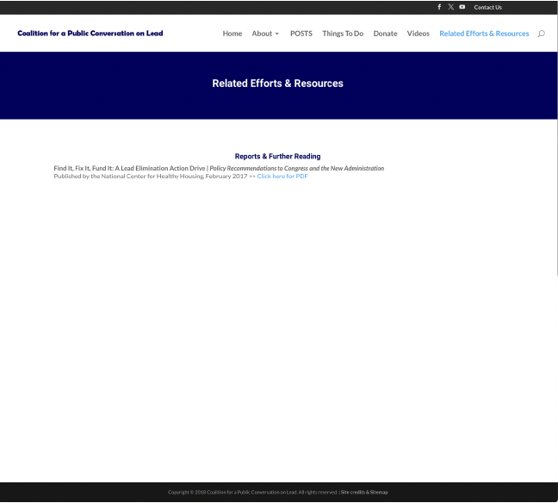
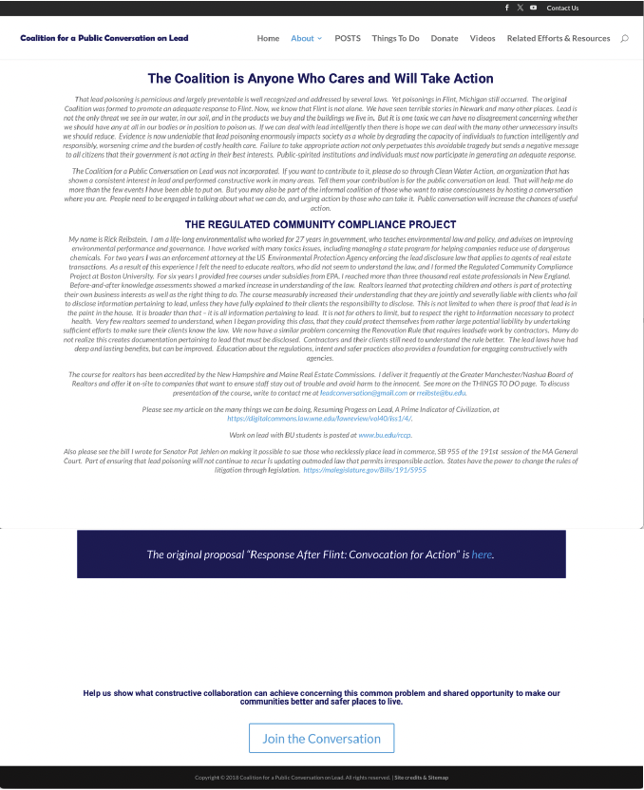
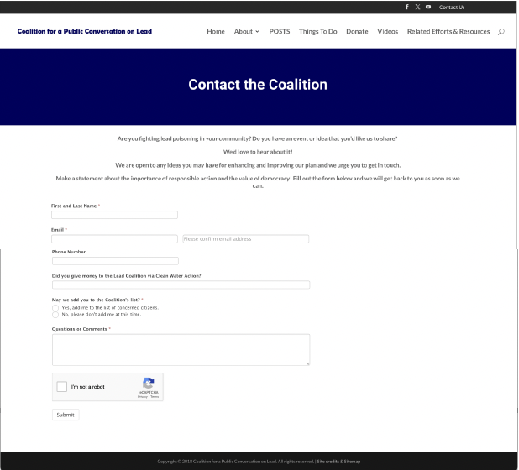
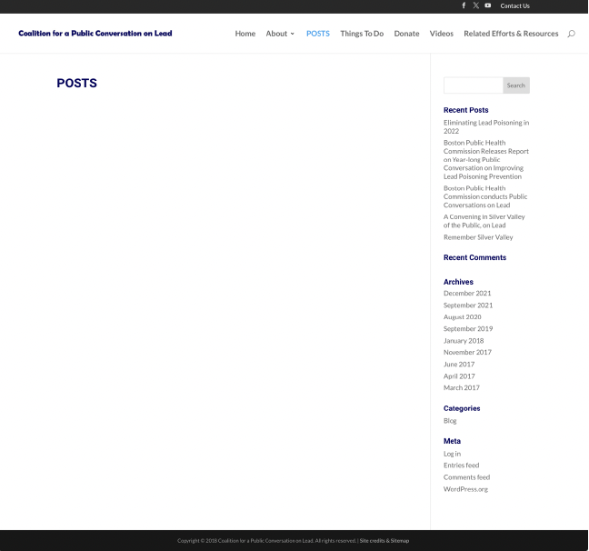
Suggestions
Incorporate visual elements (Images and colors).
Improve navigation (Simplify the structure and organization of the contents).

Slide 4
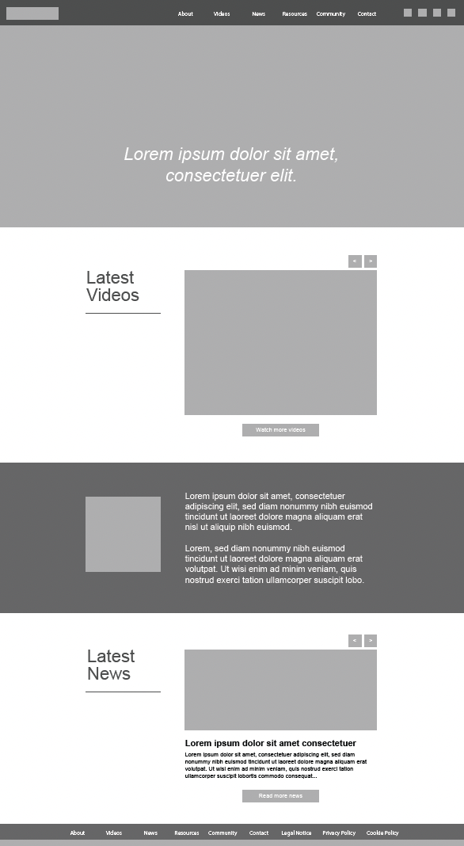
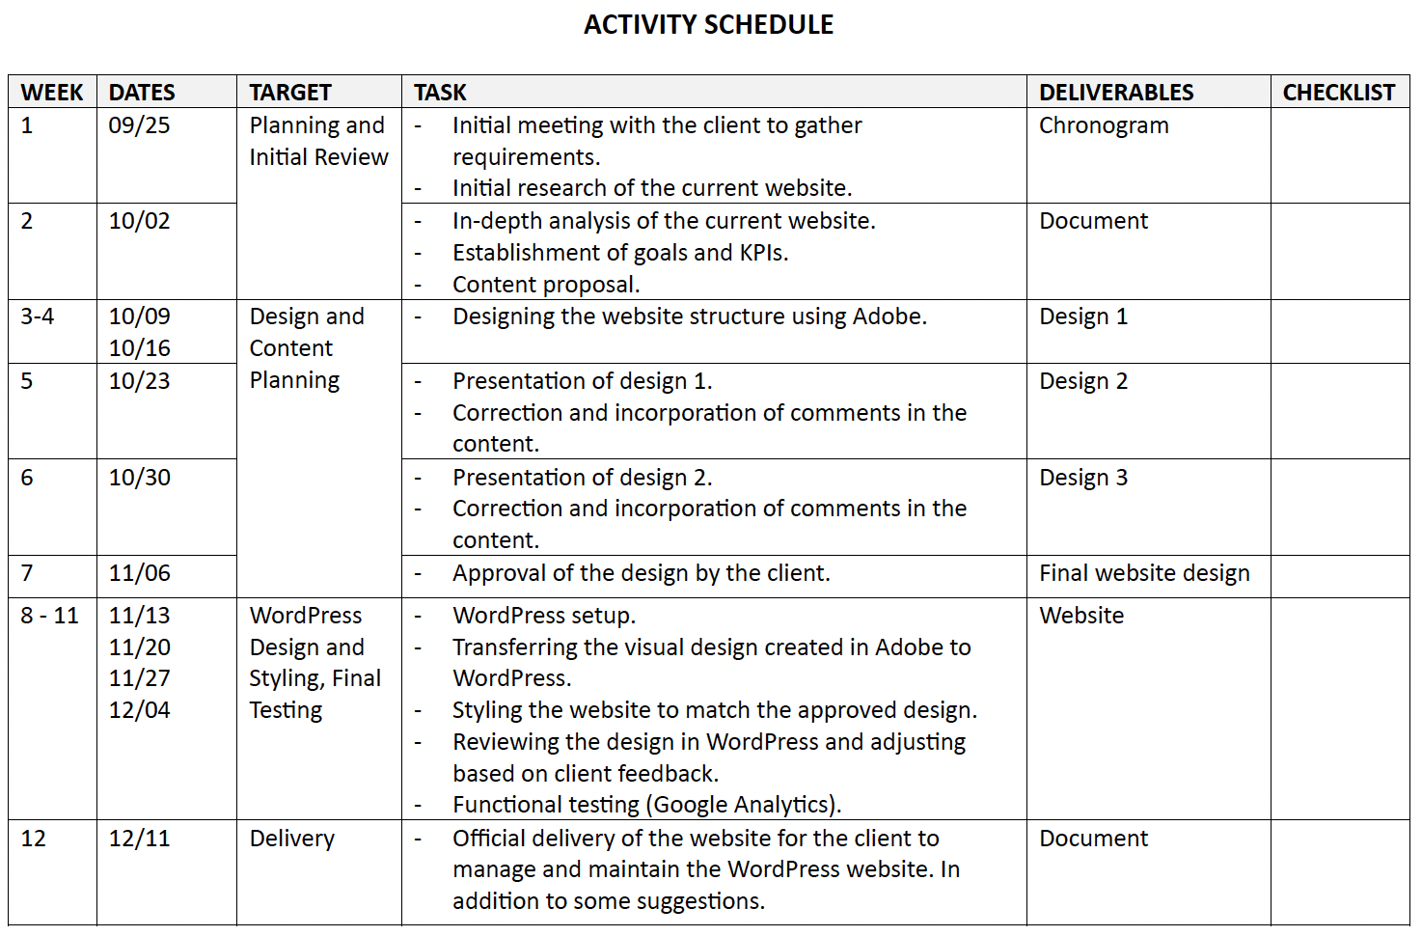
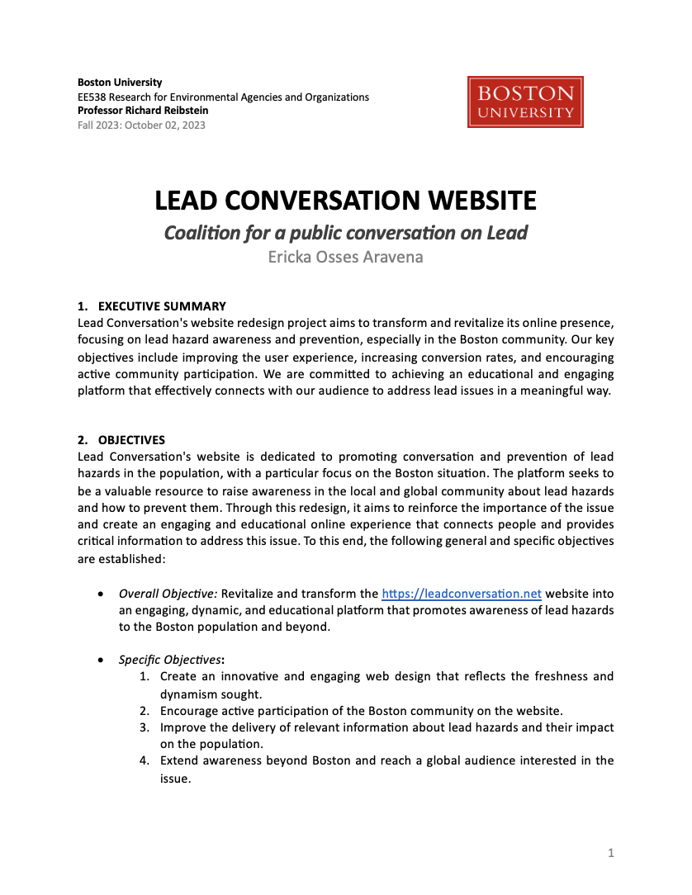
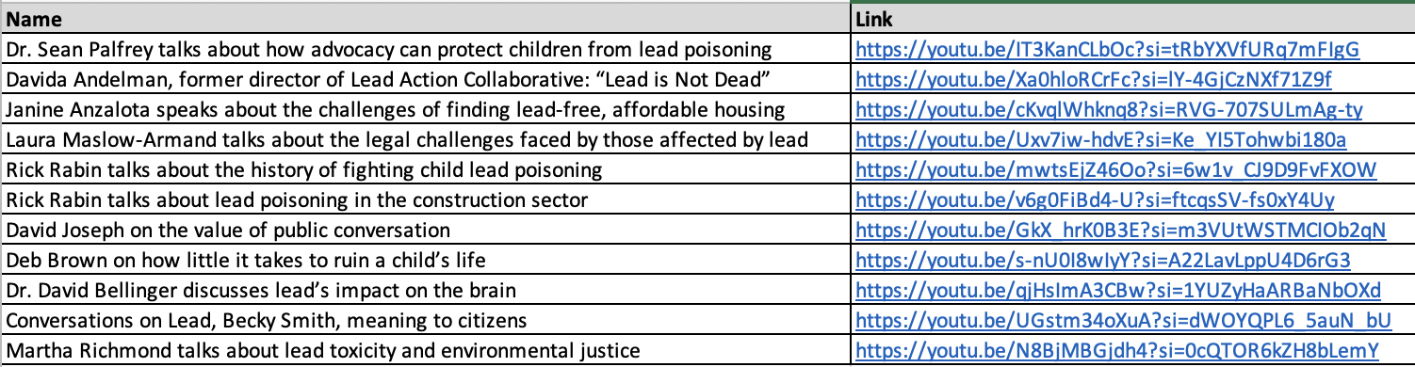

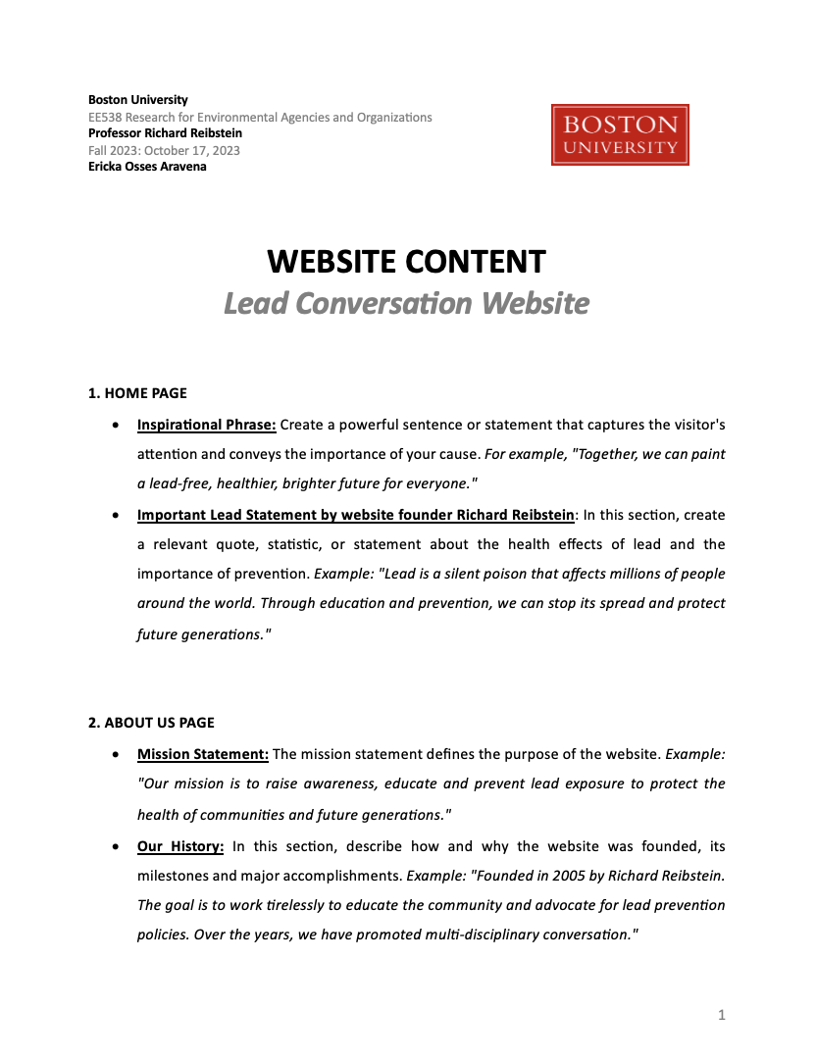
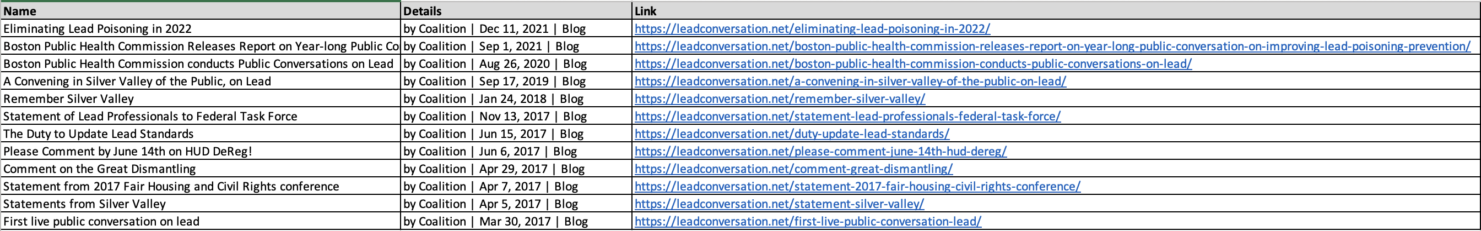
The design process included:
1 Timeline
1 Website status analysis
2 Content requests
10 Adobe Illustrator mockups

Slide 6
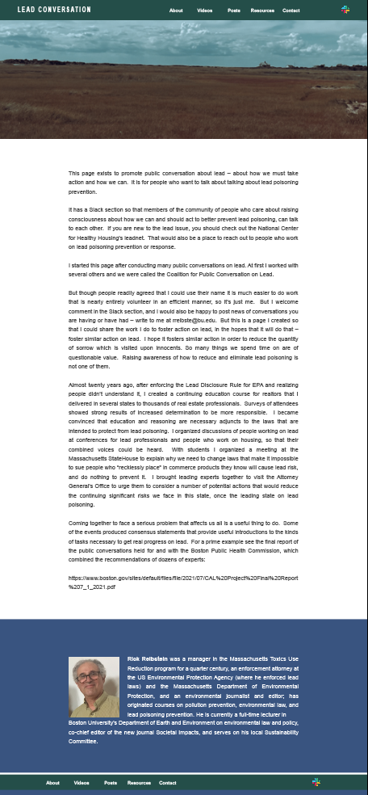
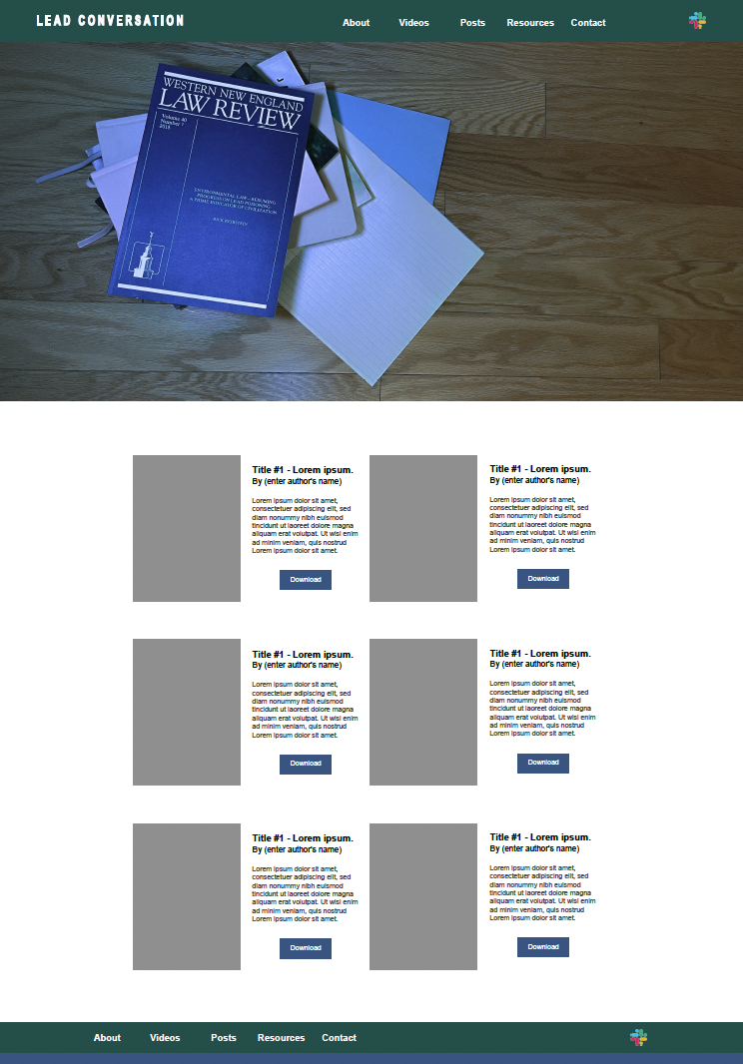
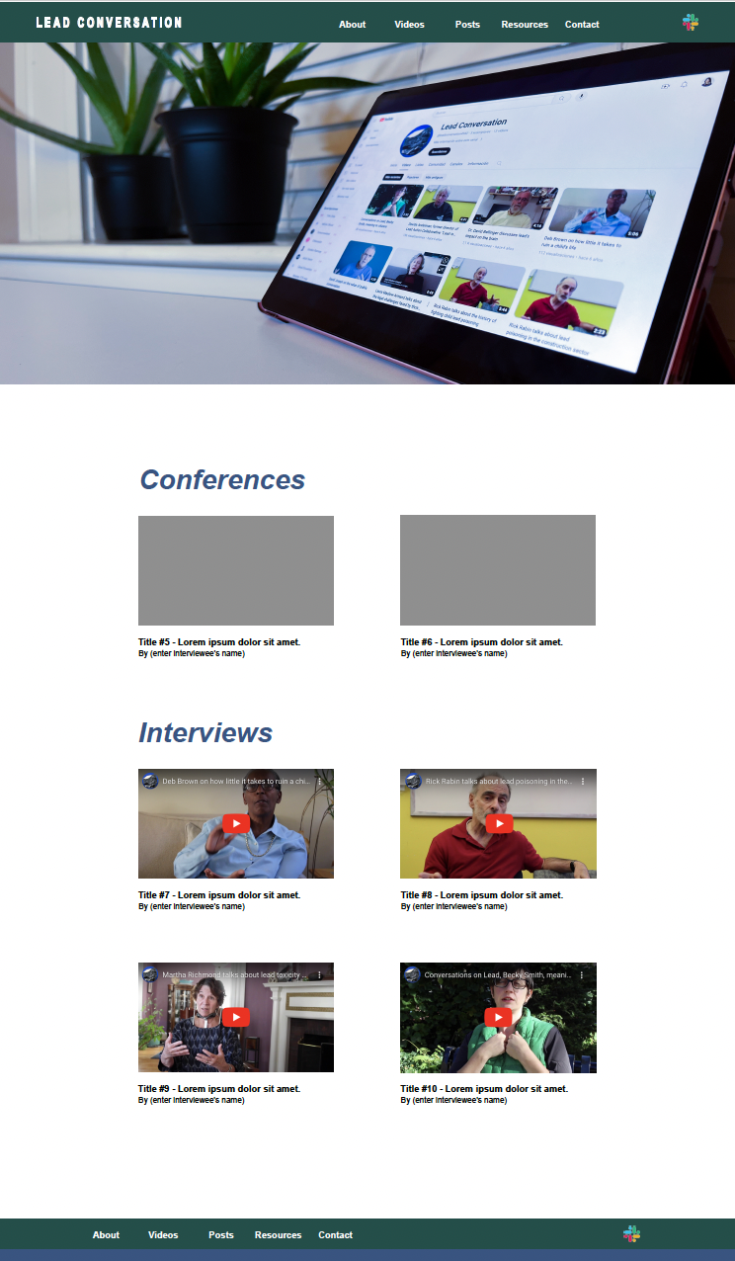
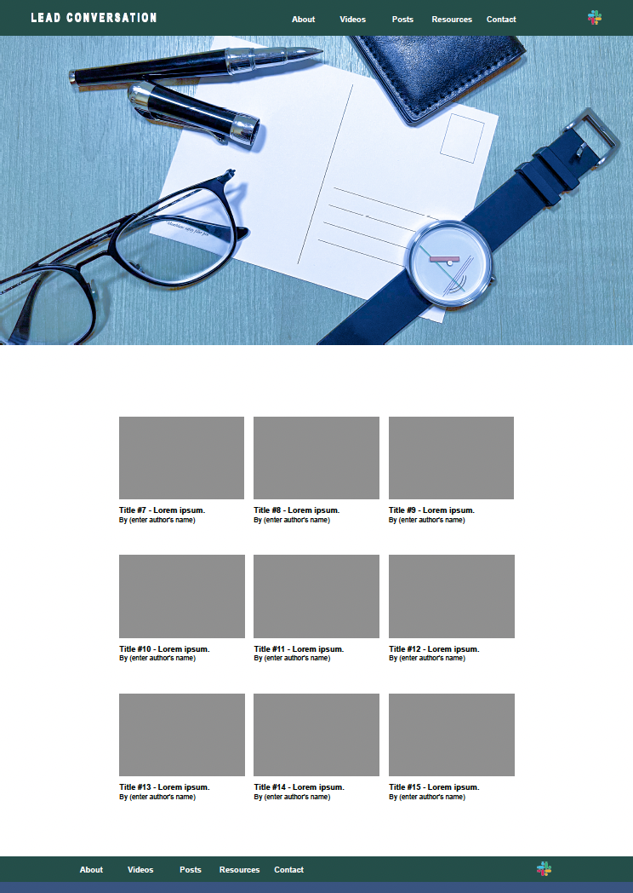
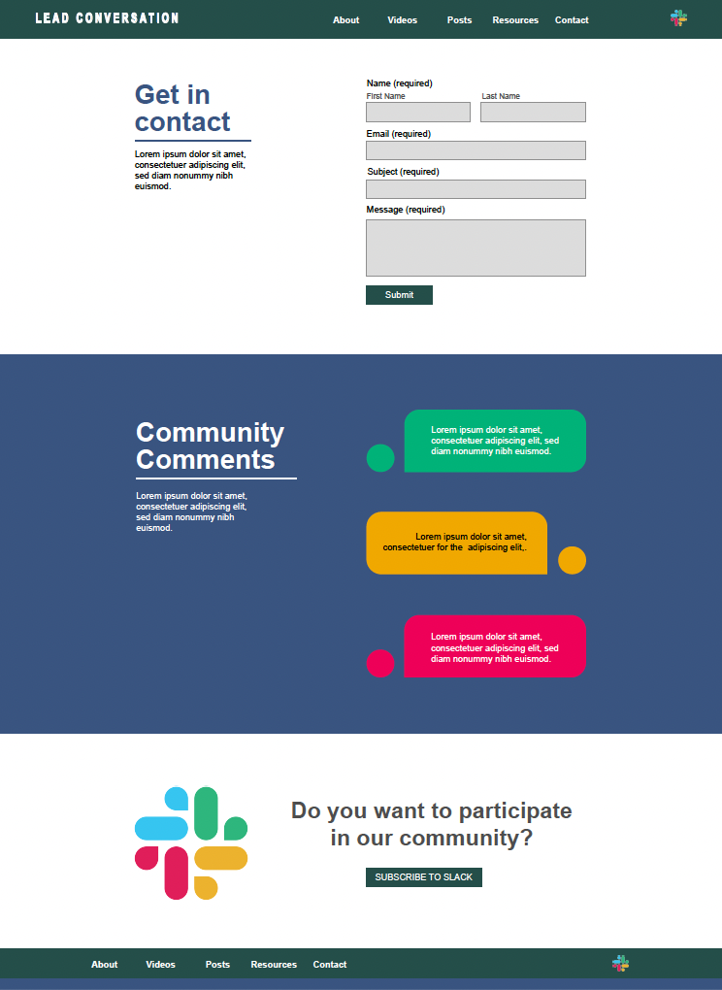

Slide 7
Learning
Time Management (scheduling activities).
Recommendations
Include a 25% margin of error in the planned deadlines.
Next steps
Design transfer.
Organization and Order (guiding the client and generating deliverables).
Continuous communication with the client.
Request periodic feedback.
Establish clear milestones to give security to the project.
Wordpress implementation.

