Slide 1
Devens Enterprise Commission & The Great Exchange
Matthew Kalinowski, Ishika Shah

Slide 2
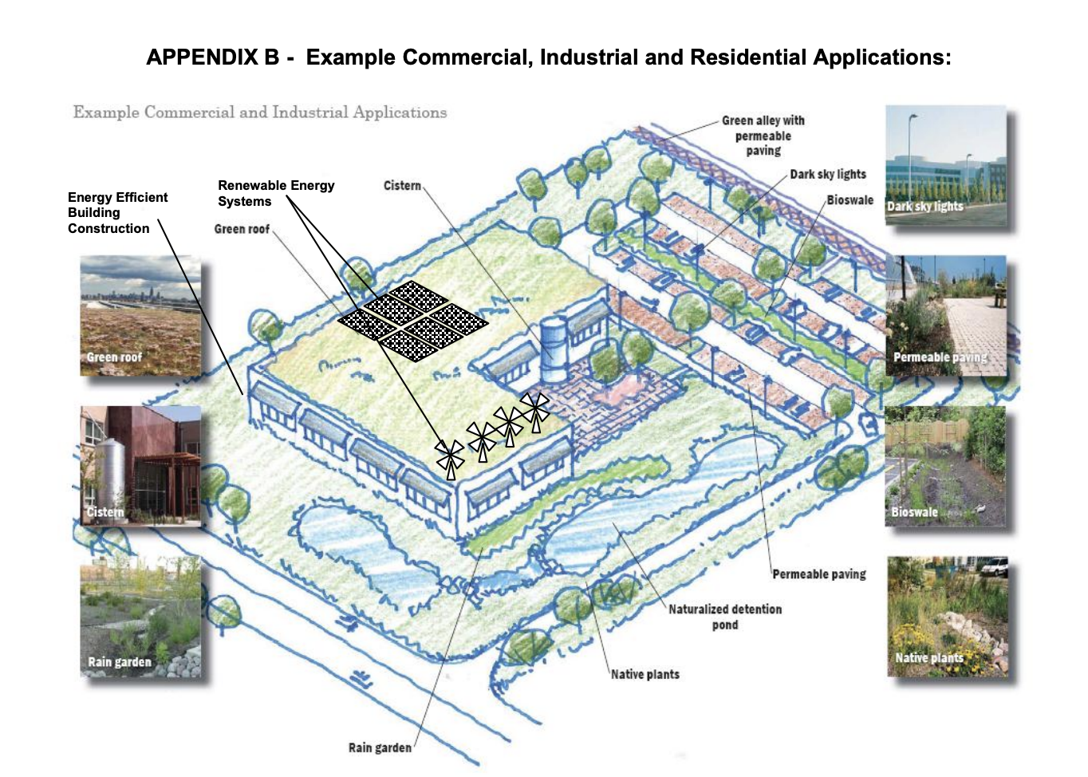

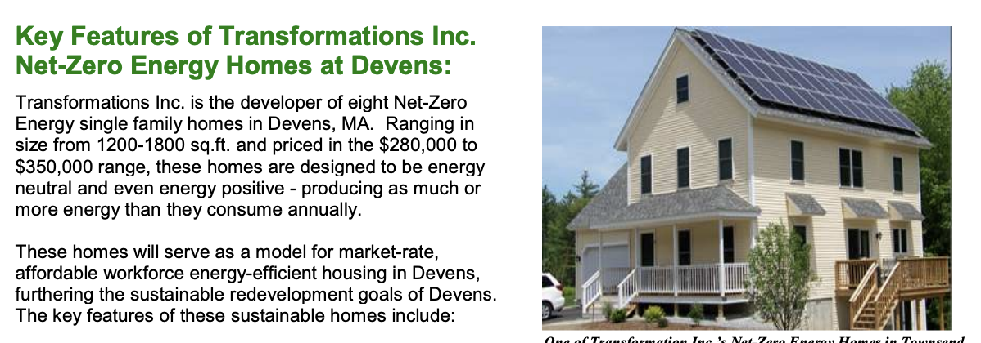
About the Company
Devens Enterprise Commission
Oversees the sustainable redevelopment of former Fort Devens (Military Base)
Eco-Industrial Park
Seeking policy suggestions for deconstruction guidelines, retrofit projects and reusing waste materials from Construction and Deconstruction Activities.

Slide 3
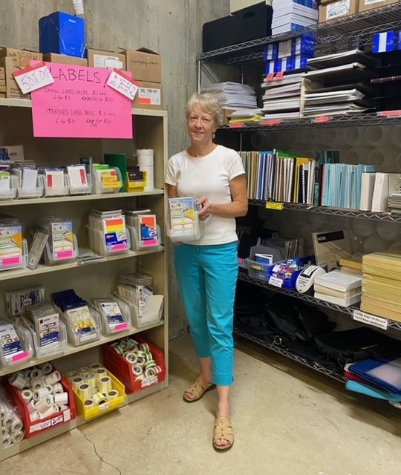

About The Company
The Great Exchange
The Great Exchange (TGE) is the alternative solution for resources that establishments can no longer use internally but can be utilized by other institutions.
Furniture, fixtures and operating supplies are made available with significant discounts benefitting schools, libraries, nonprofits, and more.
Wishes to further expand and market the opportunity it provides to more companies with valuations and marketing flyer on TGE website

Slide 4

Project Deliverables
Research Report on Policy Suggestions for Sustainable Redevelopment
Academic Review
Expert Interviews
Marketing Flyer for The Great Exchange
Valuations

Slide 5
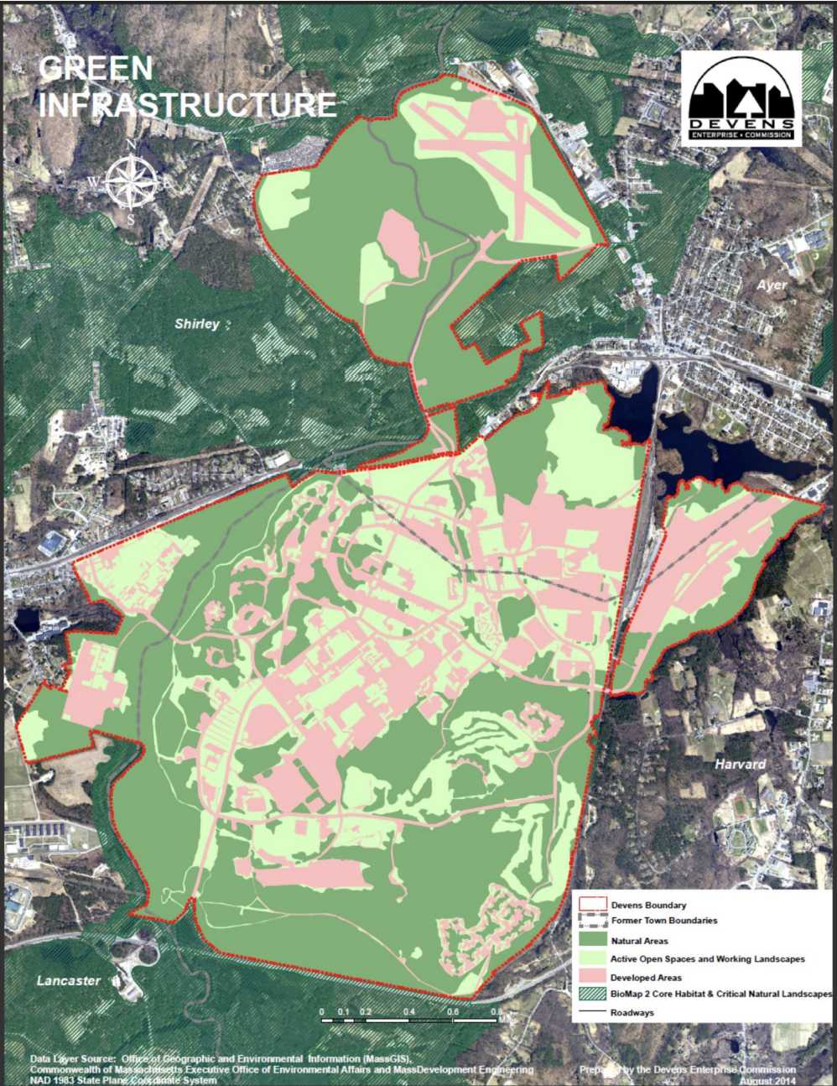
C & D Material Reuse Opportunity for Devens
Industries:
Residential
Technology
Distribution Centers
Life Sciences
Environmental
New England Studios
“One company’s trash is another company’s treasure”

Slide 6
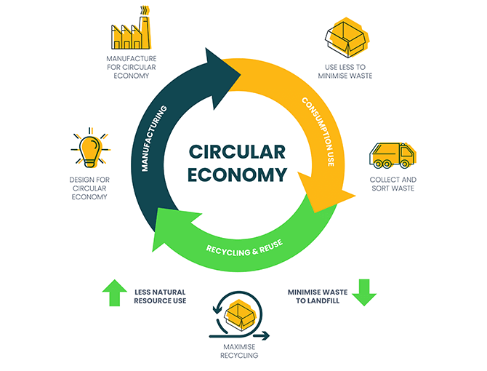
Key Strategies for Reuse
Certifying products so that companies can earn LEED credits
Detailed DFD plan with key material information
Modularity
  Standardization of Components and Uniform Design
  Non-Destructive Connections
Durable and Sustainable Materials
Building Information Modeling (BIM)

Slide 7
Interviews
Construction Companies
Sto Building Group & Boston Building Resources
Columbia Construction
DCAMM
Offices of Planning, Design and and Deconstruction
MassDEP
Municipal Waste Reduction Programs

Slide 8
Literature Review
Colorado Construction, Demolition and Deconstruction Policy Toolkit
EPA - Lifecycle Construction Guide
Solid Waste Master Plan 2030
Build REuse

Slide 9
What We Learned?
The Construction Industry has adapted since C & D Recycling Ordinances
  Contractors are procuring efficient material volumes to minimize waste
  Excess construction materials used when space is available
Significant opportunities to divert materials to reuse centers (The Great Exchange)
Opportunities for deconstruction framework (Product ID Tagging Upon Construction)

Slide 10
Technologies in C&DW Management
Material Tracking Platform: Green Halo System
Inventory Catalogue: Open Space
Mechanized Source Separation
Blockchain Technology: Transparent and Secure Logging
Product Tagging

Slide 11
Challenges
Transportation
Storage and Space on-site
Lack of Certification (History) for Possible Reuse Materials
Toxic Contaminants
  Asbestos
  Lead
  PCBs

Slide 12
Solutions and Policy Suggestions
Mandatory Deconstruction Ordinances
Incentives for Material Reuse
  Financial and Tax incentives
  Support Measures: Technical Assistance and Training
Extended Producer Responsibility for Building Materials
Expansion of Reuse centers
  Facilities specifically for Construction Materials

Slide 13
Successful Examples
Susquehanna Avenue Row-House Deconstruction Project
  Received a $73,000 grant
  Salvaged Material Revenue: $6,530
Wesley House & Reichert House
  44% of mass was recovered in deconstruction out of which 20% was reused
  8.84 tons of materials were diverted from landfills
  Cost was 5% lesser than general cost of disposal

Slide 14
Marketing Valuations
The Great Exchange
Diverts an average of 50,000 pounds of valuable materials from the landfill each year.
More than 850 types of materials in Inventory
TGE provides pick-up from the initial user and then significant discounts to donated materials sold to community organizations making it more cost efficient than traditional disposal processes while supplying affordable materials to local partners.

Slide 15
Green-House Emissions Diverted - 2023
Operating Supplies - 11,624 lbs = 20,342 kg CO2e
Furniture - 18,606 lbs = 22,327 kg CO2e
Classroom Supplies - 2565 lbs = 5,130 kg CO2e
Office - 6336 lbs = 12,672 kg CO2e
Total CO2e diverted - = 60,471 kg
The 2023 data provides a rough estimate of around 66 tons of Carbon Emissions Equivalent diverted from waste streams by The Great Exchange accepting donations for reuse.
Notes:
Coggin-sos.co.uk. (2024). The Carbon Footprint of Office Furniture: A Detailed Guide. [online] Available at: https://www.coggin-sos.co.uk/the-carbon-footprint-of-office-furniture#OfficeFurnitureCarbonFootprint [Accessed 29 Apr. 2024].
‌

Slide 16
Thank You

