Slide 1
On-Campus Supervisor Training
Boston University Student Employment Student Job Board

Slide 3
Accessing the Job Board

Slide 4
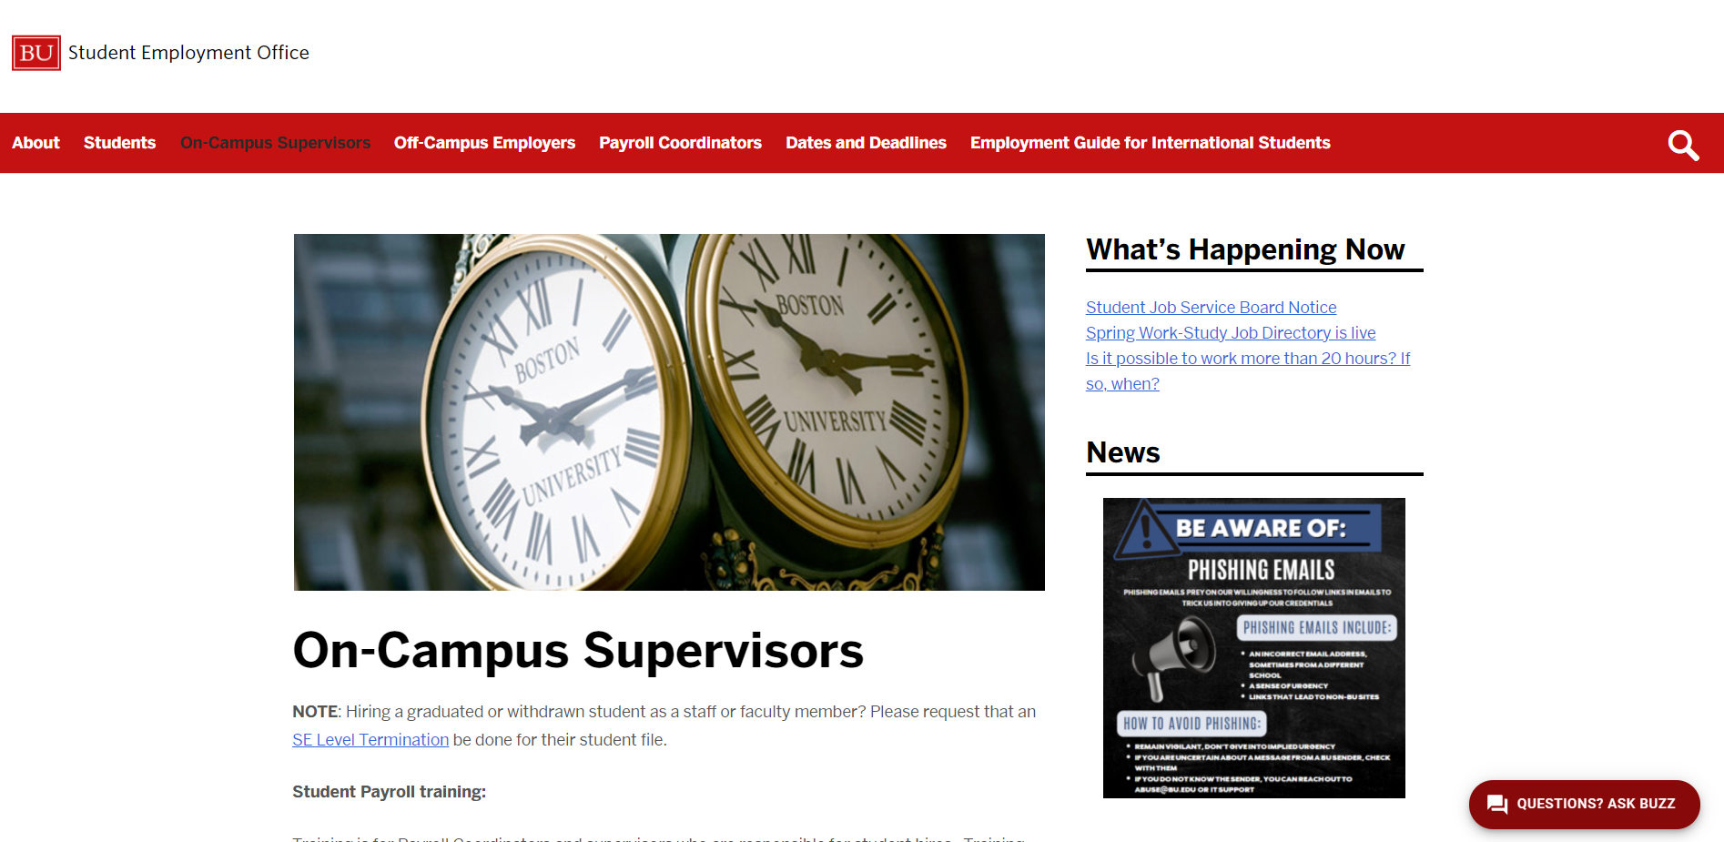
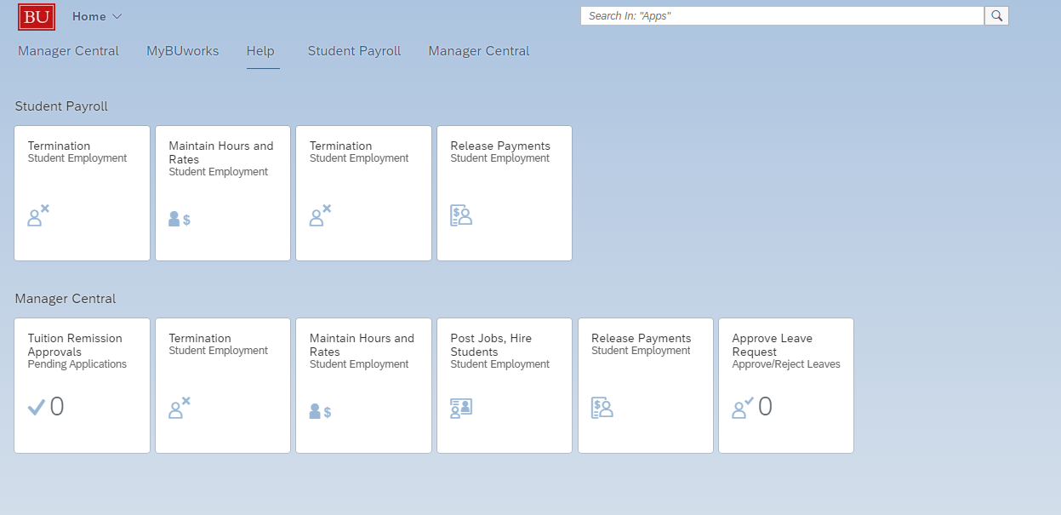
Accessing the Job Board
Navigate to
BU Works
or
Student Employment On-Campus Supervisors Web page
Click on the corresponding Job Board Link

Slide 5
Accessing the Job Board
Click the ‘JobX Login’ link to login to the system using your Boston University SSO credentials.
See next page if you fail to login using your BU Credentials

Slide 6
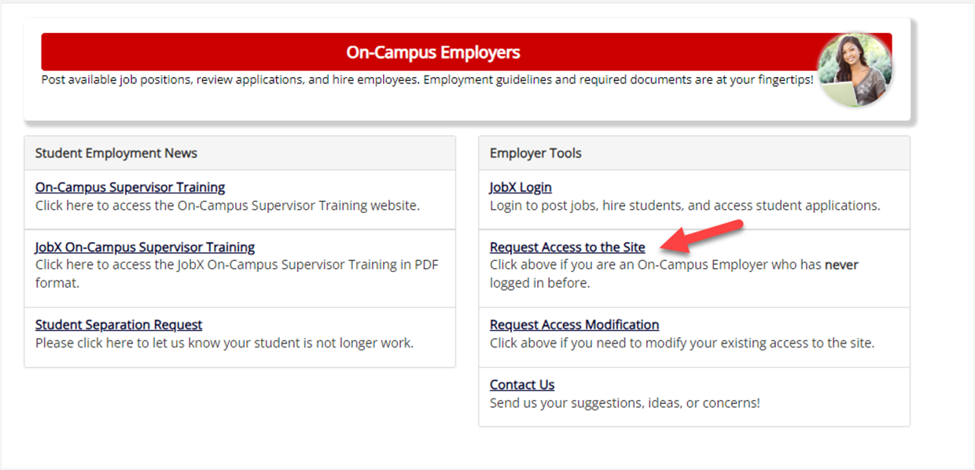
Accessing the Job Board – Request Access
If you fail to login using your BU Credentials, Click the ‘Request Access to Site’ link.

Slide 7
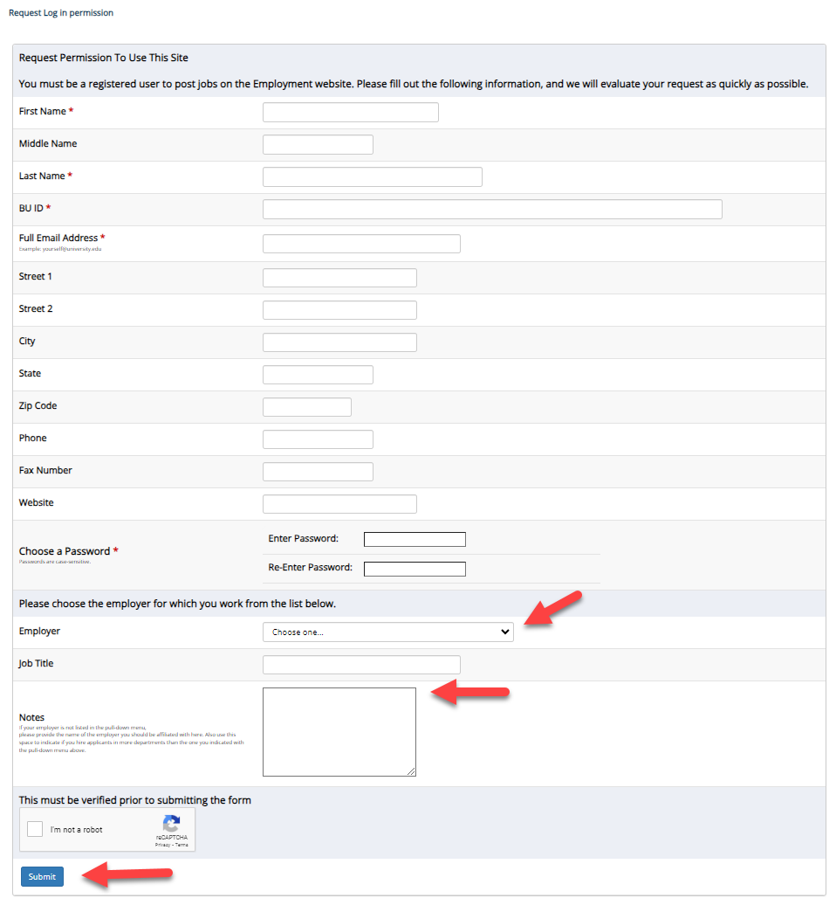
Accessing the Job Board – Request Access
Complete the Request Login Form.
If your department/employer is not listed in the drop-down, you may add it to the Notes for the Student Employment to review.
Then click ‘Submit’ button to submit your request for an approved login.

Slide 8
Creating a Job/Job Posting

Slide 9
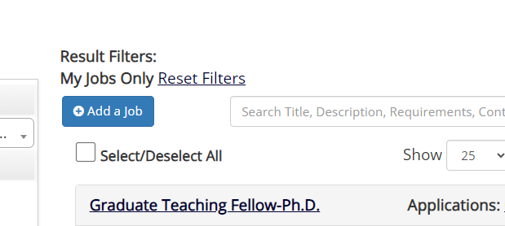
Create a New Job
Click ‘Add a Job’ button to start the process to create a job.

Slide 10
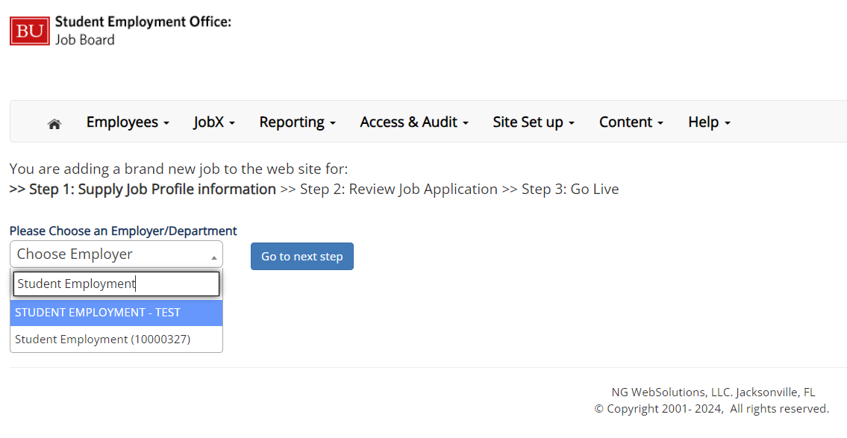
Selecting Department
If you have posting permissions for more than one department, Select the department for which you want to post a job from the ‘Employer/Department Name’ drop-down list.
Next click ‘Go to next step’ button to proceed.
Note: If you only have permission to post for one department, please proceed to the next slide.

Slide 11
Selecting Job Type
Select the job type that aligns with the position. Then Click ‘Go to next step’ to proceed. Note: Most of the job postings will be considered ‘On-Campus Jobs.’ Certain jobs at the graduate level, such as Teaching Assistants and Research Assistants will utilize the ‘Graduate Teaching and Research’ job type.

Slide 12
Completing Job information Template
The Job Posting Template may vary depending on the job type selected
Fields denoted with a red asterisk marks (*) are required fields
Lastly, click ‘Submit’ to continue the next steps in the process.
Important Note: Contact information (e.g. Phone Number, Fax Number, & Office Address), will be pre-filled systematically. If not, please contact Student Employment

Slide 13
Review Default Application
To ensure you find the most qualified candidate for your job, you may add job specific questions to the institutional default application questions.
Your site administrator must approve these job specific questions.
To add job specific questions to your default application, at the bottom of the page you may use the customized tool, see next slide for additional information.

Slide 14
Add Customized Questions
When creating a new question, please select a type of question from the ‘Question Type’ drop down menu (i.e. Single Line, Multiple Line, Single Choice , Multiple Choice, Date, File Upload, or Instructional Text).
Use an abbreviated name for the question you’ll be adding for retrieval purposes in the “Pick from Existing Questions” library.
Please Note: This will not be presented to the applicant.
The Question Label is what the applicant will see. Use the text and HTML editor feature to make your questions look more professional.
You can either add your question to the existing general section or create a custom section for your question to be placed underneath. If you’d like to add a new section for a question to be within, please enter the name of the section in the “Create a new section” at the same time you’re adding the 1st new field being presented within this new section.
Once this section has been added with your new question, all subsequent questions you may want to add to this new section can be done by simply selecting the new section from the “Select an existing section’ drop down list.
You can place any new question exactly where you want it by selecting the desired location in the “Where to Add this Question” drop down list.
When you are completed adding a question, click the “Add Question” button. Lastly, to save the application, please click the “Save Application” button.
Please note: All job specific questions you add to your institutional default application will be reviewed and approved by your Site Administrator.

Slide 15
Finalize Job Posting – Question 1
When do you want to list the job on the web site?
Select ‘Right Now’ from the list if you want the job to “List” immediately upon approval.
Select ‘Some time Later’ if you wish to review the job further before approval. The job will be placed in Active, Not Listed until you are ready for approval.
Select ‘On a specific date in the future’ from the list if you want the job to “list” on a certain date.
Select ‘Place the job in review’ from the list if you want to retain a review status.

Slide 16
Finalize Job Posting – Question 2
Do you want JobMail to be sent when the job is listed?
Select ‘Yes, send JobMail’ from the list if you wish for a notification to be sent out to students who have presets seeking newly listed opportunities.
Select ‘No, do not send JobMail’ from the list if you do NOT wish for a notification to be sent out to students when listed.

Slide 17
Finalize Job Posting – Question 3
3. For how many days do you want the job to be listed on the site?
If you want the job to be posted until you close the job, select ‘Until I close the job.’
If you want to designate a specific period of time the job should be posted, select the applicable duration from the drop-down list.
Click the “Click here to Finish!” button.
Your job will be submitted to the Student Employment Office for review/approval.

Slide 18
Creating a Job/Job Post- Video Guide

Slide 19
Await Approval From Student Employment Office
You may either print your job details or click ‘Return to your control panel’ to view and/or manage your jobs further.
If you choose to return to the control panel, the job you just created will be in the ‘Pending Approval’ queue on the left side. Student Employment will review each submission within one business day.

Slide 20
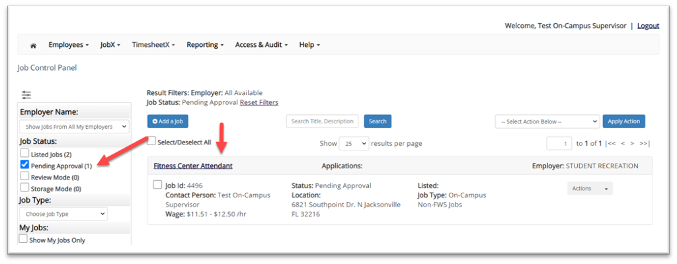
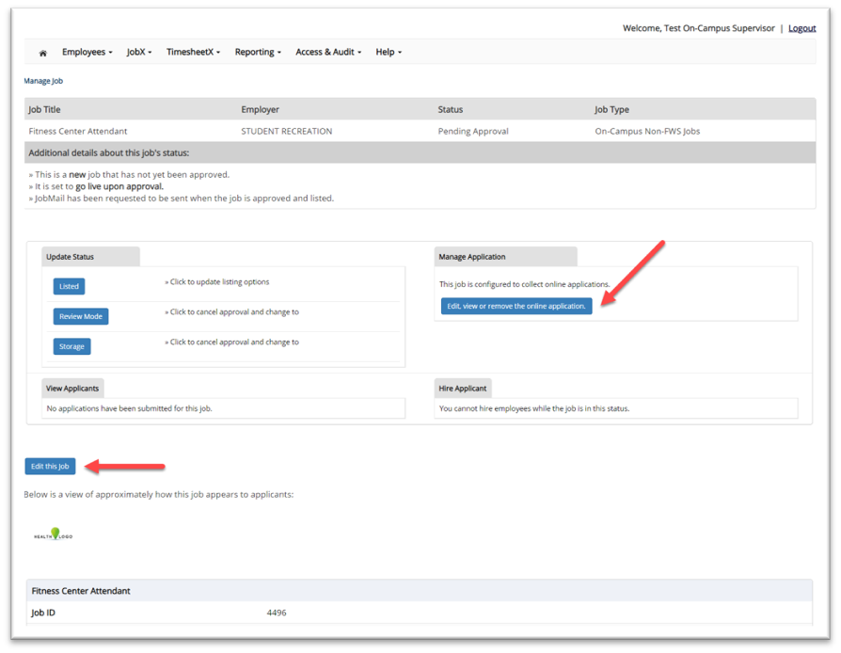
Edit a Job Posting
You may view the job and/or application details or request the job status be changed by simply clicking on the Job Title link.
To edit the job, click ‘Edit this Job’ button on the ‘Manage Job’ page.
To edit the application tied to your job, click ‘Edit or View the Online Application’.
NOTE: Edits will be resubmitted for approval by Student Employment

Slide 21
Reviewing Applicants

Slide 22
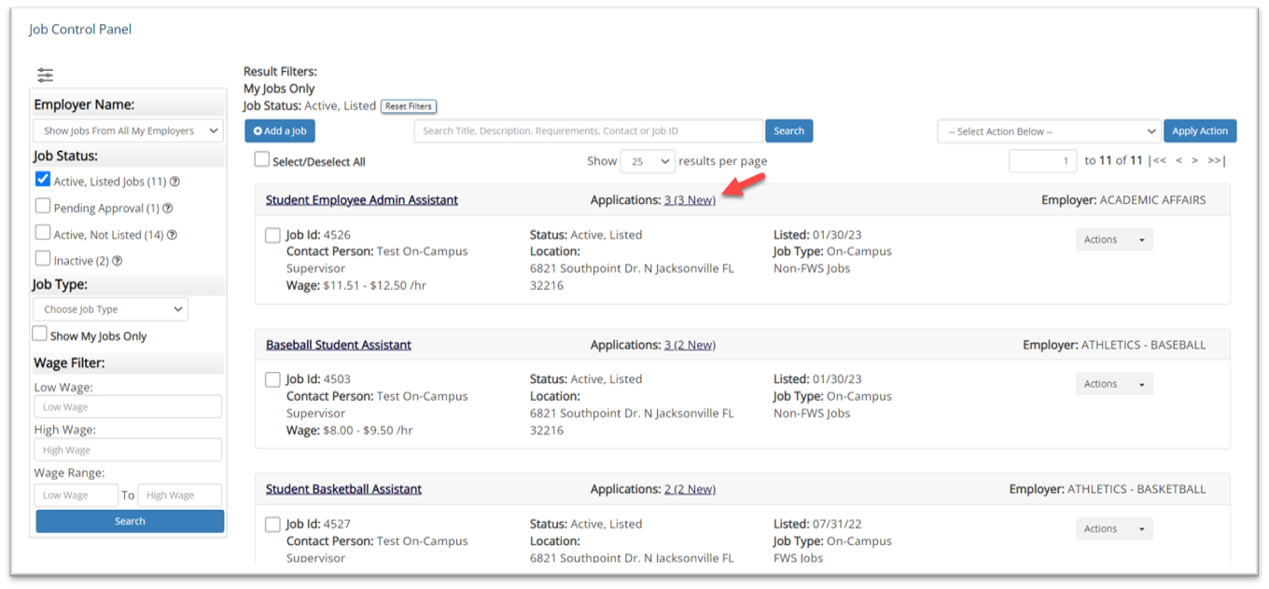
Managing Applications
You may hire an online applicant by clicking the ‘Applications’ link next to the job title or ‘Hire Applicant’ from the action drop down menu.
Notes:
Jobs will display on the Job Control Panel. The job status will present within each listing. You may the filter by Job Status function on the list side of the screen. Students will have the opportunity to review and apply to any jobs that are actively listed on the Job Board. Supervisor can review and online applicant submission by either clicking on the Applications Link or utilizing the Actional drop down menu within the listing.

Slide 23
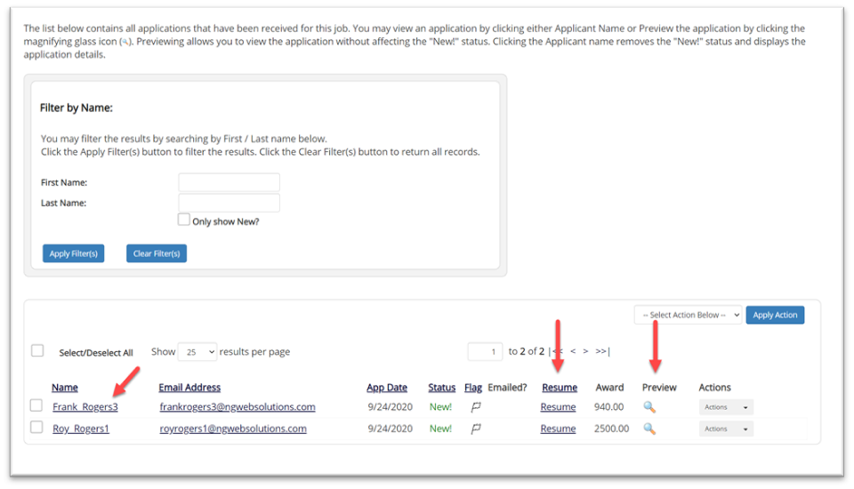
Managing Applications
Click the Applicants Name link to view the application in a full screen view.
Click the magnifying glass next to the student’s name to get a quick view format of the application.
If the student has provided a resume, click on the “Resume” link next to their name.
Notes:
The next page will display a list of current applicants who have expressed interest in the opportunity and submitted and application.
At this stage supervisors can see:
Who applied
Their email
When they applied
Identify any new submissions
Download their resume
View Work Study Award amounts
And see a “quick view” of the student’s application

Slide 24
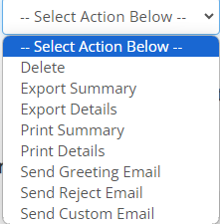
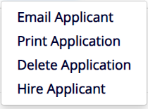
Communicating with Applicants
This feature can be utilized to communicate with one or more applicants. For example, users may send a greeting email to set up interview appointments. Users may also send rejection notifications if applicants do not meet the job qualifications, or you can send out customized emails.
This feature also allows for printing and exporting the data available on this page.
Notes:
Important Note: Do NOT use this function for informing applicants you are not interested in hiring them and the job has been filled. For that purpose, you can utilize the integrated ‘Send Rejection Email(s)’ function reviewed in a future slide.

Slide 25
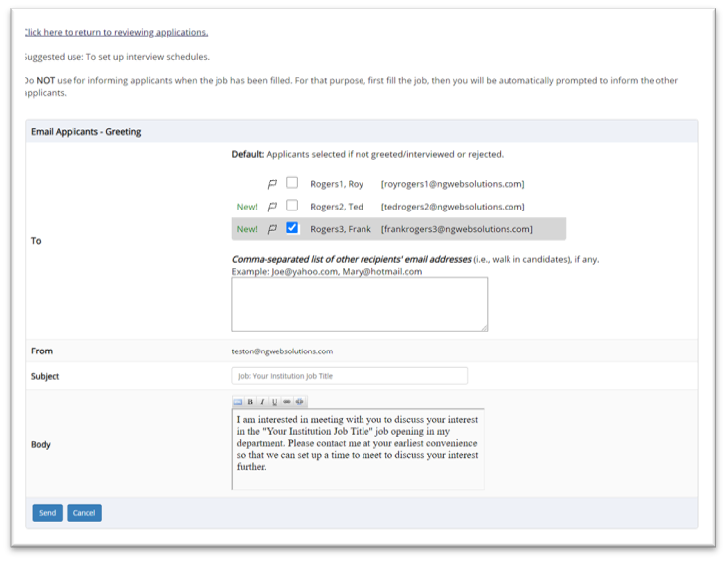
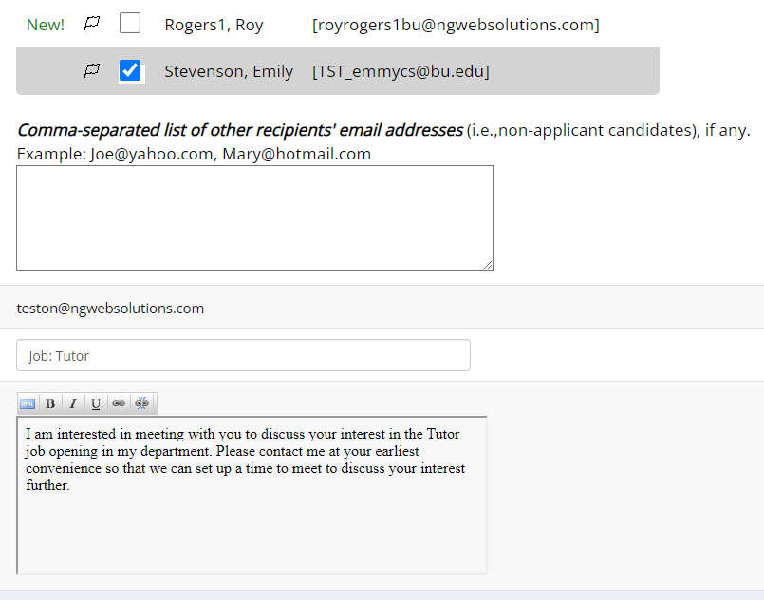
Greeting Applicant(s)
This feature is utilized to reach out to one or more students.
If you select more than one student to interview, individual e-mails will be sent to each student selected. If you don’t wish to interview an applicant, please be sure the box next to that candidate is not checked.
You may change the text in the body of the e-mail or add other email recipients in the ‘To’ box, then click on the “Send” button.
Current template:
I am interested in meeting with you to discuss your interest in the [Job Title] job opening in my department. Please contact me at your earliest convenience so that we can set up a time to meet to discuss your interest further.

Slide 26
Notify applicant(s) they were NOT selected
Click the box next to one or more applicants you would like to send a rejection email. Next, select the ‘Send Reject Email’ action. Finally click, ‘Apply Action’

Slide 27
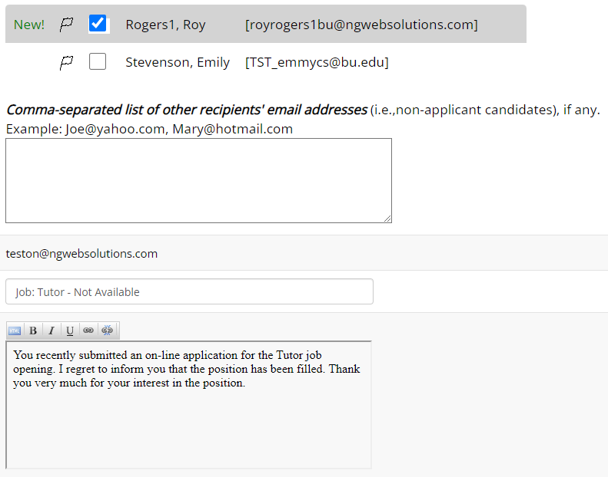
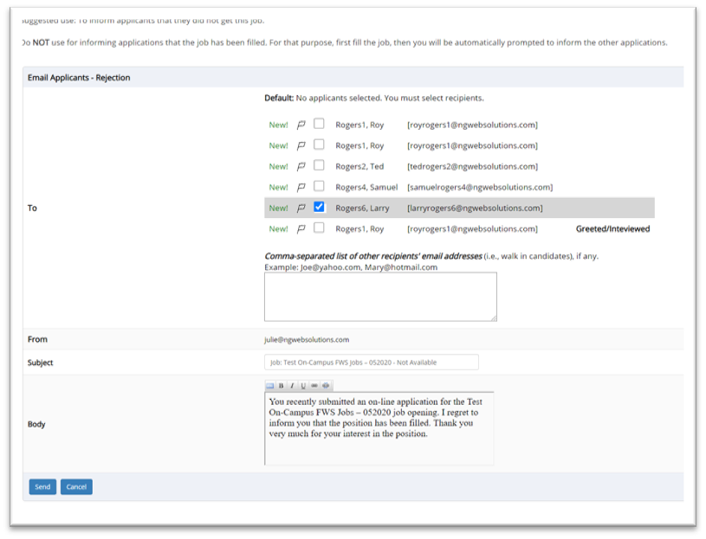
Notify applicant(s) they were NOT selected
This feature is utilized to inform one or more students they did not get this job.
If you select more than one student to reject, individual e-mails will be sent to each student selected. If you don’t wish to reject an applicant, please be sure the box next to that candidate is not checked.
You may change the text in the body of the e-mail or add other email recipients in the ‘To’ box, then click on the “Send” button.
Current template:
“You recently submitted an on-line application for the [Job title] job opening. I regret to inform you that the position has been filled. Thank you very much for your interest in the position.”

Slide 28
Hiring Applicants

Slide 29
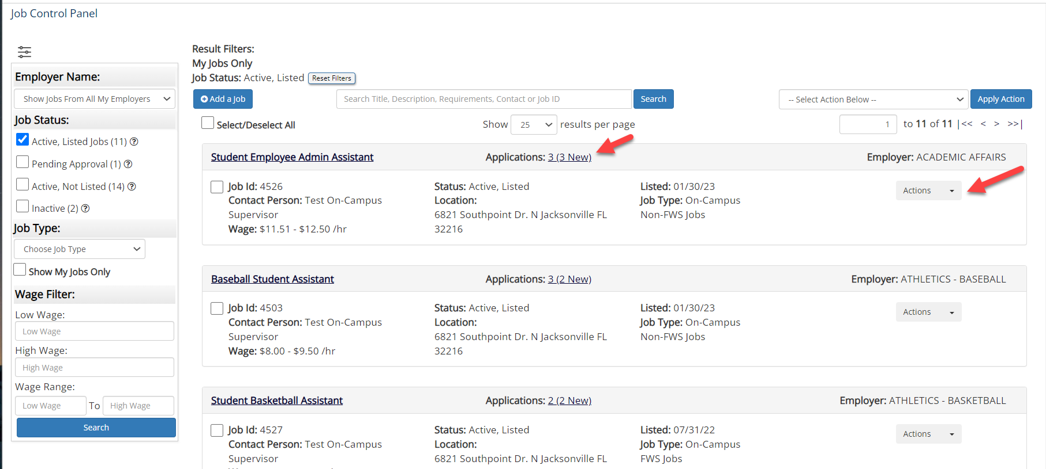
Hiring Applicants
To hire an applicant, click on the ‘Applications’ link or select ‘Hire Applicant’ from the action drop-down menu. This is also used to hire or rehire an applicant that did not submit an application.

Slide 30
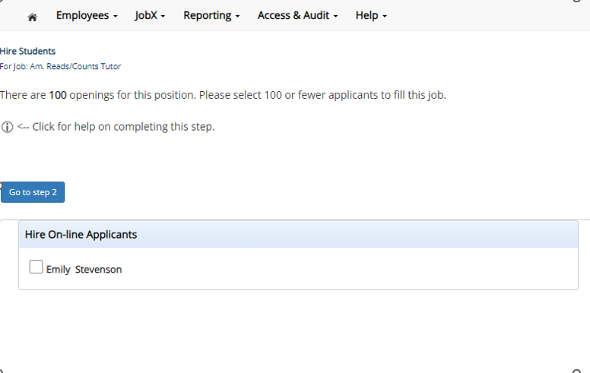
Hiring Applicant(s) who applied to Job Posting
The applicant’s name will be automatically selected for you if you are hiring from an application.

Slide 31
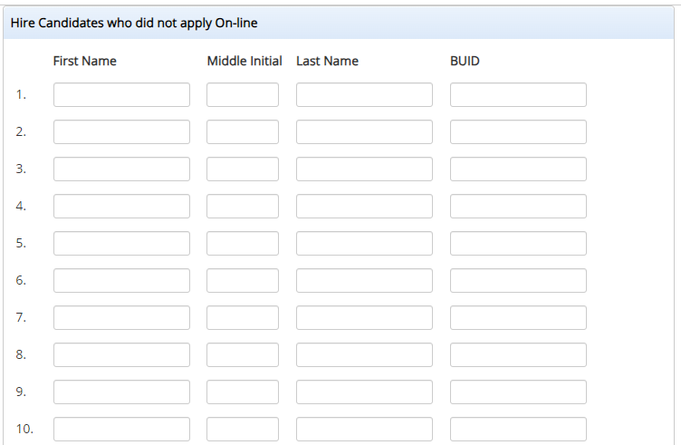
Hiring Applicant(s) who did NOT apply to Job Posting
To hire an applicant who did not apply you will need to enter their information manually.
In either scenario, once the applicant has been identified click ‘Go to Step 2’ to proceed.

Slide 32
Verification of Student ID
The Employee’s Downstate ID provided by the applicant in their job application will be defaulted into the ID field. If the applicant mis-keyed their student ID, you may correct their ID by typing over the pre-filled ID.
Please note: If their ID has been mis-typed, they will likely fail the hire process as the system validates against the BUID provided to JobX.
Next, click ‘Check Employee ID’ to launch the hire validation service for this employee.

Slide 33
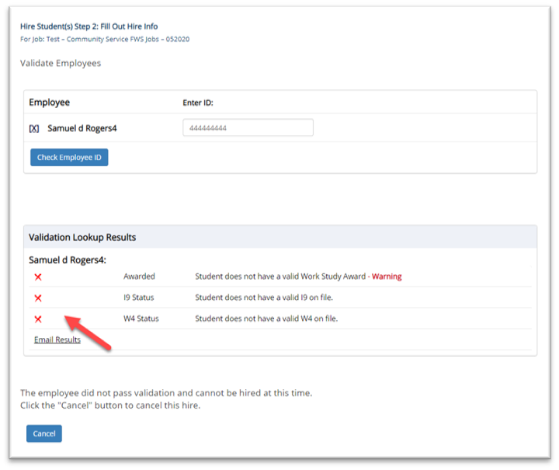
Compliance Validation - Warning
The system will validate the employee’s account to ensure they are eligible to be hired.
If the employee does NOT pass one or more of the employment eligibility checks, the system will present a red X next to each eligibility requirement the employee did not meet.
If the supervisor wishes to email the employee regarding the employment eligibility results to get them resolved, they can click the ‘Email results’ link to open an email. The results of their validation check will be pre-filled in the body of the email. The supervisor can type additional text in the body of the email and add other recipients of the email in the cc or bc fields.
The supervisor will need to click Cancel if the employee cannot be hired at that point in time.
Notes:
Student with Compliance Warning will be allowed to proceed with the hire request. For example, if the student needs to complete their Form I-9, the system will allow for the hire request to be submitted but the final approval will be contingent upon the compliance item being resolved.
Student with “hard stop” validation failures denoted with a X and no warning message will not be able to proceed forward. If they have a validation issue that may be inaccurate, the student should contact student employment for guidance/assistance.

Slide 34
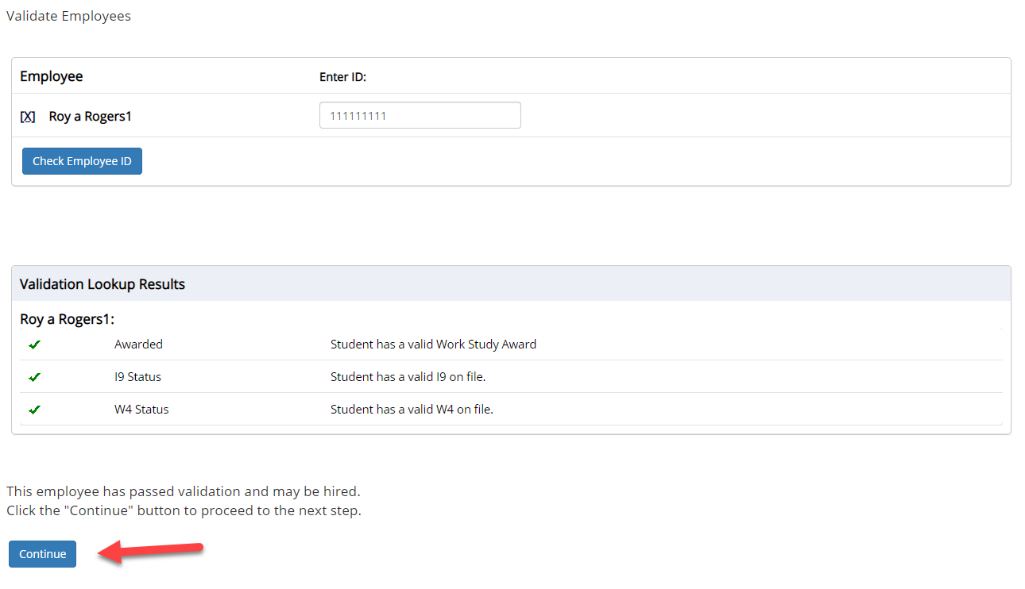
Compliance Validation - Pass
If all the employment eligibility requirements have been successfully met, green check marks will be presented next to each eligibility requirement and a “Continue” button will be presented to continue the hire process.

Slide 35
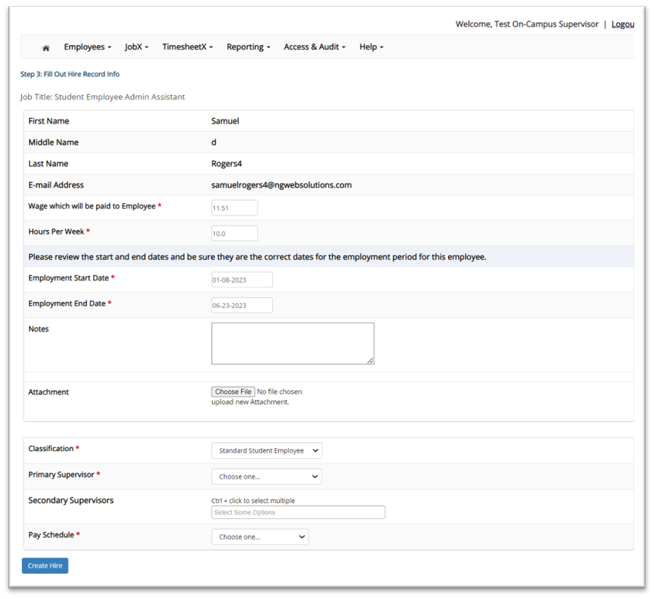
Completing Hire Request form
Data from the original job listing will be pre-filled in the Hire Request Form to reduce your data entry efforts.
Ensure you enter all information that is required and labeled with a * if not already populated for you.
You may edit the information prior to submitting the hire request.
Click on the “Submit Request” button to send your hire to your pay person to complete the hiring process.
After this step, the process is completed within JobX.

Slide 36
Completing Hire Request form - Video Guide

Slide 37
Pending Hire Approvals
To view pending hire requests, you may click on the ‘JobX’ menu drop down and select ‘Hire Requests’.
In the ‘Action’ drop down, you have the option to ‘Preview’ the hire information, ‘Cancel’ the hire, or send a follow-up ‘Email’ to the student from this dashboard.

Slide 38
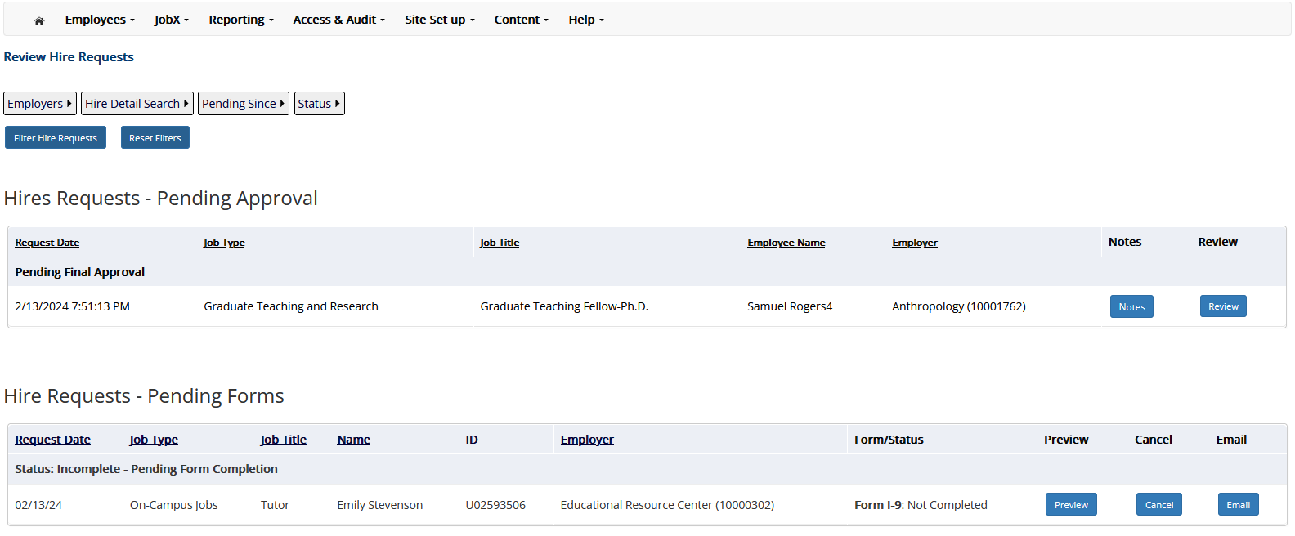
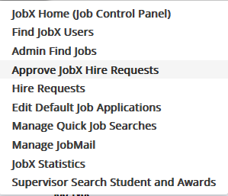
Reviewing and Approving Hire Request(s)
The ability to approve hire request will only be available to Payroll Coordinators and Student Employment.
To review pending hire requests, you may click on the ‘JobX’ menu drop down and select ‘Approve Hire Requests’.
Depending on where the Hire Request status you will have the ability to see which applicants are ready for hire and which have other requirements to fulfill.
For applicants ready to hire you have the option to Look up any ‘Notes’ added to the hire submission or ‘Review’ the hire information, to either “Approve,’ ‘Postpone,’ or ‘Reject’ the hire.
For applicants with outstanding items, you have the option to ‘Preview’ the hire information, ‘Cancel’ the hire, or send a follow-up ‘Email’ to the student from this dashboard.

Slide 39
Reviewing and Approving Hire Request(s) –Video Guide

