Slide 1
Boston University School of Social Work
Online Program
Social Work Licensing
and
Career Seminar - Part I

Slide 2
Agenda & Welcome
Social Work Licensing
Career Resources
Social Work Careers
Your Portfolio

Slide 3
Disclosures
Social Work Licensing
Most of you will want to obtain your social work license
You must apply to the state you want to work in
All states require a social work licensee to have an MSW accredited by the Council on Social Work Education (CSWE)
Boston University is accredited by CSWE
Licensing is in each state’s jurisdiction
It is your responsibility to know your state’s licensing requirements

Slide 4
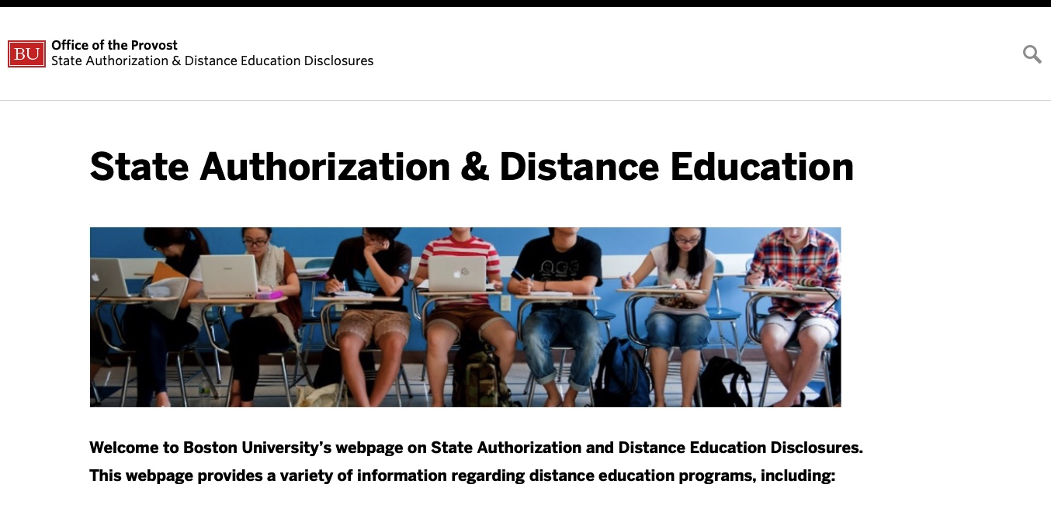
http://www.bu.edu/state-authorization/

Slide 5
“Click Path” to Licensure Information
http://www.bu.edu/state-authorization/
Scroll down towards the bottom of the screen:
“Professional Licensure and Certification Requirements”
Under this heading, scroll down to
“Master of Social Work”
Click on the state you are interested in

Slide 6
Things to Remember:
States do not have the same licensing requirements
Each state has its own license titles
Each state has its own license hierarchy
Some states have different licensing tracks
Some states have different levels of licensure that may have additional requirements
BUT…ALL states utilize the ASWB Licensing Exam

Slide 7
Licensing Requirements for Each State
Most states require a CSWE accredited university degree
Some states require additional coursework/training
California
Florida
Massachusetts
Missouri
New Mexico
New York
Pennsylvania
Washington
Notes:
As of July, 2020

Slide 8
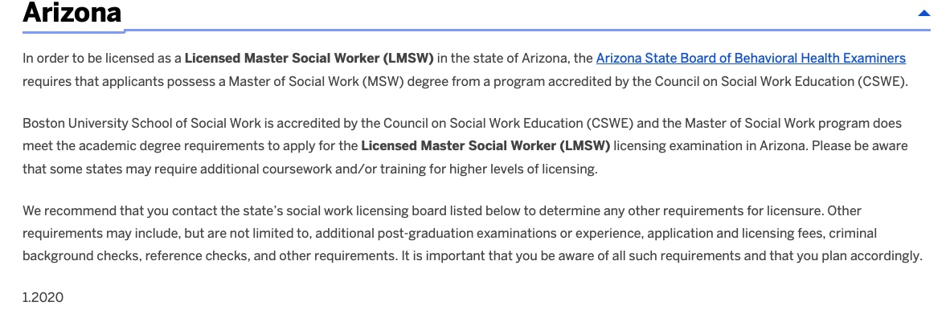
A State with Minimal Requirements:

Slide 9
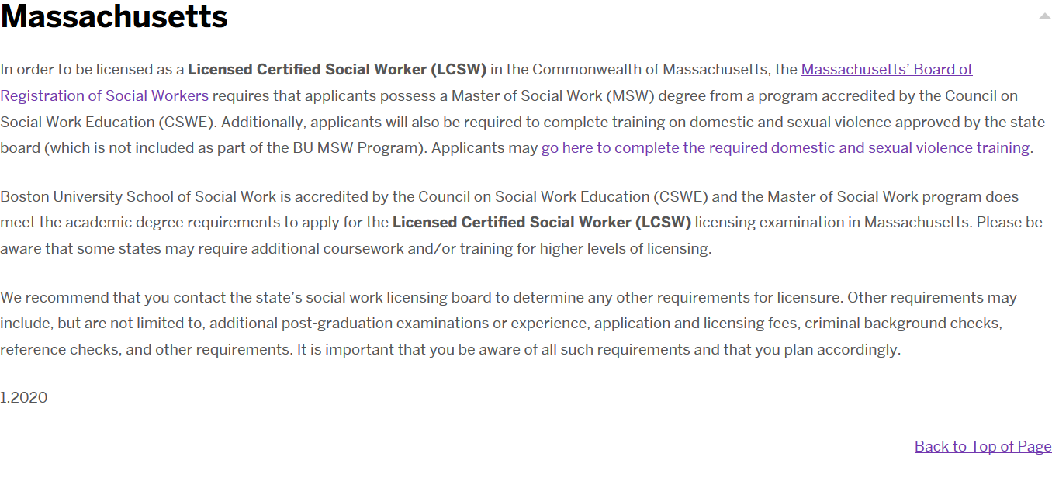
A State with Minor Additional Requirements

Slide 10
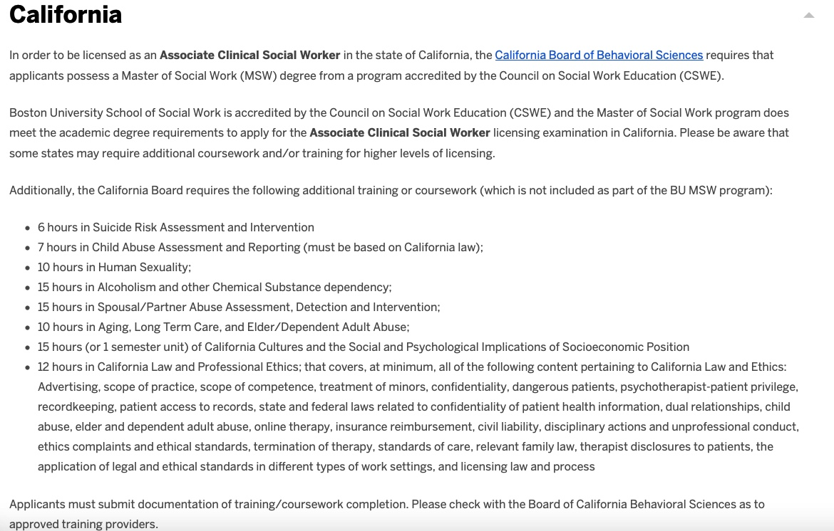
A State with Multiple Requirements

Slide 11
What’s Tricky – Some Obstacles
State’s change their requirements at will, any time
Websites may not be easy to navigate
Not all the information is readily available
It can be difficult to get answers from calling/talking to people
Other websites claim they know state requirements – use the specific state board website to gain the most up to date information

Slide 12
What do you need to do?
Look up
Look up your state's requirements from the state board page itself (LINK in State Disclosure)
Read
Read everything carefully, which license: now and in the future? Are there additional educational and/or testing requirements?
Research
Diligently research the state statutes, rules and regulations about the license you are interested in obtaining
Go over
Go over the application, if available (sometimes it’s a click through online application) and any additional licenses you may want to get in the future
Re-Check
Go back every semester or year to make sure there are no changes

Slide 13
Social Work Licensing and Examination
Why is this important?
For Clinical Social Workers – licensure is your ticket to legally provide clinical practice in most states
For Macro Social Workers – licensure is an added level of credibility when you apply for macro & mezzo jobs
Licensing is a consumer protection process that establishes and enforces professional regulations
Sets and protects clinical scope of practice
  Who can be called “social worker” and what clinical services you can provide
State Licensing boards Issue licenses and audits professionals for license compliance
  Ensures life-long learning: Continuing Education Units (CEUs), supervision, etc.
Each state has different requirements and processes for licensing – you must check your state’s requirements
  You can compare licensing requirements at ASWB

Slide 14
Process for Social Work Licensure
“The Association of Social Work Boards owns and maintains the social work licensing examinations that are used to test a social worker’s competence to practice ethically and safely. Exams are administered throughout the year at secure test centers in North America and abroad.”
ASWB provides:
  Social Work Licensing and Regulations Information for each state and each level of practice (BSW, MSW, Clinical/Independent, etc.)
  Exam Materials and Exam Registration
  Social Work Registry – a repository for SW credentials
  Continuing Competency and Credentialing Requirements

Slide 15
Application Requirements For Many States
Social work licensing applicants will likely be required to complete some or all of the following:
  An application (sometimes notarization is required)
  References
  Earn a passing score on the Licensing Exam
  Provide an official sealed transcript stating you have graduated with the MSW
  Payment for the license
  Criminal background check
  Passport-sized photograph
  Citizenship/Immigration verification
This is not an exhaustive list, please check with your state’s licensing board

Slide 16
The Process
The registration process
  Apply to ASWB for the state in which you would like to work
  Register for the ASWB exam
  Schedule exam through Pearson VUE

Slide 17
Example: Process for Social Work Licensing in Massachusetts
You MUST have your MSW degree BEFORE you apply for your license in Massachusetts (and in many other states – check your state’s regulations)
Before graduation, read the instructions and begin the application process
  Collect all the information and forms you need, other than your transcript
  Apply online at ASBW https://www.aswb.org/exam-candidates/exam-registration/
  Check your application status
As soon as your degree is confirmed , and your transcript is available, complete and submit your licensing application!

Slide 18
Which ASWB Exam?
Bachelor’s exam (BSW)
Master’s exam (MSW – most states require this exam – check your state)
Clinical exam (some states require this exam – check your state)
Advanced Generalist exam (In some states this for the advanced macro practioner – check your state)

Slide 19
The Exam
Computer-based exam
  Reservations may be made online at www.pearsonvue.com/aswb
    Or call for reservations: 877-884-9537
  Pearson Vue provides multiple test sites in every state
170 multiple choice questions (150 count towards exam grade)
4-hour testing window
Broken down into 11 content areas (listed on next page)
  The good news for BUSSW grads
    BUSSW pass rate is typically over 90% which is higher than the MA and US averages
Special accommodations available for candidates with disabilities and those whose first language is not English

Slide 20
ASWB Masters Exam Content
Latest Update: 2018
The exam identifies your “knowledge, skills, and abilities” in the following areas:
  Human Development, Diversity, and Behavior in the Environment – 27%
    Human Growth and Development
    Concepts of Abuse and Neglect
    Diversity, Social/Economic Justice, and Oppression
  Assessment and Intervention Planning – 24%
    Biopsychosocial History and Collateral Data
    Assessment Methods and Techniques
    Intervention Planning
  Interventions with Clients/Client Systems – 24%
    Intervention Processes and Techniques for Use Across Systems
    Intervention Processes and Techniques for Use with Larger Systems
  Professional Relationships, Values, and Ethics – 25%
    Professional Values and Ethical Issues
    Confidentiality
    Professional Development and Use of Self
Complete Outline: https://www.aswb.org/wp-content/uploads/2017/04/2018-Masters.pdf

Slide 21
Should I Study?
Yes!
ASWB Offers:
  FREE Exam Candidate Workbook Candidate-handbook-06-2021.pdf (aswb.org)
  $15 (e-guide) Study Guide / $20 (print edition) Study Guide
  $85 on-line practice exam
  ASWB 1-800-225-6880, or Online at www.aswb.org
Other Test Preparation
  NASW State Chapters often have test prep courses (often at a reduced rate for NASW members)
  There are other private test prep services
  Apps include https://www.pocketprep.com/exams/aswb-lcsw/
The above supports can assist with:
  Reducing exam anxiety
  Demystifying a high-stakes exam
  Assisting with examination preparation
Exams can typically be re-taken after 90 days if you do not pass – check your state’s procedures
  Often you will only need to pay for the exam again, not the application fee

Slide 22
Changes in ASWB Exams Due to COVID
The process takes longer
Asking applicants to do as much online for registration as possible
Fewer exams provided due to social distancing
You are only allowed to bring:
  Face mask
  Bottled Water
  Photo ID

Slide 23
Resources Due to COVID:
Information about how the ASWB exam is affected by COVID-19 is available at aswb.org
Please use the following link to stay current on Pearson VUE updates regarding COVID-19: https://home.personvue.com/coronavirus-update.
Confused about the steps and multiple organizations involved when taking an ASWB exam? Watch Steps for taking the ASWB exams. (aswb.org/exam-candidates)
  Apply to your state’s board
  Register with aswb.org to take the exam
  Contact Pearson VUE to schedule your exam

Slide 24
HOW MUCH WILL IT COST?
Here are costs you will need to consider:
    Application fee
    Exam fee
    Test preparation fees (optional)
    Initial license fee – each state sets it’s own fees
    Renewal fee (typically every one or two years – check your state’s regulations)
    Professional development
  Keep paper and electronic receipts of professional development

Slide 25
Example: Massachusetts Licensing Fees
$173 Application fee
$230 for Examination
($260 for LICSW exam)
$68 for initial license fee
LCSW total = $471
Plus any optional test prep fees
Renew Your License Every Two Years:
$68 (LCSW) or
$82 (LICSW)
  Renewal on your birthday every 2 years after your initial license date
Plus, cost for CEUs

Slide 26
Example: State of Massachusetts
Multi-Level Licenses
Education | Examination | References | Supervision & Reference | Documented Experience
Licensed Certified Social Worker (LCSW) Apply as soon as you graduate! Hours towards your LICSW do NOT count until you have your LCSW!
MSW, DSW, or PhD in Social Work | ASWB Masters Exam | 2 professional references (1 LCSW or LICSW) | 1 second year placement supervisory reference (LCSW or LICSW) | 2nd / Advanced Year placement
Licensed Independent Clinical Social Worker (LICSW) Apply after obtaining the required, documented experience and supervision
MSW, DSW, or PhD in Social Work | ASWB Clinical Exam | 2 professional references by professionals licensed at the highest level in their field (LICSW, LMHC, PhD, MD, RNCS) | 1 supervisory reference by an LICSW (Supervisor must be licensed in the state in which the license is being sought in. In MA out-of-state supervisor must be LICSW eligible) | No less than 2 years (3500 hours) of experience post-LCSW plus 100 hours of supervision (50 per year) by an LICSW. Hours do not all have to be at the same agency or by the same supervisor

Slide 27
Example: Additional Massachusetts Requirement
PRIOR to Licensing
Chapter 260: Training in Domestic, Sexual Violence
Pursuant to M.G.L. c. 112, § 264, applicants and licensees shall participate in at least one domestic violence and sexual violence training as a condition for licensure, renewal, revival or reinstatement of licensure.
Free online training from DPH at https://chapter260training.org/courses/training/
  1.5 hours – Completed sections can be saved and completed within a 30-day period
  You will receive a “Certificate of Completion,” but no continuing education units (CEUs)

Slide 28
Example: Massachusetts
Scope of Practice and Regulations
SCOPE OF PRACTICE for LCSW
LCSWs may not provide PRIVATE/INDEPENDENT clinical services; BUT may provide clinical services as an employee, and only as an employee
LCSWs may provide clinical social work services only under LICSW supervision
  NOT LMHC, PhD, PsyD, RN, PA, MD, etc.
  This is enforced via the complaint process too!
There are other regulations under “scope of practice”
REGULATIONS
First set of regulations is free and provided automatically when you request application from ASWB
Regulations are on this website www.mass.gov/dpl/boards/sw
KNOW THE RULES & REGULATIONS – CHECK YOUR STATE’S REGULATIONS!

Slide 29
Possible Limitations to Licensure
“good moral character”
  Listed as a requirement in many states – ambiguous
  Some states refuse to license those with convicted felonies
Citizenship
  Citizen, Naturalization, DACA (Deferred Action for Childhood Arrivals)

Slide 30
National Association Of Social Workers
National Association of Social Workers (NASW)
  Provides career services, job listings, training/CEUs, licensing and legislative information, and most importantly, many networking opportunities
  Join as a student for significant discount on dues and 3-years of graduated increases until reaching the full rate
    Reduced Membership for students
    Reduced fees on test pre courses and other services
    Each state has its own chapter
NASW Code of Ethics
  Sets forth the values, principles and standards that guide social workers' conduct in all practice areas.

Slide 31
Boston University Career Resources
The BU Center for Career Development
The University’s Center for Career Development offers digital resource for students:
BU Handshake—a digital hub for those exploring employment opportunities.
VMock, one minute to a better resume
  Upload your resume (via web or mobile)
  You will receive feedback on how to improve your resume
BUSSW Career/Job Hunt website
  https://www.bu.edu/ssw/students/current/career/job_hunt/

Slide 32
The BUSSW Career Guide http://www.bu.edu/ssw/students/current/career/
  BUSSW Career Resources
  BU Center for Career
  Deciding What to Do Within Social Work
  Prioritize Your Skills, Values, and Interests
  Networking and Informational Interviewing
  Resume Writing
  Writing Cover Letters
  Interviewing
  Negotiating Terms of Employment
  Social Work Licensure by State
  Job Placement and Temporary Employment Services
  Loan Forbearance and Forgiveness
  Planning the Job Search Process

Slide 33
Boston University Alumni Association Resources
BU School of Social Work Alumni Association
BU Alumni Association
  Connect with BUSSW alumni via our LinkedIn group
  Use BU’s Career Advisory Network (CAN) to connect with alumni across the country. As a student, you are eligible to join your professional organization
BU Online Degree Students/Alumni Resources
  Attend Career Fairs, Events, Webinars and More
Networking
  Social Media and Websites (LinkedIn, Facebook, NASW’s JobLink, Monster, Indeed, Idealist.com, etc.)

Slide 34
Some of the Exam Prep Courses:
https://www.naswma.org/page/prep
https://ssw.umich.edu/offices/continuing-education/exam-preparation
https://www.therapistdevelopmentcenter.com/exam-prep/social-work
http://www.siripro.net/
https://swes.net/study-materials/licensure-exam-prep-course/
https://swtosw.teachable.com/p/lcswlmswcourse
https://aatbs.com/
**BUSSW does not endorse or recommend any of these review courses. They are listed in no particular order**

Slide 35
Social Work Careers
Child and Families
Healthcare/Public Health
Mental Health
Military
School
Substance Use Disorders
Social Work Administrators
Policy Maker
Research
Aging
Leadership/Management
Program Development
Case Management
Home Based Services
Residential Services
Community Organizing

Slide 36
The Portfolio
A Portfolio (paper or electronic) is a visual representation of your abilities, skills, capabilities, knowledge, qualities
  Assembles the knowledge you have gained
  Makes your learning visible
  Fosters agency and reflection
Students utilize Portfolios to critically assess their academic work, to reflect on that work, and make connections among different courses, assignments, and other activities, such as work/volunteer experience, field experiences, and more

Slide 37
The Portfolio Cont.
The Portfolio is a collection of documents that represent educational and work-related goals and accomplishments.
A Portfolio will help you to plan, organize and document your educational experience
  Track professional development
  To be utilized as you move into the professional world (interview prep, reminder of knowledge/skills developed, for use in reflection, etc.)

Slide 38
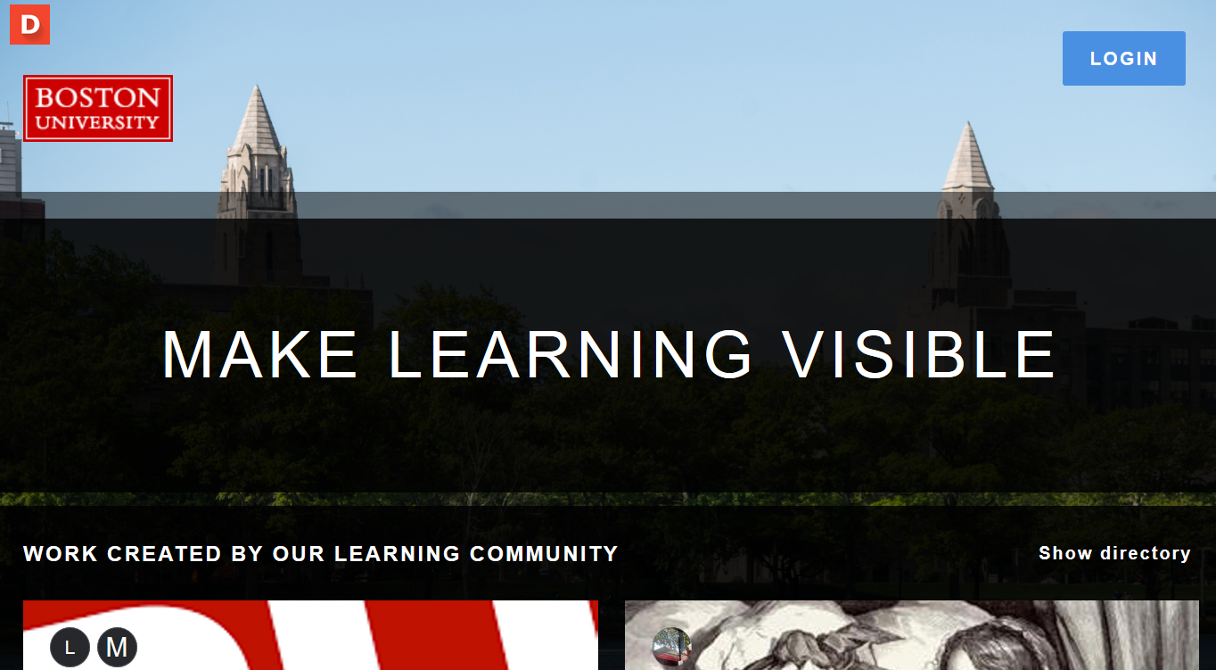
https://bu.digication.com/app/

Slide 39
Portfolio Checklist
Please Include:
All Course Syllabus
Your Program Plan with course title
Your transcript
A copy of the learning contract for the foundation and advanced years in the field
Agency material (e.g., orientation, workshop or seminar outlines)
A sample process recording or practice analyses, appropriately disguised
Field instructor evaluations from all semesters
Copies of two psychosocial assessments, appropriately disguised
Community Assessment (MP 759 assignment)
Supervision log
Graduation Review Form
Updated Resume If Appropriate:
                Group curriculum used by student in leading a group
                Outline and handouts from workshops designed and run by student
                Material developed for a community education project or grant proposal
                List of any additional training
                Any other documents or material reflective of your learning

Slide 40
Student Experiences Across the Country

Slide 41
Our thanks go to:
This presentation was adapted from:
“Social Work License Process” Power Point presentation by Erin LeBel, LICSW and Erin Murphy, LICSW, Board of Registration of Social Workers (2017)
“Primary Care Recruitment and Retention Programs in Massachusetts” PDF presentation by Nicole Watson, Massachusetts Health Care Workforce Center (2017)
Revised in 2019 by Erin LeBel and Jonas Goldenberg, BUSSW MSW Program Manager
Revised in 2020 by Cynthia Bramble-Daley and Cindy Ciluffo, BUSSW Student Services Administrators

Slide 42

CONGRATULATIONS
You are on your way!

Slide 43
THANK YOU FOR ATTENDING!
We wish you much success in the MSW Program
and in your career.
We want to hear from you.
Please, Keep in Touch

