Slide 1

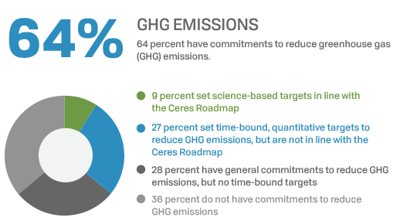
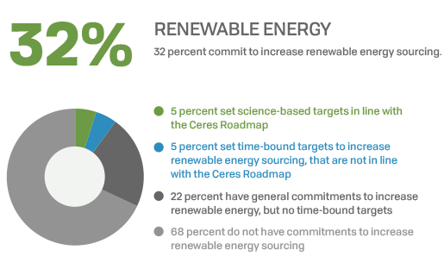




Momentum Building for
Clean Energy Goals
Notes:
63% of fortune 100 companies have set GHG targets, 32% have specific renewable energy goals (most companies with GHG goals will be using RE to hit those goals but haven’t set a specific target yet)
RE100 now includes 152 global companies, many are already 100% renewable.

Slide 2
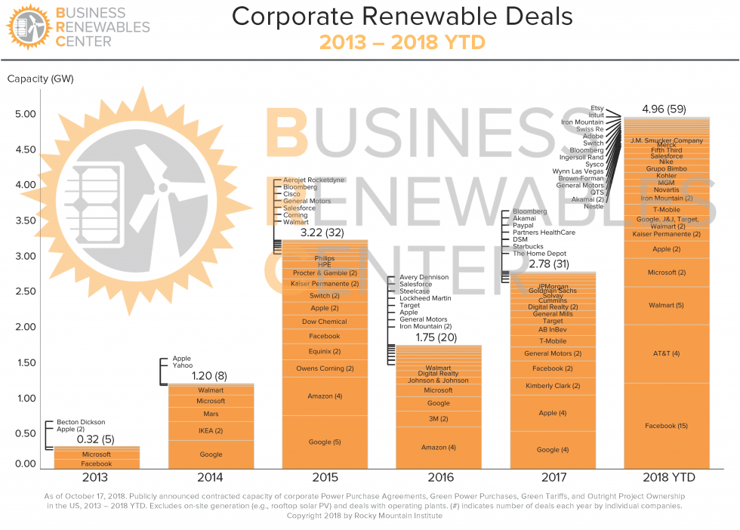
Notes:
In the last 5 years companies have signed roughly 8GW of RE contracts, 2017 was another record year globally (REBA) though not in the US.
Despite the proposed repeal of the clean power plan, threats of solar tariffs and uncertainty around RE incentives in the tax bill, 2017 was the second best year on record in the US and 2018 has already set a new record, surpassing the last two years combined.
Big deals still matter, and it big tech companies still lead the charge but companies with smaller energy footprints, and companies like Kohler (toilet maker in Wisconsin), Groupo Bimbo (baker of snack cakes and chips) and Brown-Forman (whiskey maker in Kentucky) are showing that renewable energy has growing strength in diverse industries and well beyond of silicon valley.
Aggregation is key to growing the impact of large buyers and opening up access to smaller buyers.

Slide 3
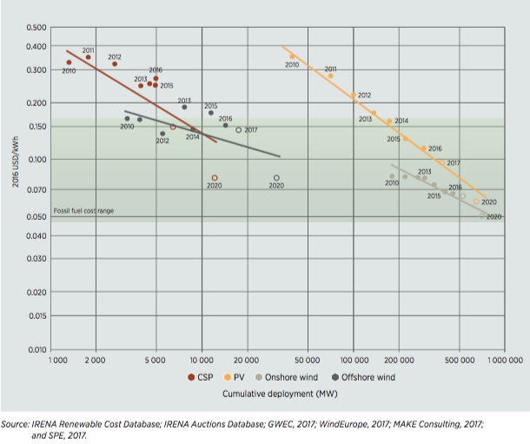
The Business Case for Renewable Energy
Notes:
RE cost less than grid power in many markets.
Also, price stability
Grid power costs companies ~$0.1055/kWh (EIA). By 2020, average cost of onshore wind power will be $0.05/kWh and solar will be $0.06/kWh. More expensive technologies like concentrated solar and offshore wind will be in the $0.06-$0.10 range (IRENA).
According to IRENA “By 2020, all the renewable power generation technologies that are now in commercial use will fall within the fossil fuel-fired cost range, with most at the lower end or even undercutting fossil fuels.”

Slide 4
Other Benefits of Renewable Energy
Electricity Prices
Cost Stability
Resiliency
Reputation
Investor Expectations
Cost of Inaction/Need for Climate Leadership

