Slide 1

ENGIE Overview

Slide 2





About ENGIE
ENGIE is a global energy and services group, with wide expertise and strong international positions in the fields of electricity, natural gas and energy services.
153,090
employees worldwide
Operations in more than 70 countries
$74.7 billion
revenues
$12.2 billion
EBITDA
$17.9 billion growth investments over 2016-2018 including
$1 billion
in innovation and digital
¨*Figures as of 31 December 2016

Slide 3



ENGIE has 3 core businesses to lead the global energy transition
  Generation of electricity mainly from low CO₂ sources
  (renewables, thermal contracted)
  Development and management of global infrastructure and networks
  (gas-electricity)
  Customer solutions and services for residentials, professionals, businesses, cities and territories

Slide 4
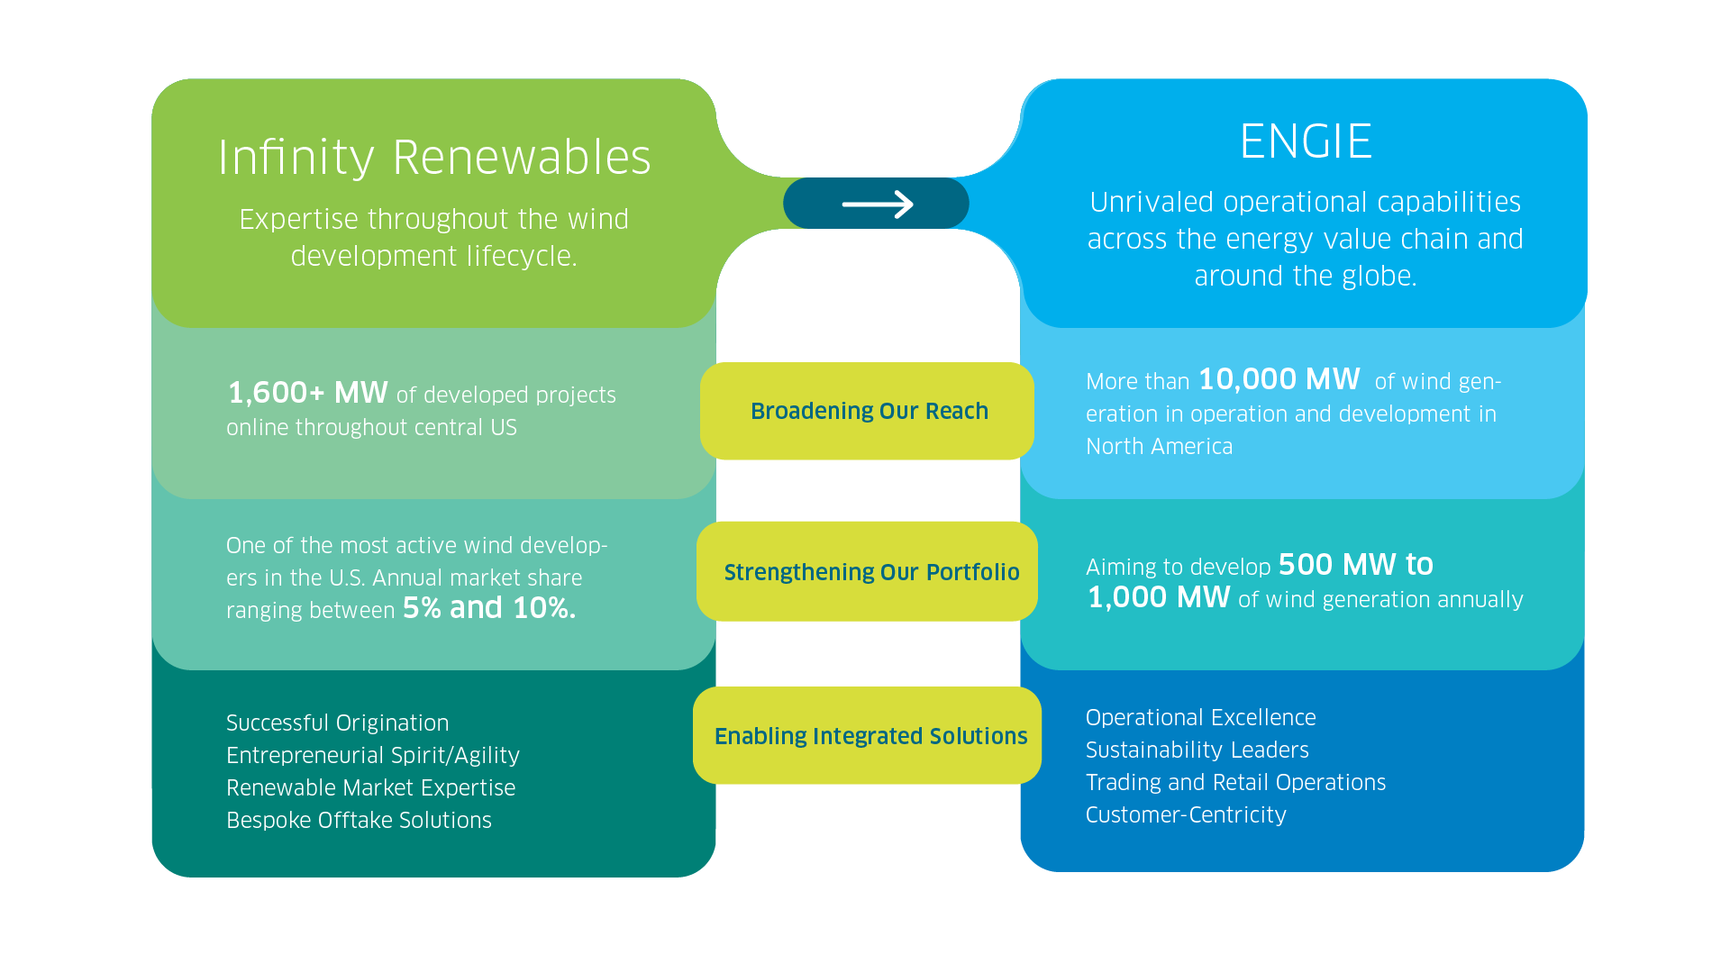
Transforming Infinity Renewables to ENGIE:
Blending strengths to ensure operational and development success

Slide 5

ENGIE is present in 70 countries across 5 continents
NORTH AMERICA⁽¹⁾
  $4.6 billion
    total revenue
europe⁽²⁾
  $59.9 billion
    total revenue
150,000
  employees
$76 billion
  total revenue
asia
  $3.3 billion
    total revenue
SANTA BARBARA
  Wind Business
oceania
  $2.2 billion
    total revenue
latin AMERICA⁽¹⁾
  $5.0 billion
    total revenue
Middle-east
  $1.0 billion
    total revenue
africa
  $0.5 billion
    total revenue
(1) Including Mexico. (2) Including Turkey.
5

Slide 6
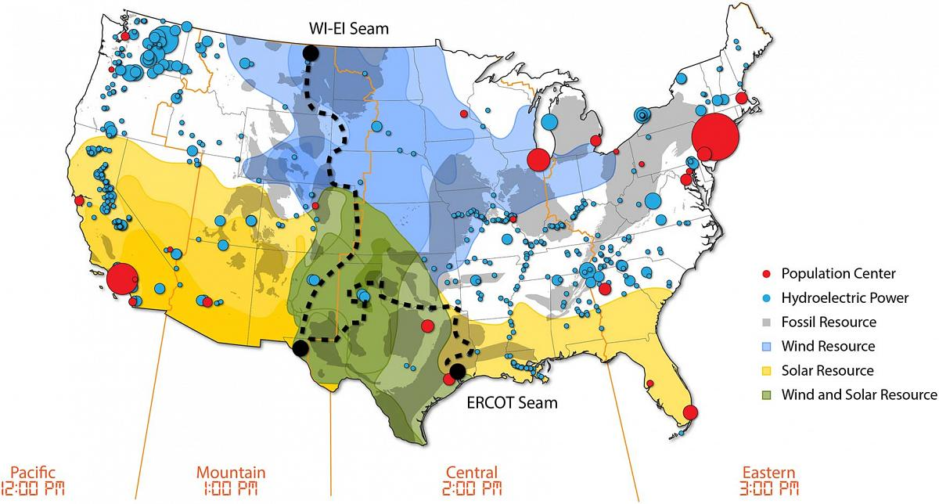
Corporate PPAs by Region
Source: National Renewable Energy Laboratory

Slide 7
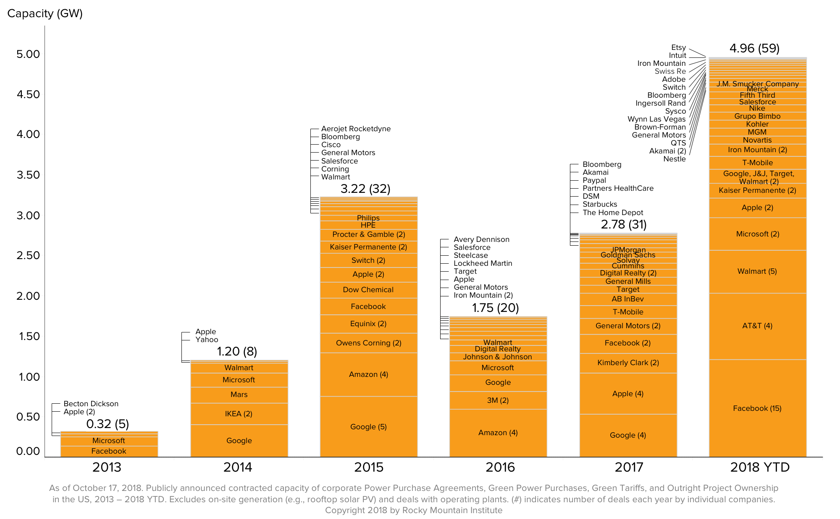
Corporate Renewable PPAs by Year
Source: Business Renewables Center

Slide 8
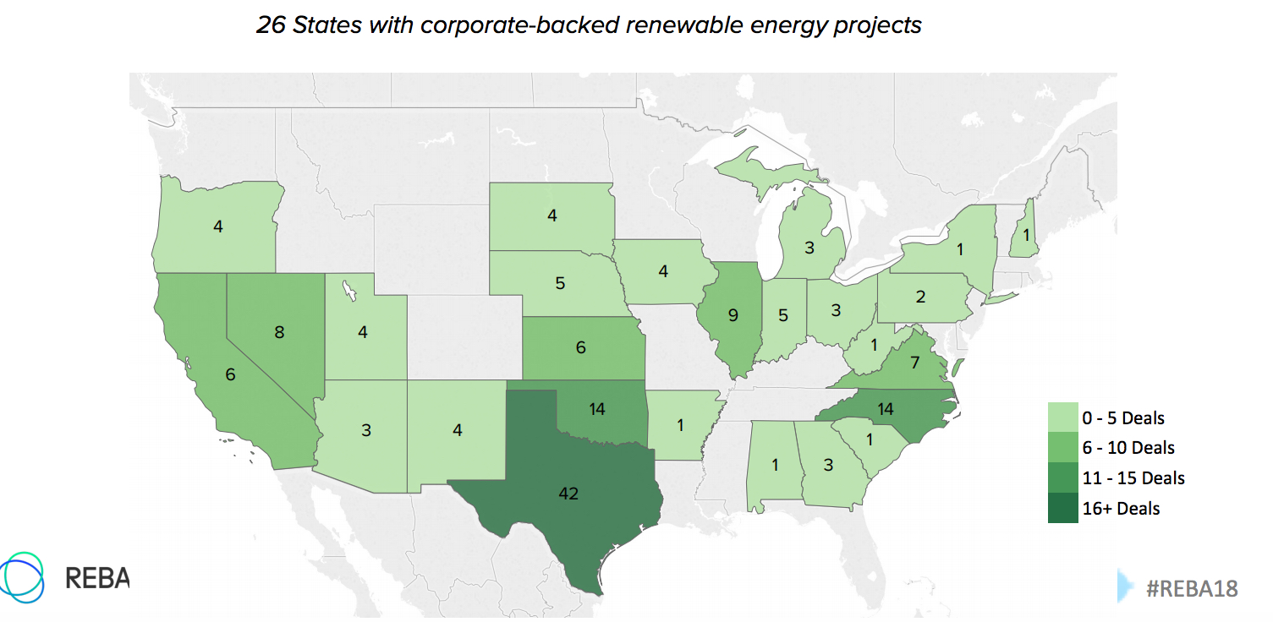
Corporate Renewable PPAs by State
Source: Business Renewables Center

