Slide 1
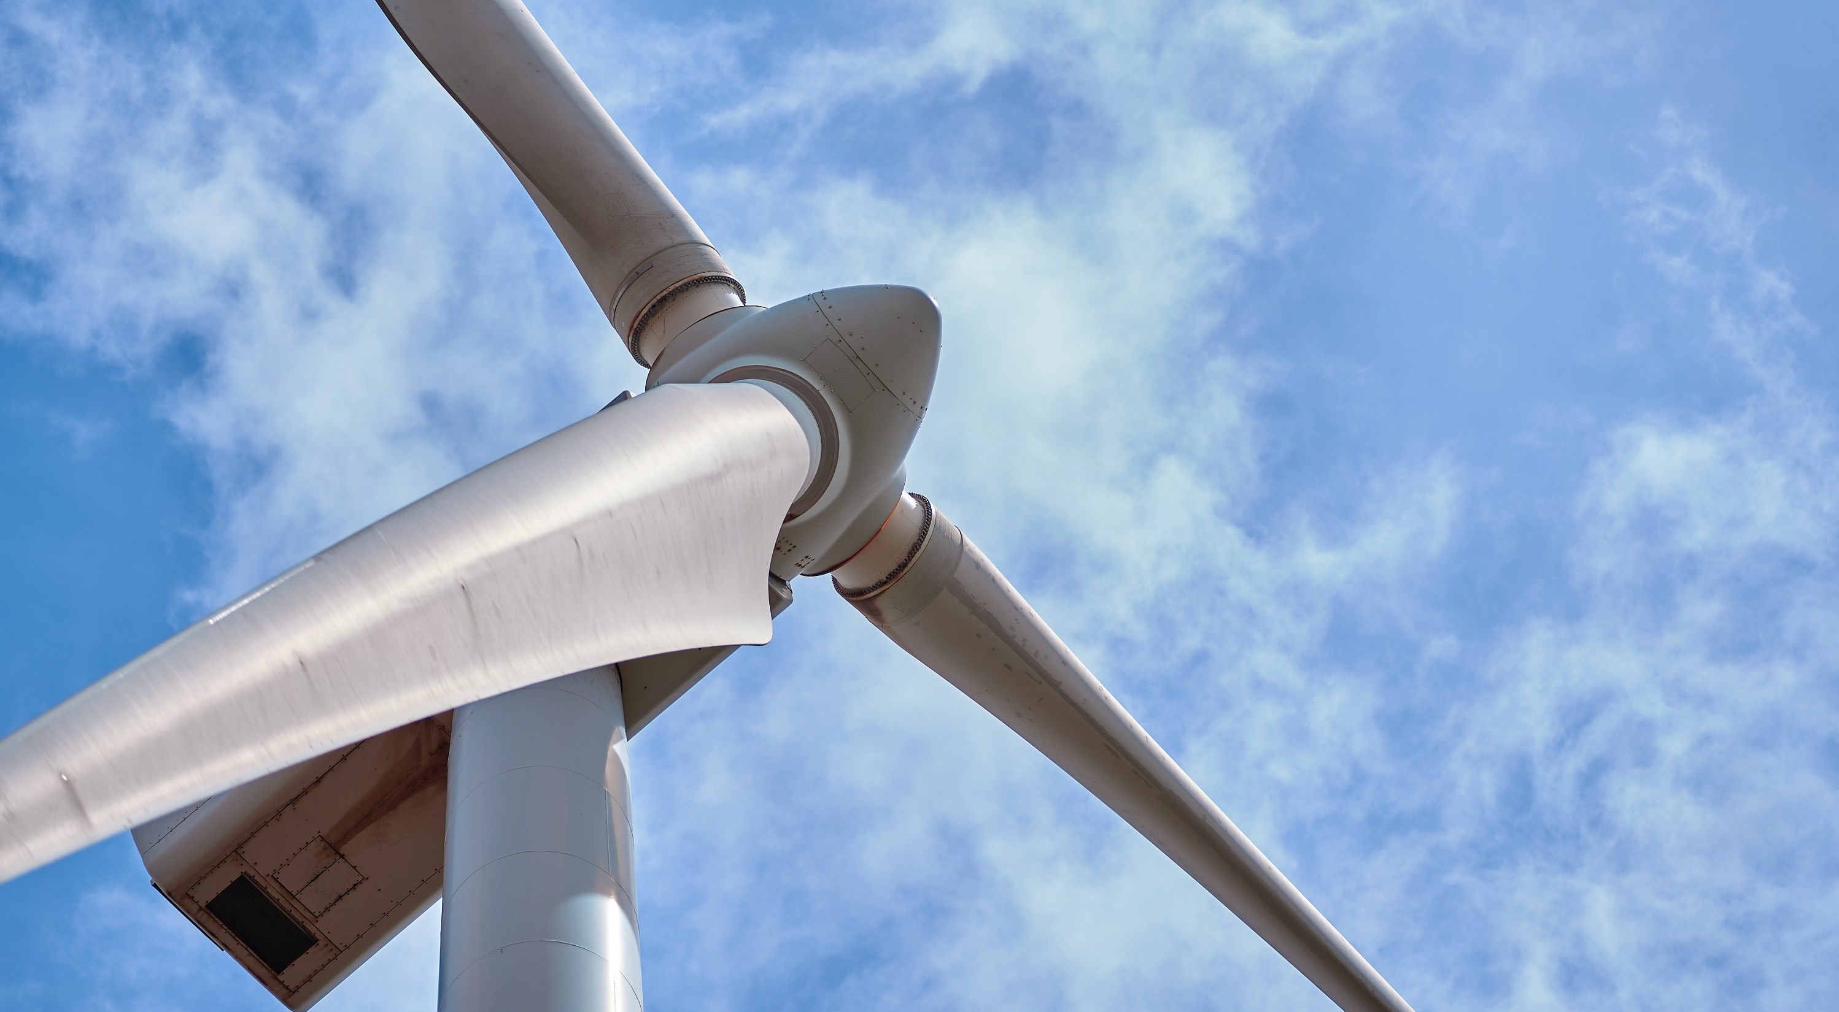


BUwind
Green Ribbon Commission
Renewable Energy Workshop
October 24, 2018
Notes:
In 2016, BU’s Board of Trustees asked the University to develop a Climate Action Plan.
President Brown assembled a faculty-led Task Force charged to:
Develop the Plan
Engage the BU community and the broader community of stakeholders in our process, and
To use this as an opportunity to raise the University’s position as a leader in climate action.
For those of you in the room who contributed to our process, thank you

Slide 2

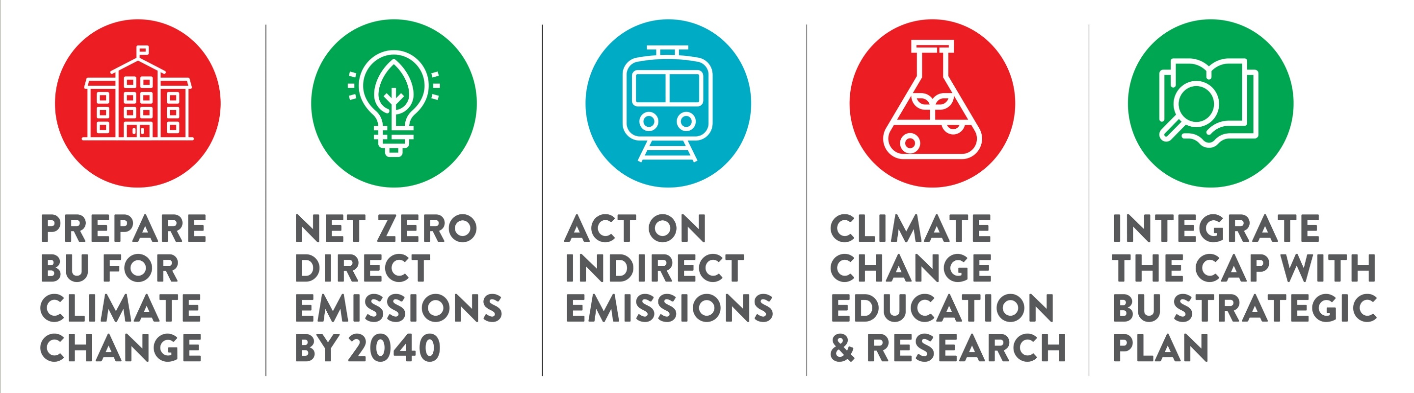
BU Climate Action Plan
#1
#2
#3
#4
#5
2
Notes:
These are the 5 high-level recommendations approved
Today, I will focus on #2 Zero Net Emissions for our operations by 2040

Slide 3
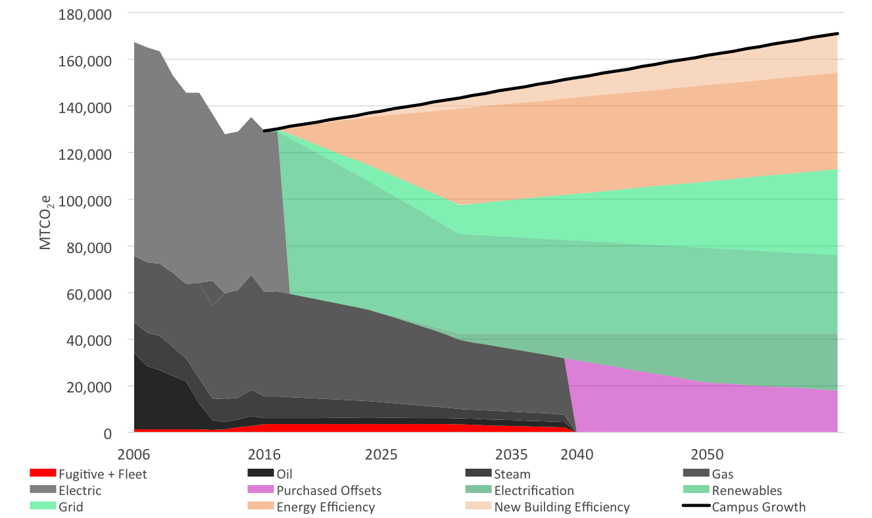
Net Zero Direct Emissions by 2040
Efficiency
Electricity
Grid
Renewables
Natural Gas
Steam
Electrification for
Renewables
Oil
Offsets
3
Notes:
To close the gap starting in 2040, we will need to buy offsets. Our goal is to minimize this gap as much as possible over the next 22 years.
[Do you want to mention reducing the rate of campus growth?]

Slide 4
Power Purchase Agreement Economics
Board / C-Suite Talking Points
  Energy cost hedge
  Electricity and natural gas pricing highly correlated
  Natural gas price stability
  45% decrease in fixed price since 2015
Market Price
Price $
PPA Price
Time: 15 years
4
Notes:
c) This project provides a ~ 50% hedge on our current natural gas spend. As we complete energy efficiency projects, this will be closer to a 75% hedge at the end of the PPA period
d) We believe the declining PTC value has increased market pressure for developers to get these deals done.
e) There is a strong correlation between HH natural gas prices and electricity prices. Through a very thorough downside risk analysis we believe this project will be cash positive for us in year 1 and over the life of the project. We assume electricity prices will remain fairly flat over the next 10 to 15 years.

Slide 5
Power Purchase Agreement is an Energy Procurement Hedge
 | BU Purchased Gas MMBtus | BU Purchased Steam MMBtus (at 1.8 MMBtus per Mlb) | Subtotal BU Purchased Gas and Steam MMBtus | BU Purchased Electricity MMBtu Equivalent at 7.8 MMBtus per mWh | Total BU Energy Purchases MMBtu Equivalent | Wind Generation MMBtu-Equivalent for 205,000 mWhs at 6.34 MMBtus per mWh | % of Total BU Energy (MMBtu Equivalent) Covered by Wind Generation
2017 | 841,666 | 223,300 | 1,064,966 | 1,506,619 | 2,571,585 | 1,300,000 | 51%
2018 | 821,207 | 213,870 | 1,035,077 | 1,472,368 | 2,507,445 | 1,300,000 | 52%
2019 | 800,748 | 204,441 | 1,005,188 | 1,438,116 | 2,443,305 | 1,300,000 | 53%
2020 | 780,288 | 195,011 | 975,299 | 1,403,865 | 2,379,165 | 1,300,000 | 55%
2021 | 759,829 | 185,581 | 945,411 | 1,369,614 | 2,315,024 | 1,300,000 | 56%
2022 | 739,370 | 176,152 | 915,522 | 1,335,362 | 2,250,884 | 1,300,000 | 58%
2023 | 718,911 | 166,722 | 885,633 | 1,301,111 | 2,186,744 | 1,300,000 | 59%
2024 | 698,452 | 157,292 | 855,744 | 1,266,860 | 2,122,604 | 1,300,000 | 61%
2025 | 677,993 | 147,862 | 825,855 | 1,232,608 | 2,058,464 | 1,300,000 | 63%
2026 | 657,533 | 138,433 | 795,966 | 1,198,357 | 1,994,323 | 1,300,000 | 65%
2027 | 637,074 | 129,003 | 766,077 | 1,164,106 | 1,930,183 | 1,300,000 | 67%
2028 | 616,615 | 119,573 | 736,188 | 1,129,855 | 1,866,043 | 1,300,000 | 70%
2029 | 596,156 | 110,144 | 706,300 | 1,095,603 | 1,801,903 | 1,300,000 | 72%
2030 | 575,697 | 100,714 | 676,411 | 1,061,352 | 1,737,763 | 1,300,000 | 75%
2031 | 555,238 | 91,284 | 646,522 | 1,027,101 | 1,673,622 | 1,300,000 | 78%
2032 | 555,238 | 91,284 | 646,522 | 1,027,101 | 1,673,622 | 1,300,000 | 78%
2033 | 555,238 | 91,284 | 646,522 | 1,027,101 | 1,673,622 | 1,300,000 | 78%
In the Climate Action Plan, BU energy purchases (in MMBtu-equivalents) are projected to exceed the project’s wind generation in MMBtu-equivalent measures.
The wind generation will be sold at market prices and provides a price hedge for 51 to 78% of the MMBtu-equivalent portion of BU’s future energy demand purchased at market.
An increase in Henry Hub natural gas prices would increase BU’s energy costs, but will also have an offsetting increase PPA market prices and revenue for electricity.

Slide 6
High Correlation of Electricity Pricing to Henry Hub Natural Gas Price
SPP South Electricity Price Correlation to
Henry Hub Natural Gas Price
March 2014 through December 2017

Slide 7
Stable Historic and Future Market Pricing for Henry Hub Natural Gas
Natural gas prices are likely to stay relatively stable for the next 8-12 years as technology offsets inflation.
After that period, prices could move higher or lower depending on demand and technology.

Slide 8
BUwind
Take Aways:
Major step to achieve Climate Action Plan goals
Makes business sense
Benefits education and research mission

