Slide 1

Payroll Coordinator Training

Slide 2
Agenda
Training Objectives
Responsibilities of a Payroll Coordinator (PYC)
Org. Management (OM) & Personnel Administration (PA)
Payroll Calendar Deadlines
Lifecycle for a BU Employee
Navigating the Payroll Coordinator Menu in BUworks
Important HCM Reports
Sample Business Scenarios and OM/PA Forms to be used
Viewing Employee information via WebGUI (SAP transaction PA20)
Organization & Staffing Display via Nakisa tool & PPOSE (SAP transaction)
Training Resources

Slide 3
Training Objectives
By the end of this training, you will have an understanding of:
What is the difference between Org. Management (OM) & Personnel Admin (PA) forms and how they are related
Employee’s lifecycle at BU and the basic OM and PA Scenarios that need to be processed during that lifecycle
Reports to be run during the Weekly/Monthly Payroll Cycle
Importance of meeting Weekly/Monthly Payroll Deadlines

Slide 4

Responsibilities of a Dept. Payroll Coordinator (PYC)
Review and maintain Org. Units (Departments) and their reporting structure (OM)
Review, Maintain and Create Positions (OM)
Process employee related SAP transactions (PA) such as:
    - Hires
    - Terminations/Retirements/Leave of Absence
    - Promotions/Transfers/Position Changes
    - Changes in % time (FT to PT, PT to FT, PT to PT)
    - Salary changes and updates to cost distributions
    - Process appropriate additional and/or recurring payments
Run HCM reports throughout the payroll period to review employee data, prior to and post payroll runs, to reconcile payments for the period
Monitor (in conjunction with managers and timekeepers) the recording & tracking of sick/vacation accruals
Process vacation payouts for Non-Exempt employees upon termination

Slide 5
What is Organizational Management (OM) – An Overview
As a payroll coordinator, you will be required to maintain your Organization’s Structure & Positions within the Org. Structure
Your Org. Unit is your department/school. It’s attributes include Org. Unit Id, name and Cost Center. It may have sub-org units (one or more departments under the umbrella of the main department) and positions within each of those departments. A hierarchical relationship exists between Org. Units and sub-org units, and the positions within them
Positions in your Org. Unit are occupied by Staff/Faculty OR could also be unoccupied/vacant. Candidates are hired into positions and there is a 1:1 correspondence between a position and it’s holder
Information relevant to a position:
  - Enterprise structure (Personnel Area(CRC/BUMC) , Personnel Subarea (Represented/Non-represented Staff/Faculty), Emp. Group (EG) & Emp. Subgroup (ESG)
  - Org. Unit
  - Job Code
  - Percent Time (Full-Time is 100%, Part-Time is <=99% )
  - Assignment Duration (< 9 months is temporary)
  - Budget (Proposed Recruitment Amount)
  - Cost Center/ Grant
  - Salary Cost Distribution
  - Essential Duties
  - Position Requirements
  - Work Location
  - Recruitment Info

Slide 6
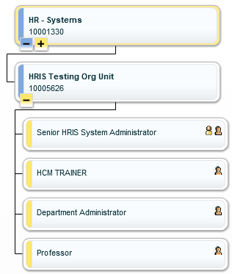
Organization Structure – An Example
“HR Systems” is one of the Org. Units under the “Human Resources Information Systems” Org. Unit, which in turn, is one among several Org. units under the “Human Resources” Org. Unit umbrella
“HRIS Testing Org Unit” with Org. Unit Id 10005626 comprising of four distinct positions, is a Sub Org. Unit of “HR Systems” whose Org. Unit Id is 10001330
1. Senior HRIS System Administrator, Position Id: 50043651
2. HCM Trainer, Position Id: 50043652
3. Department Administrator, Position Id: 50043653
4. Professor, Position Id: 50043654

Slide 7
What is Personnel Administration (PA) – An Overview
Forms processing requires you to link position information resident in Org. Management (OM) to employee info. which resides on the individual employee’s record in Personnel Administration (PA). PA employee data can be dependent on as well as independent of OM (Org. structure & Position) data
PA Employee Data DEPENDENT on OM | PA Employee Data INDEPENDENT from OM
Enterprise Structure (PA, PSA, EG, ESG) | Employee Personal Data such as SSN, Gender, Home Address, Personal email
Org. Unit | Work Schedule Rule (How many days a week, how many hours a day, rotating/non-rotating schedule)
Job Code | Salary and Salary Cost Distributions
Assignment Duration & Percent Time | Additional/Recurring/Secondary Payments
Position Summary, Essential Duties, Requirements & Budget | Patent (Intellectual Property) related information, Service Date
PA Actions Update Employee Data | Purpose
Employee Position Update - EPU (Maintain Position OM action must complete approvals before EPU can be submitted) | Change multiple attributes on an employee’s record such as title, salary, cost distribution
Salary Change (Maintain Position OM action may be required if Position Budget needs to be increased) | Change an employee’s salary for Market/Equity Adjustment reasons
Additional Payment (No OM pre-requisite action needed) | One time payment to an exempt staff member
Recurring Payment (No OM pre-requisite action needed) | An amount of money paid equally over multiple pay periods to an exempt staff member
Secondary Work Payment (No OM pre-requisite action needed) | Work done by a non-exempt staff for a different Org . Unit at a different hourly rate than regular rate
Salary Cost Distribution (No OM pre-requisite needed if grant funded but if distribution involves cost-center change, position must be maintained) | Change existing cost distributions
Leave of Absence (LOA) /Termination/Retirement (No OM pre-requisite action needed) | Leave of Absence > 3 days, Termination or Retirement due to voluntary actions

Slide 8
OM vs. PA Actions
OM Actions
PA Actions
Create & Update Info about Org. Unit/Position
- Request for creation of a new Org. Unit
- Create/Update Position’s Enterprise Structure (PA/PSA/EG/ESG)
- Create/Update Position’s affiliation to Job
- Create/Update Position’s Essential Duties
- Create/Update Position’s Budget
- Create/Update Position’s Work location
Create & Update Info about Employee/Person
- Hire/Re-Hire
- Salary, Grade, Pay Scale
- Leave Status
- Salary Cost Distribution
- Additional/Recurring Payment (Exempt Employee)
- Secondary Payment (Non-Exempt Employee)
- Retirement/Transfer/Termination
IMPORTANT: When the OM form “Maintain Position” is a pre-requisite to submitting a PA form, it must complete approvals in workflow BEFORE the PA form is submitted. If you are processing an EPU and you do not see the new position info on the PA screen for the EPU, please stop and make sure your that your OM form shows “Completed” status. If it just finished approvals, please wait two hours for the OM and PA data to sync.

Slide 9
Not Advisable! Multiple PA Form Submissions for the Same Employee on the Same Day
Cautionary Note: The simultaneous submission of more than one PA action on an employee with the same effective date will cause the PA forms not to complete properly.
Example of Business Scenario and multiple PA forms submitted on the same day:
Business Scenario: Part time lecturer is hired for 20 hours a week and promised a monthly salary of $X effective Sep 1, 2018. The expected student enrollment changes for the Fall course and there is a subsequent need to adjust percent time and salary to change monthly salary to $Y effective Sep 1, 2018 for the same employee.
Payroll Coordinator form submission resulting in form failure:
If a Salary Change for the employee effective Sep 1, 2018 is submitted on the same date as an EPU with further changes to percent time and salary for the same employee effective Sep 1, 2018
Solution: Consult a member of HRSYS team by emailing your specific scenario to hrsys@bu.edu to get advice on how to proceed BEFORE you submit multiple PA forms for any employee with the same effective date.

Slide 10
The Importance of OM and PA Data Being in Sync
The enterprise structure comprises of Personnel Area (PA), Personnel SubArea (PSA), Employee Group (EG) & Employee subgroup (ESG) and resides in OM and PA records. Since the relationship between OM and PA is very important, a payroll coordinator must ensure that the enterprise structure and attributes on a position must match the OM data on the employee’s record. The EG/ESG on the position must always match the EG/ESG on the employee’s record
Certain PA actions need an OM action as a pre-requisite. For instance, when an employee changes from FT to PT, the position will be required to be maintained as a pre-requisite for the PA action, Employee Position Update (EPU) which changes the % time & salary. If only the position is maintained and % time changed without being followed by a PA (EPU) action, OR, if just a PA action (EPU) is performed without first maintaining the position, the EPU form will error out & the OM and PA pieces are no longer be in sync and pose a problem to data integrity.
Personnel Area (PA) | Personnel Area the employee is located in such as Charles River Campus, BU Med. Campus, NEIDL etc.
Personnel SubArea (PSA) | Non-Represented Faculty, Non-Represented Staff, BU Police, Represented Faculty, Represented Staff etc.
Employee Group (EG) | Employee Groups such as Exempt Full-Time/Part-Time Staff/Faculty, Non-Exempt Full-Time/Part-Time Staff, Non-compensated Staff etc.
Employee Subgroup (ESG) | Subgroups within an EG such as Executive, Temporary, Academic Research, Guest Affiliates etc.

Slide 11
Descriptive Comments are Essential!
A descriptive comment can expedite approval of the form in workflow! It should serve as a means of communicating the desired outcome for the form and set context by mentioning any discussion with HRBP or Compensation/Budget Analyst pertaining to the form.
When creating/maintaining a temporary position (< 9 months assignment duration) that should not be accruing vacation/sick time or other benefits, it is important to mention it in a descriptive comment. Based on your description, a Compensation Analyst will ensure the proper assignment of Enterprise Structure to the position (Personnel Area/Personnel Subarea/Employee Group/Employee Subgroup).
Example of a descriptive comment on a Maintain Position form:
New title on the position “Lead Designer”, change in Essential Duties, Revised Pay Grade from AP73 to AP74 and revised annual salary from $50,000 to $60,000 based on discussion with Compensation Analyst Jane Doe on June 4, 2018
Notes:
.

Slide 12
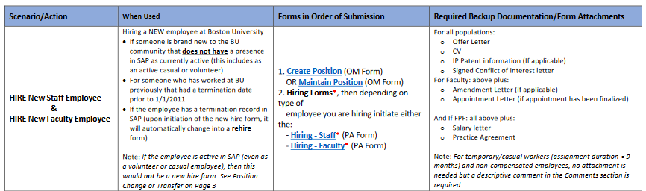
Which PA actions require OM pre-requisite action?
The Form Letter Matrix explains which forms require an OM form as a pre-requisite to a PA action to maintain OM and PA info in sync. For instance, before you begin to hire a candidate, you must have an “open” and vacant position available in your department
http://www.bu.edu/tech/files/2016/02/End-to-End-Process-Matrix.pdf

Slide 13
Sample Payroll Timeline for OM and PA Forms
Position (OM) & Employee related (PA) forms must be submitted by the designated OM/PA deadlines. Creating new position & hiring as well as maintaining existing positions and updating PA forms MUST complete approvals before monthly payroll deadline. The calendar below is an example. Click here for the actual OM/PA calendar
Effective Date for Hiring New Employees | Create Position (OM form) must complete approval in workflow | New Hire (PA Form) must complete approval in workflow
June 2018 | May 18, 2018 | May 23, 2018
Effective Date for Maintaining existing positions and updating PA forms | Maintaining an existing position must complete approvals | Submitted PA Form must complete approvals
June 2018 | June 18, 2018 | June 22, 2018
Notes:
.

Slide 14
Consequences of Missing OM/PA deadlines (A Scenario)
Payroll Deadline for January, 2018
Effective Date | OM Form approval deadline | PA Action approval deadline
January 1, 2018 | January 15 | January 19
Scenario – Employee making $5,000 a month moves from a 100% Full-Time exempt employee to a 49% Part-Time exempt status on January 4, 2018
The proper OM form of maintaining the position to PT is approved in time, but the EPU (PA form) to update the employee’s record is not completed & approved by the PA deadline. Due to the employee’s record not being updated on time:
The employee is paid the full salary of $5,000 resulting in overpayment for the period Jan 5th – 31st
Employee benefits are not cancelled on time and will have to be retro-cancelled after EPU completes
The employee’s automatic vacation payout does not happen in time and the retirement plan contribution is impacted
- The department now must deal with collection of money from ex-employee who was overpaid

Slide 15
BU Employee Lifecycle
A payroll coordinator is responsible for the maintenance of an employee’s record during their entire lifecycle as an employee in your department. The possible events that can occur between an employee’s hire and term/retirement are shown below:
IMPORTANT: Some events such as percent changes in employee’s work such as FT -> PT or PT -> FT changes can require BOTH OM and PA actions while changes to cost distribution/termination/retirement/additional payments only requires PA
Cost Distribution/
Work schedule Change
Salary Increase/
Additional Recurring/Secondary Payments
% Time Change
FT to PT
PT to PT
PT to FT
Leave of Absence/Return from Absence
Promotion/Transfer/
Position Change
Employee is Hired/Re-Hired into BU
Employee Leaves BU
Retirement/Termination

Slide 16
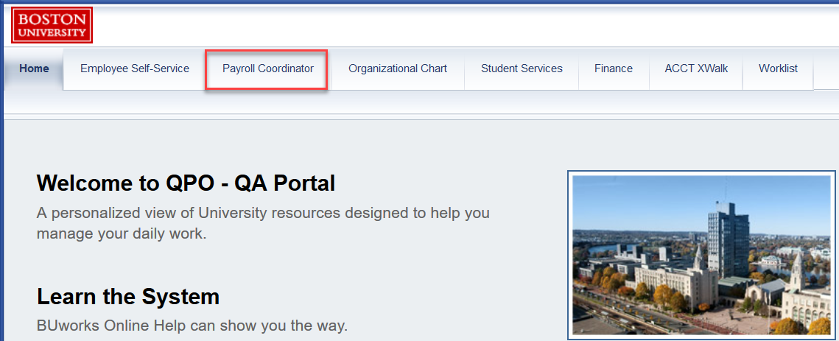
The Payroll Coordinator (PYC) Menu in BUworks
A PYC does most of their OM & PA work through the Payroll Coordinator tab in the BUworks portal. A PYC role is given to an employee by their department through a Departmental Security Administrator (DSA) request. If you do not see the Payroll Coordinator tab when you login to BUworks, email hrsys@bu.edu
To access OM and PA forms, logon to http://www.bu.edu/buworkscentral

Slide 17
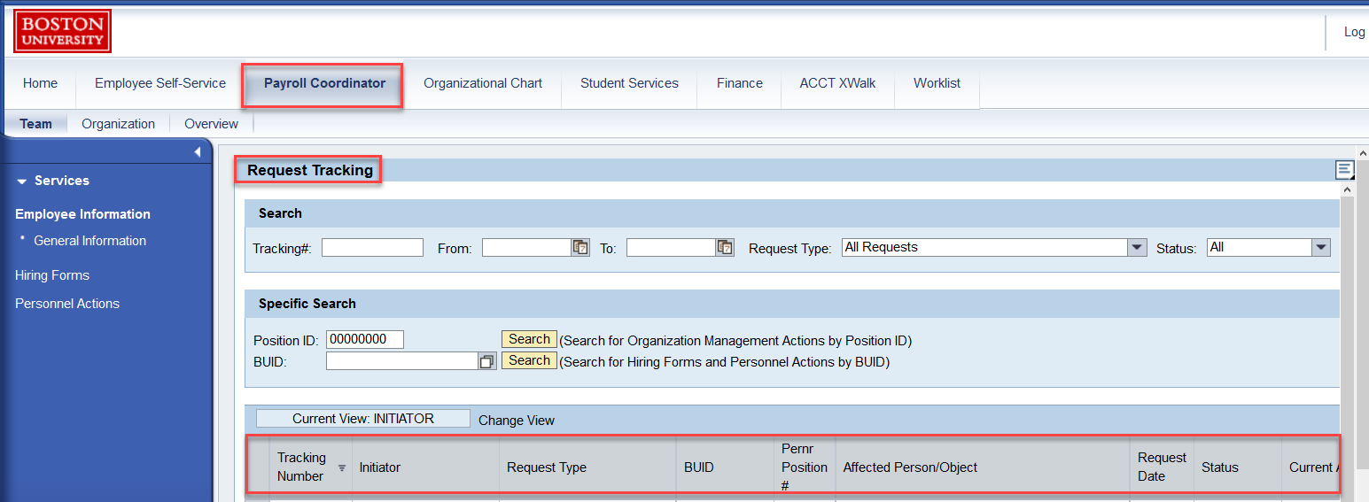
The Team Tab
The default view displays the Request Tracker. This tool allows you to track submissions of OM & PA forms via a tracking number. It gives you information about the initiator, request type, affected object, form status & current agent. Once your submitted form completes approvals/or is rejected, you will be notified via email

Slide 18
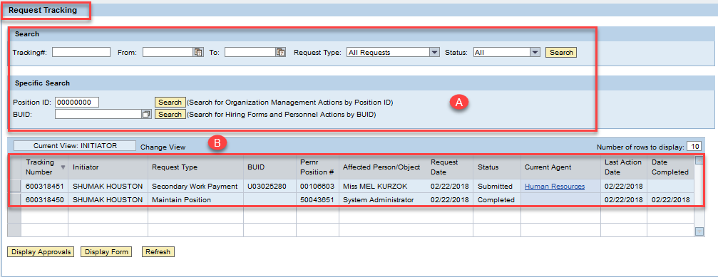
Tracking your OM/PA Form Submission via Request Tracker
All submitted OM & PA forms go through an approval process called “Workflow”. The Request Tracker allows you to check the status of your form submissions in workflow. Section (A) allows you to search for records related to a tracking #, date range, specific position (Position Id) or employee (BUID). Section (B) displays the request’s initiator, request date, request type, current agent (clickable link), status of submission and date completed

Slide 19
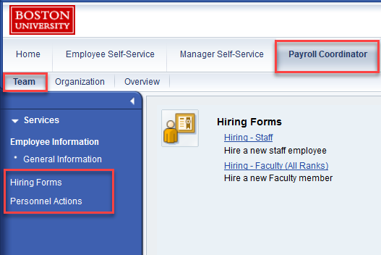
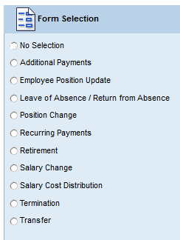
The Team Tab – A Gateway to Personnel Administration (PA)
The Team Tab allows you to hire staff/faculty based on your authorization and to also process personnel actions (PA) related to position update, movement (transfer/termination/retirement) money (salary change/additional payment/recurring payment/secondary work payment), leave of absence, funding changes in cost distributions etc

Slide 20
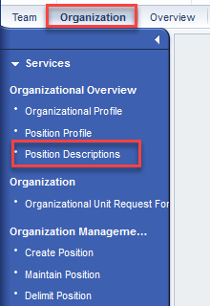
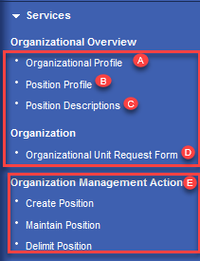
The Organization Tab – A Gateway to OM (Org. Management) Actions
Via the Organization tab, a PYC can view profiles of Org. Unit and Positions within it and perform OM actions such as Requesting a new Org. Unit or Create/Maintain/Delimit Position
Organizational Overview and OM Actions
A. Gives you information about your department’s personnel area, subarea, home cost center and staffing including manager info
B. Gives you information about the position in terms of occupancy (vacant or occupied) and names of employees holding positions
C. Position description provides department, essential duties and task priorities in terms of percentages
D. Creates a request for a brand new Org. Unit (Department)
E. Create a brand new position for a new faculty/regular staff position/temporary position (<=8.8 months duration)
E. Maintain an existing position to modify existing attributes (Title, Assignment Duration, % Time, Budget, Essential Duties, Building address & Mail code and/or to prep it for a new candidate and open the Position for hire if previous holder leaves BU
E. Delete/remove a position from SAP when the department no longer needs it

Slide 21
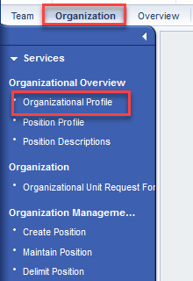
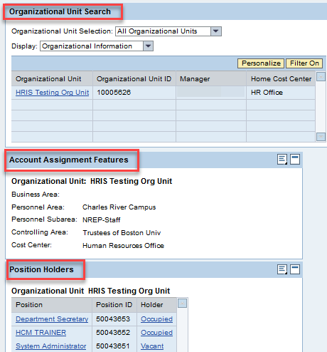
Organization/Department Profile
The Organizational profile gives you information about your Org. Unit, Enterprise Structure, Positions & Occupancy

Slide 22
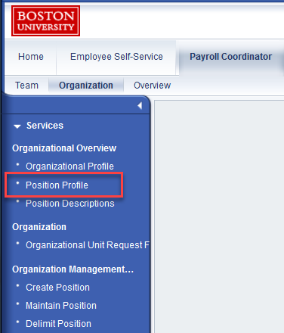
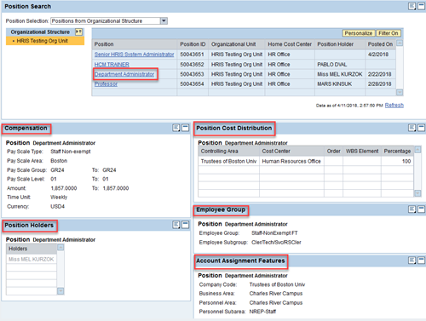
Position Profile and Detail
Click on “Position Profile” to get a position’s details such as Compensation, Cost Distribution, Employee Group & Subgroup and Account Assignment. If position is vacant, the Position Holders section will display “No data available”

Slide 23
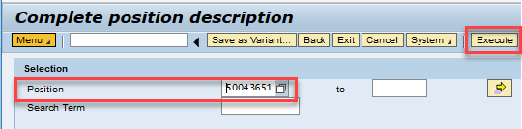
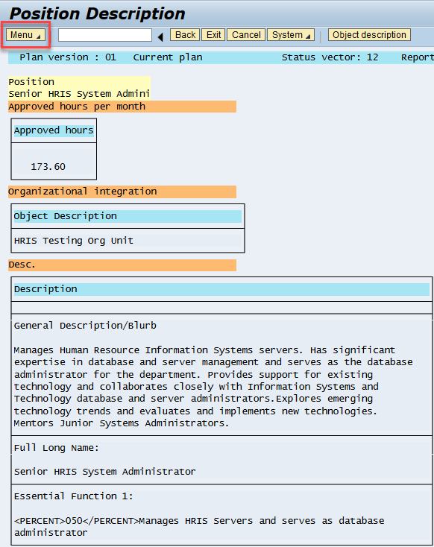
Viewing Position Descriptions
To view position description(s), specify either a single position number or a range of position numbers and click on “Execute”. Data such as Position Id and title, Org. Unit, General description and Essential functions are displayed. The Menu option allows you to download the description and/or print it

Slide 24
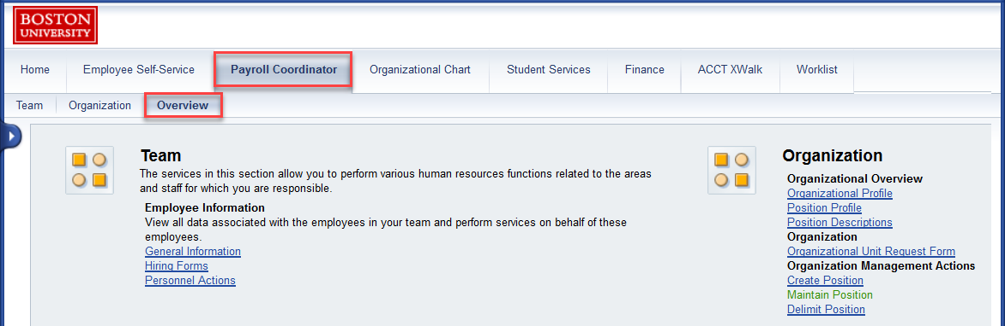
The Overview Tab
The overview tab gives you access to General information, Employee Working Times, Compensation Information, Hiring forms and Personnel Actions for the staff in your Org. Unit

Slide 25
OM & PA Form in Workflow
Submitted forms go through a workflow stopping at several Central HR departments and/or department level approvers.
Form submission status can be one of the following:
Submitted
In-Progress
Completed
Rejected/Returned/Resubmitted
Correction (The form did not complete successfully and HRIS team is reviewing errors)
Wait4payroll (Approvals completed but form did not make it to payroll)
Once your form completes approvals successfully or is rejected/returned, you will be notified via email
Please note that OM forms can only be rejected and will need to be re-created from scratch and submitted for approval. approver can however return PA forms which can then be edited and re-submitted for approval. If a PA form is “rejected” for a reason, it will need to be re-created from scratch and submitted
If the form that you submitted is in the workflow and you realize you have made an error, you can click on the Current Agent link and reach out to one of the approvers in the list to request that they reject/return the form to you

Slide 26
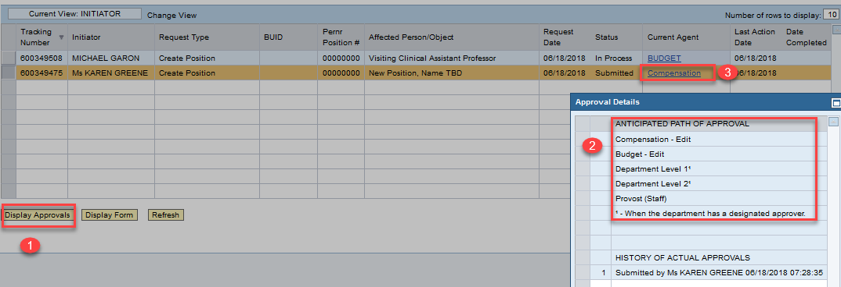
Request Tracker - Displaying Anticipated Approval Path
You can check on anticipated approval path and progress of approvals for a submitted form by clicking on Display Approvals in the Request Tracker. The history of approvals as well as the current status of submission are displayed

Slide 27

When a Submitted OM Form is Rejected or PA form Returned to Sender
OM forms can be rejected by an approver if support documents are missing or for other reasons such as a department request to reject it (eg. Entered incorrect hourly rate). The status column in Request Tracker will display “Rejected”. Access the form from your worklist by clicking on it. Scroll down to see the comments that describe why the form was rejected. The form will need to be re-done from scratch and re-submitted.
PA forms can be returned by an approver if support documents are missing or for other reasons. The status column in Request Tracker will display “Returned”. This returned form will appear in your worklist. Open the form by clicking on it. Scroll down to see the comments that describe why the form was returned. The same form can be corrected and re-submitted.

Slide 28
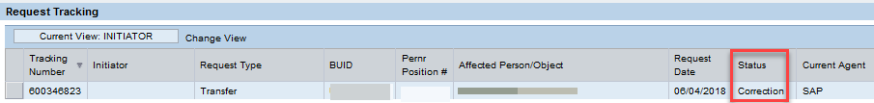
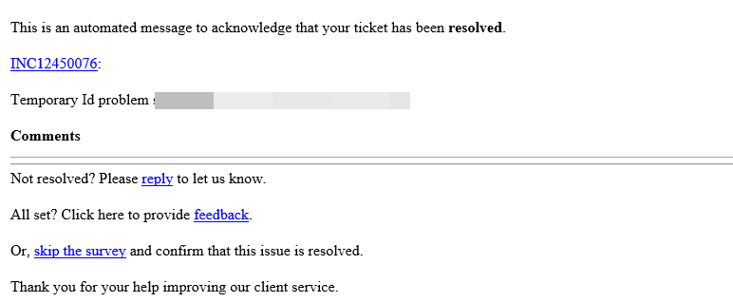
What a “Correction” in Status Column Means..
OM and PA forms may not complete successfully due to a system error. When this happens, the status column shows “Correction” and Current Agent as “SAP”. A service ticket is automatically generated for HRIS department and the form submitter is notified via email.
When HRIS resolves the error, the form submitter is once again notified via email. The status changes to “Completed”. In the meantime, the form submitter is requested not to write to hrsys@bu.edu about the ticket because it creates duplicate tickets about the same problem.

Slide 29
Sample Approval Paths for OM/PA Forms
There may be multiple levels of approval needed for an OM or PA form. It is vital that the OM/PA deadlines posted on the HR Website OM/PA schedule be followed. After submission, please allow four days for approval
Create Position Action | Criteria | Initiator | Editors |  |  | Approvers
 | Compensated Full-time Faculty Positions | Manager/PYC | Compensation | OM | Budget | Dept L1/L2 | Provost
 | Compensated Part-time Faculty Positions
 | Compensated Staff Positions | Manager/PYC | Compensation | OM | Budget | Dept L1/L2 | Provost/Staff
 | Non-Comp and Retiree Faculty and Staff Positions | Manager/PYC | Compensation | OM |  | Dept L1/L2
Termination Action | Criteria 1 | Criteria 2 | Initiator | Approvers
 | Faculty | Voluntary | Manager/PYC | BMC | FPP | Dept L1/L2 |  | HR- Service Center | PAFO
 | Faculty | Involuntary | Manager/PYC | BMC | FPP | Dept L1/L2 |  | HR- Service Center | PAFO
 | Staff | Voluntary | Manager/PYC | BMC | FPP | Dept L1/L2 |  | HR- Service Center | PAFO
 | Staff | Involuntary | Manager/PYC | BMC | FPP | Dept L1/L2 |  | HR- Service Center | PAFO

Slide 30
Business Warehouse (BW) Reports – Introduction to HCM Reports
The Business Warehouse (BW) reporting tool helps you in reporting information about your Org. Unit and employees. Note that the report data is a day old and access is limited to your authority in SAP. Take the training on HCM Reports for more detailed information.
The following reports need to be run on a periodic basis:
Prior to Payroll Run | After Payroll Run
Employee Data Model | Labor Distributions by Employee (PA15)
Most recent occurrence of payments | Labor Distributions by Fund Center (PA12)
Cost Centers soon to expire | Historical View of Payments
Position Status
Absence Tracking Verification

Slide 31
Sample Payroll Timeline for HCM Reports
For an overall understanding of employee payments and for the purpose of avoiding underpayments or overpayments to employees, HCM Reports must be run prior to and after the monthly payroll run. Here is a sample calendar for June 2018
Effective Date | Reports to be run on May 1, 2018 | Reports to be run on June 23, 2018
June 1, 2018 | 1. May’s Labor Distribution Report (PA15) 2. Position Status Report to check for occupancies and vacancies 3. Employee Data Model report to check employee work schedules 4. Cost Centers soon to expire report to gain an understanding of which cost centers/grant numbers will be active in June, 2018 | 1. June’s Labor Distribution Report (PA15) to understand payments made to employees in the department 2. June’s Labor Distribution Report by Funds Centre (PA12) to understand the payments made from the home cost center to all employees within and outside of the home department 3. Historical View of Payment Report to understand all payments made to an employee by wage type

Slide 32
Walkthrough of Business Scenarios
What OM & PA actions need to be performed to
To create a position & Hire a candidate into the position
To terminate an employee and remove position from SAP
To change employee’s percent time (Full-Time to Part-Time)
To change employee’s percent time (Part-Time to Part-Time)
To promote an employee
To make a one-time additional payment to exempt staff
To make a secondary work payment to non-exempt staff

Slide 33
Business Scenario 1: (Creating a Position & Hiring a Candidate)
As a PYC, you are required to create faculty/temporary positions and process the Hire action. Central HR will help you with hiring of candidates into regular Exempt/Non-Exempt positions.
Your department needs to post a position for a “Systems Administrator” and hire a candidate to fill the position ASAP
Solution:
Make sure a position exists in the department by running the Position Status report. If no position exists, Create a new position and allow two-three weeks for position creation and hiring action
Does the report display a vacant Systems Administrator position in your department?
Yes
No
Note the position number, submit a “Maintain position” OM form and mark it open it for hire
Create a new “Systems Administrator” position and mark it open it for hire. If external candidates are to be considered for the position, choose the option “Mark this position open for hire and post to HR Recruitment Website”.

Slide 34
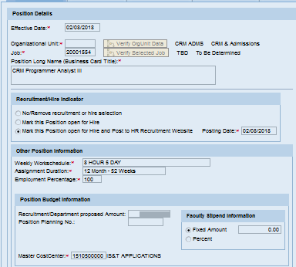
OM Form – Creating a Position and Opening for Hire
Unless the position you are creating is exactly the same as an existing position in your Org. unit, create the new position from a Job. Consult a Comp. Analyst for the correct job code. The Position effective date must precede or equal the Hire date. Have Essential Duties readily available, enter a descriptive comment, attach authorization & do not forget to mark the position open for hire
Mandatory Fields: Create Position Overview: Suggested Job Codes:
Position Id (If Copying from Position)
Effective Date
Org. Unit
Job Code (If Creating from Job Code)
Title
General Description blurb
Recruitment Indicator
Weekly work hours
Assignment Duration
Percent Time
Proposed Budget
Cost Center
Cost Distributions (Must Equal 100%)
Essential Duties
Position Requirements
Building Number
Mail Code
Hiring Manager
Comments
Job Code | Family
20001554 | To be determined (TBD)
20001559 | Postdoctoral Associate
20001553 | Non-compensated Staff
20001551 | Temporary/Casual Position

Slide 35
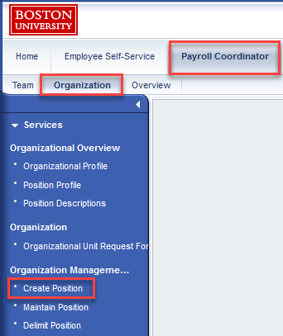
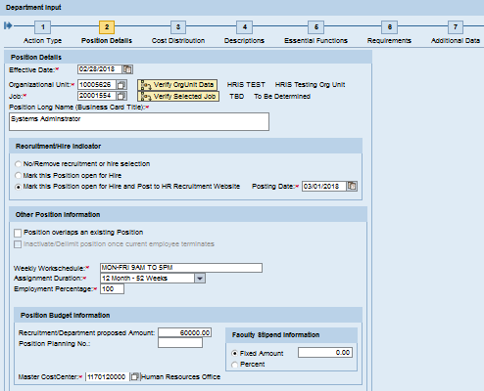
OM Form - Create Position
The “Create Position” action can be accessed in the BUworks portal via the Organization tab. In a seven step process, the payroll coordinator specifies position effective date, Org. Unit, Assignment Duration, % effort, budget, work hours, cost distribution, essential duties, educational requirements & work building location
Click here for a short Video Demo of Create Position

Slide 36
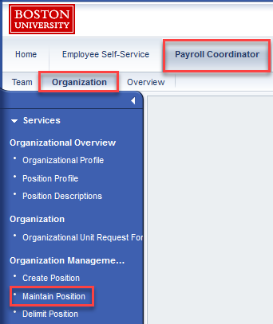
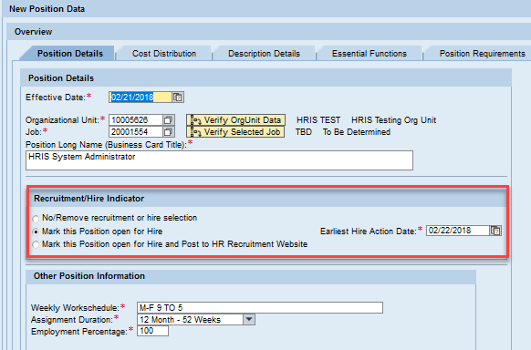
OM Form - Maintain Position
If a vacant position already exists with some details needing revision, maintain the position and mark it open for hire in the Recruitment/Hire Indicator section. If the position is to be posted on the HR Recruitment website, choose the last option in the Recruitment Indicator section and specify the posting date. If the candidate is already working at BU and there is no need to post the position on the HR recruitment website, choose the middle option to mark position open for hire and indicate the Earliest Hire Date. Use the position change/transfer forms as the next step (if needed) AFTER the maintain position action completes approvals

Slide 37
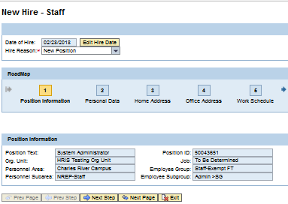
PA form - Hiring a Candidate
The Hiring form is accessed via the “Team” tab in the BUworks portal and needs an open and vacant position as a pre-requisite. Depending on your authority, you will see Hire-Faculty OR Hire-Staff OR both options on the landing page. Select the appropriate hiring action. Have the info listed in “Mandatory Fields” column readily available as saving the form for later use is not possible. Click here for a short Video Demo of Hiring Action
Mandatory Fields
Effective Date for Hire
Hire Reason
Social Security Number
BUID (Re-Hire)
Position number
Personal data (First name, last name, Date of Birth, Gender, Country of Citizenship,
Personal Email
Home Address(House #, Street, City, State)
Office Address
Work Schedule Rule
Assignment Duration
% Time
Basic Pay
Mail Code
Service Date
Cost Distribution
Patent Information

Slide 38
Business Scenario 2: (Terminate Employee & Delimit Position)
An employee needs to be terminated due to a voluntary resignation. The department decides it no longer needs the position & wants to remove it from SAP
Solution: Use the “Termination” PA action followed by “Delimit Position” OM action to remove the position from SAP.The Terminate Form can be submitted ahead of the employee’s last day.
IMPORTANT:
1. The consequence of not terminating an exempt employee before the PA payroll deadline in the month that the employee is leaving BU is that he/she continues to get paid till he/she is terminated (or moved to non-compensated status) in SAP
2. While unused vacation time is automatically paid out to exempt staff in last paycheck (make sure that estimate shown on termination form matches department’s records), you will need to manually process a payout for unused vacation for non-exempt staff using “Process Time Quota Compensation” PA61 transaction

Slide 39
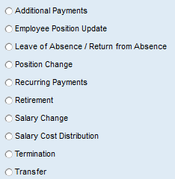
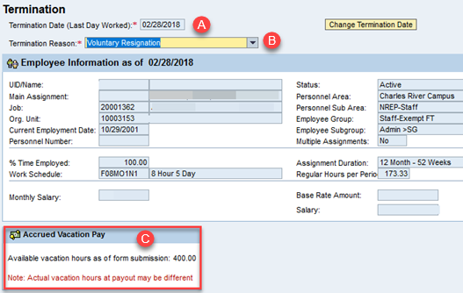
The Termination (PA) Action
The “Termination” form can be accessed via the Team tab. Click on Personnel Actions and enter BUID of employee. For Exempt Employees, estimated unused vacation payout is displayed and paid out automatically in the final paycheck. Click here to watch a video on how to terminate an employee. For non-exempt employees, PYC must manually payout the unused vacation using the PA61 transaction in SAP
Enter Employee’s Last Day at Work
Enter Reason Employee is leaving BU
Ensure accrued vacation hours are correct
Attach Resignation letter and add comment

Slide 40

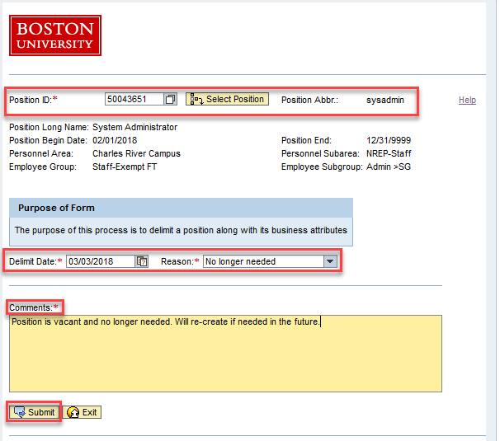
The Delimit Position (OM) Action
A Position may be delimited (removed) if it is no longer needed in the Org. Unit. If three or more positions need to be delimited, email hrsys@bu.edu. Enter Position ID, Delimit Date, Reason & Comment. Click Submit & track submission via Request Tracker. Click here to watch a video on how to Delimit Position

Slide 41
Business Scenario 3: (Full-Time Status to Part-Time Status)
An employee is reducing hours worked and moving from working 8 hours for 5 days to working 8 hours for only 3 days
Solution: The Employee Group is changing in this scenario
1. Start the process at least two weeks before the work schedule changes
2. First, maintain the position and reduce % time from 100 to 60. Do NOT mark open for hire!
3. Then, when the maintain position form completes approvals, process an Employee Position Update (EPU) and change % time, work schedule rule and update the salary to reflect the reduction in salary
NOTE: If you do not first Maintain the position and follow it with an EPU, the position data on the Org. Unit (OM) and Employee record (PA) are out of sync

Slide 42
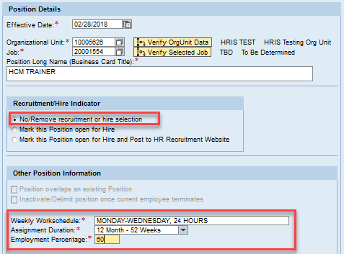
The Maintain Position (OM) Action
First, Maintain Position. Enter Position ID & Effective Date. In this case, there is no need to change the assignment duration. Select “No/Remove Recruitment or Hire Selection” option, Change Weekly work hours from 40 to 24 and reduce % time from 100 to 60.

Slide 43
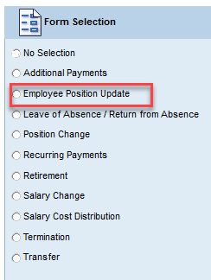
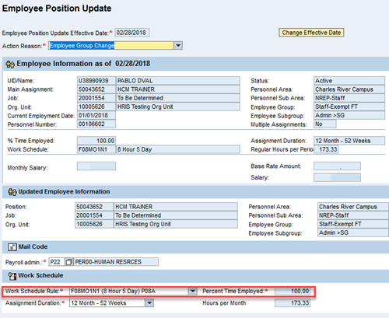
The Employee Position Update EPU (PA) Action
Once Maintain Position completes successfully, process an EPU (PA) action and reduce % Time from 100 to 60, adjust the work schedule and salary

Slide 44
Business Scenario 4: (Part-Time Status to Part-Time Status)
An employee is decreasing hours worked in a week and moving from working 8 hours for 4 days to working 8 hours for 2 days
Solution:
Consult a Budget Analyst to determine if you need to maintain position (OM Form) to revise the budget for the position. If no OM action is needed, you may simply submit an Employee Position Update (EPU)
Start the process at least two weeks before the work schedule changes
3. Process an Employee Position Update (EPU) action and change % time, work schedule rule and re-calculate salary to reflect a lower salary

Slide 45
Business Scenario 5: (Promotion)
There can be several scenarios for a promotion. For instance, a non-exempt worker can be promoted to an exempt position. This scenario examines an exempt employee who is being promoted from a Systems Administrator to a Senior HRIS Systems Administrator with change in title, position description & salary
Solution:
1. Consult a Compensation Analyst to determine correct salary for the duties to be performed. Start the process at least two-three weeks before the effective date of promotion
2. Maintain the position (OM Action) and change title, duties and budget. Do NOT mark open for hire as the position is being maintained for an existing employee!
3. When the Maintain Position form completes approvals, process a PA Action – the Employee Position Update (EPU) form to change the employee’s monthly salary

Slide 46
Business Scenario 5 (Promotion): Video Demonstration
An employee is to be promoted from a HRIS Systems Administrator to a Senior HRIS Systems Administrator with change in title & monthly salary
Solution:
Maintain the position and change title, summary description and budget. Do NOT mark open for hire as this is a promotion for an existing employee.
https://mymedia.bu.edu/media/Maintain+Position+to+update+title%2C+description+and+summary/1_zthx41t6
2. When the Maintain Position form completes approvals, submit an Employee Position Update (EPU) and change the monthly salary
https://mymedia.bu.edu/media/EPU+video/1_h4fnrc43

Slide 47
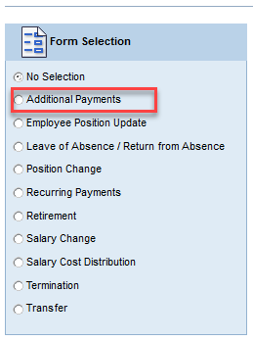
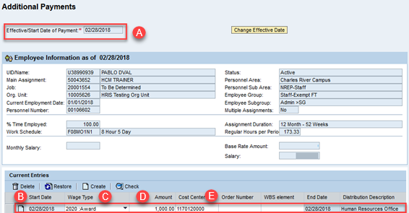
Business Scenario 6: (Additional Payment for Exempt Staff)
An Exempt employee needs to be paid a one time $1,000 award for passing a certification exam
Solution:
Select Personnel Actions, Enter BUID, select employee & select Additional Payments. Enter A. Effective Date, B. Start Date C. Wage Type, D. Amount E. Cost Center/Grant Number. End Date defaults to Payment Effective Date.
Click here for a short video demo of Additional Payment

Slide 48
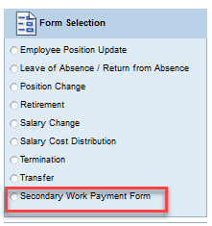
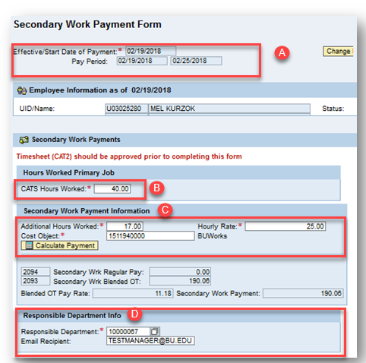
Business Scenario 7: (Secondary Work Payment for Non-Exempt Staff)
A weekly paid employee performs 17 hours of additional work in a week for a department other than their home department. The hourly rate for the extra work is different than the home department’s hourly rate
Solution: Enter BUID and select employee. From Personnel Actions, select Secondary Work Payment. A. Enter effective pay period, B. CATS hours worked in the regular assignment, C. Additional hours worked (max is 20), hourly rate, cost center responsible for secondary assignment &
D. Org. Unit, Email of responsible department

Slide 49
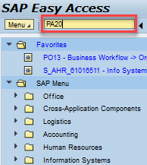
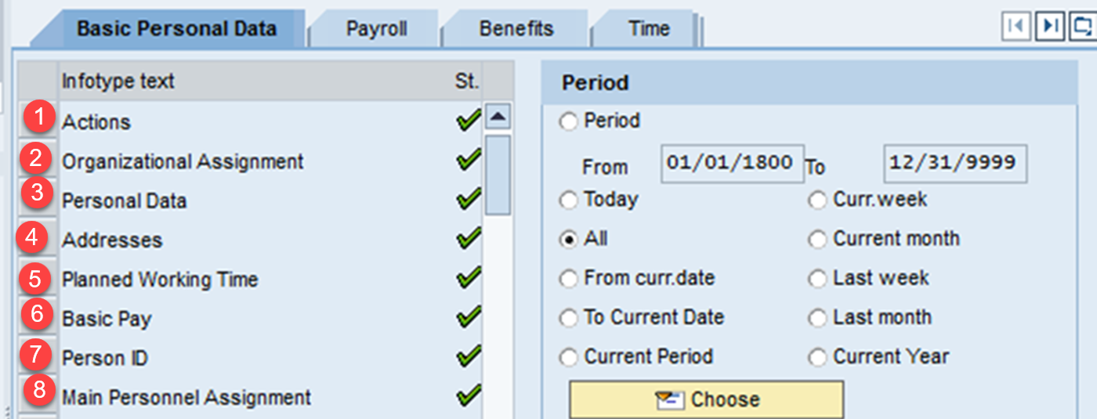
Viewing Employee Information in SAP
To view an individual employee’s master record in SAP, you can use the PA20 transaction via WebGUI → ECC System -> PA20 (Display HR Master Data). A green check next to an Information type indicates that data resides in the Infotype

Slide 50
SAP Infotypes
An employee’s data resides on a variety of tables in BUworks (SAP). Each of these Information types known as “Infotype” holds a specific type of related data
Infotype | Infotypes and Description
0000 | Actions (Important Stages in employee’s career)
0001 | Enterprise and Personnel Structure, Org. Unit, Cost Centre etc.
0002 | Personal Data such as employee’s home address
0007 | Planned working time
0008 | Basic Pay
0014 & 0015 | Recurring & Additional Payments
9027 | Cost Distributions
IT0041 | Date Specifications (Employment and Adjusted Service Dates)
IT0048 | Residence Status
IT9001 | Tenure/Contract Data

Slide 51
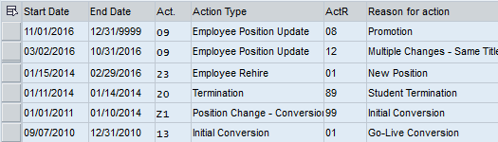
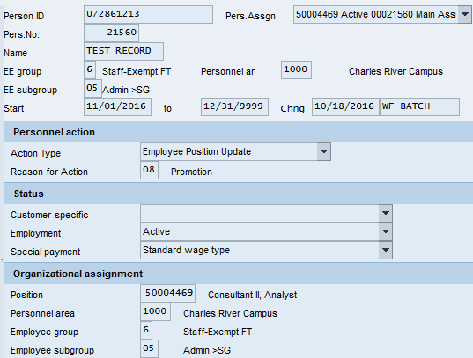
“Actions” Info type (IT0000)
IT0000 (Actions) displays the important events recorded on the employee’s record over the course of his/her employment. Starting as a student in SAP, the student was re-hired as an employee into a new position on 01/15/2014, went through multiple changes on 03/02/2016 and promoted on 11/01/2016
“Overview” “Display” View
Notes:
Are these overviews and displays for the same person? I’d make sure they match and maybe use the ECM org so we don’t have to blank out so much.

Slide 52

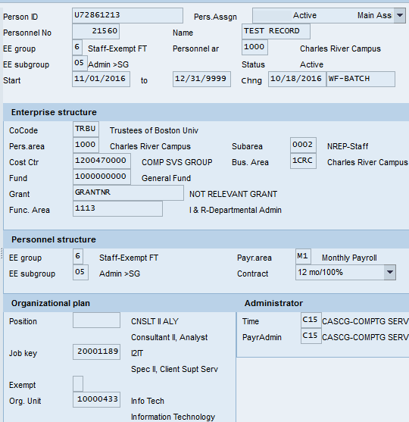
“Organization” Info type (IT0001)
IT0001 (Organization) displays the Enterprise and Personnel structure for the employee
“Overview” “Display” View

Slide 53
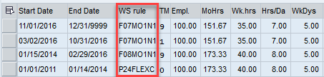
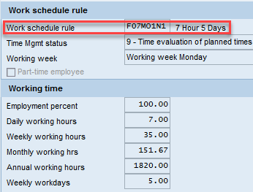
“Planned Working Time” Info type (IT0007)
IT0007 (Planned Working Time) contains information about the employee’s work schedule
In the example below, the employee’s work week was a flexible 40 hour work week between 01/01/2011 and 01/14/2014
Between 01/15/2014 and 02/29/2016 the 40 hour work week was Monday thru Friday
Between 3/02/2016 until now, the employee’s 35 hour work week is Monday thru Friday
“Overview” “Display” View

Slide 54


“Pay Related Info types” (IT0008 & IT0014 & IT0015)
IT0008 (Basic Pay) contains the monthly salary for exempt employees and hourly rate for non-exempt employees. The “overview” shows all changes in salary history with start and end dates
IT0014 (Recurring Payment) contains the wage type, start and end dates and amounts of recurring payments made to the employee
IT0015 (Additional Payment) contains the wage type, date and additional payment amount made to the employee

Slide 55

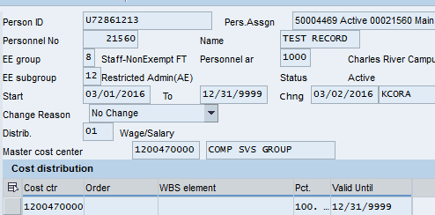
“Cost Distribution” Info Type (IT9027)
IT9027 (Cost Distribution) displays the start & end dates, wage type, cost center/grant for the distribution
“Overview” “Display View”

Slide 56
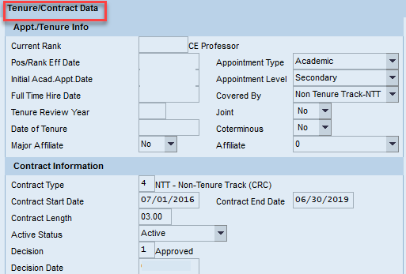
“Tenure Data” Info type (IT9001)
As a Faculty Payroll Coordinator, you are expected to maintain tenure related data, infotype IT9001 for faculty in your department. If you do not have access to this data, please contact your Faculty Actions Manager

Slide 57
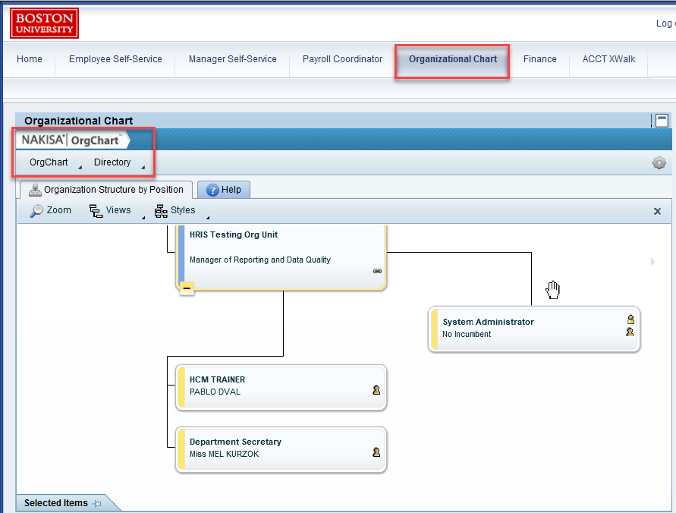
Organization Chart Display – Nakisa Tool
The Nakisa tool gives you a graphical display of your department’s position hierarchy and allows you to search for any Org. Unit, Position or Employee within the university. It is available via the Organizational Chart tab

Slide 58
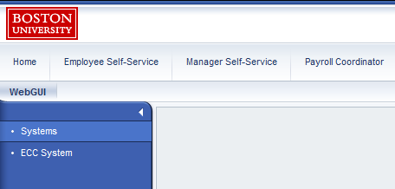
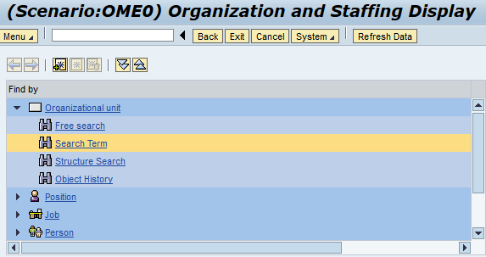
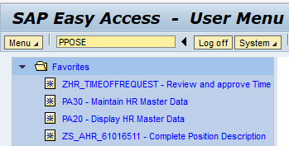
“PPOSE” Transaction - Organization and Staffing Display
The PPOSE transaction accessed via WebGUI→ ECC System is a SAP tool that displays staffing for an Org. Unit. It allows you to search by Organizational Unit, Position or Person and shows you overview and detailed information about each of them.

Slide 59
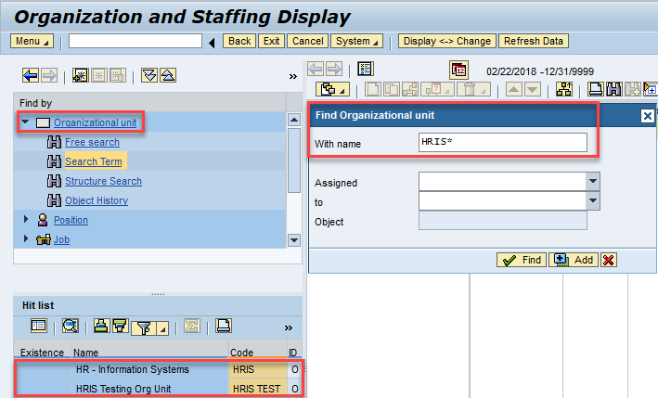
Finding Information About your Org. Unit
You may type either the Org. Unit Id or the Org. Name. Wild Card “*” at the end of the entered search term ensures all departments (Org. units) that begin with the entered Org. name are displayed in the Hit list in the bottom portion of the left column. NOTE: PPOSE only allows you access only to information that you are authorized to view

Slide 60
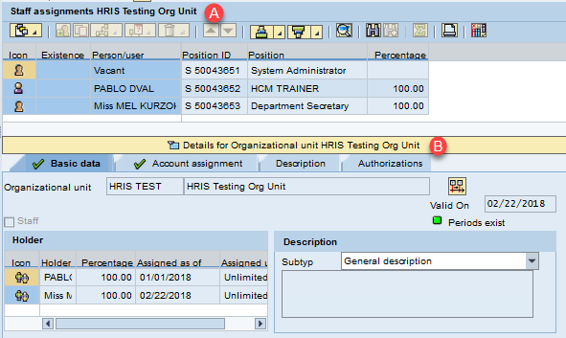
Overview and Detail of an Org. Unit
In the upper right quadrant (A), an overview of the Org. Unit is displayed. You can customize the display by clicking on the highlighted icon. In the bottom right quadrant showing details (B) , click through various tabs Basic Data, Account Assignment & Authorizations to get more information about the Org. Unit

Slide 61


Finding Vacant Positions in your Org. Unit
To view the status of a position (Vacant vs. Occupied), as provided by the Position Status report, click on the highlighted icon on the menu and click on the option “Staff Assignments (list)”
Staff Assignments by List
Vacant Positions in Org. Unit

Slide 62

Finding Information About a Position
You may type either the Position Id or the name. Wild Card “*” at the start of the search term ensures positions that contain the name are displayed
PPOSE only allows you access only to information within the specific department that you are authorized to view

Slide 63

Overview and Detail About a Position
Overview in the upper right quadrant (A) provides information about the title, position id, org. id and start and end dates, % time
Detail information (B) gives the position’s occupancy status, name of the holder if position is occupied, % time, start date for assignment, account assignment related info such as personnel area/subarea, employee group/subgroup and cost distribution

Slide 64

Finding Information About an Employee
You may get information about an employee by doing a search by “Person”. Provide the employee’s name and use the wild card in the search term
PPOSE only allows you access only to information within the specific department that you are authorized to view

Slide 65

Overview and Detail About an Employee
Overview (A) provides information about the person, position they hold in the department and the organizational assignment
Detail (B) information about the employee contains personnel number, employee group and subgroup, personnel area, position id, percent time and start date

Slide 66
Important Tips & Reminders
Click here for OM & PA form submission and approval deadlines
Attach relevant backup documents with form submissions. Click here for list of attachments expected with OM/PA actions
OM actions MUST complete approvals in workflow before a related PA action is submitted
When Creating a new position, choose option “Mark open for hire!”
Effective Date for Create/Maintain position must precede Hire Date
A temporary position cannot be converted into a regular position thru “Maintain Position” action. Create a brand new, regular position

Slide 67
Common Form Errors
“I created position 5000xxxx via tracking # 60099999. The position completed approvals successfully. When I try to hire the candidate, I get the error message that the position is not open for hire action. On another occasion I got the error that I’m not authorized to hire for the position.”
The hire date marked on the position is a date in the future OR the position was not marked open for hire OR the position was created in wrong Org. Unit.
“Four of my volunteers stopped working last summer. I want to use the positions for four new volunteers this summer. The positions are showing as occupied in OM.”
The volunteers needed to be terminated when they stopped working last summer. They are occupying the four positions. Not terminating employees on time means that they continue to occupy positions.
“The vacation requests of an employee are going to the wrong person for approval. How can they be sent to his current manager?”
Check to make sure manager of Org is correct using “PPOSE”. If the manager is wrong, email hrsys@bu.edu and request that the manager be changed. If manager is correct, move the employee to the Org. Unit with correct manager via a “Maintain Position” form and follow with an “EPU” form.
“I maintained position which changed the % time from PT to FT & proposed new salary. The employee’s record is however showing PT and listing the old salary.”
Submit an “EPU” form with revised details to update emp. Record following the successful completion of “Maintain position” form.
“I am submitting an EPU and get error message that there is a future-dated action which the current action will overwrite.”
Use “PA20” to see Actions Infotype and see what future action is preventing submission of EPU. If there is an action blocking your update or if you cannot see the action, contact HRSYS to work on a resolution.
“I am trying to update a cost center in the Salary Cost Distribution form but get an error saying “Cost Center TRBU/xxxxxxxxxxx” blocked against direct postings on mm/dd/yyyy.
The cost distribution you are trying to use could be expired. It’s also possible that the end date you are using on the form is dated too late and you must use an earlier end date. If you are trying to charge to a grant based order # contact your PAFO admin for end date info or contact hrsys@bu.edu to review.

Slide 68
Training Resources and Contact Information
Training Resources Website: Quick Reference Guides, Process Guides, Newsletters, Videos
Glossary of HCM Terminology
Scenario based selection of OM and PA Forms
OM and PA forms Deadlines
Email your HR Business Partner for Policy related questions and your Comp. Analyst for Position and Compensation related questions.
Click here to find the Compensation Analyst/HR Business Partner for your Org. Unit
Email hrsys@bu.edu with questions about OM & PA actions. Remember to submit a screenshot of the error.
Email srao22@bu.edu for OM & PA form training needs
Email wstewart@bu.edu for training on BW Reports
Electronic copy of this presentation

Slide 69
Thank You!

